Slide 1
Who was Aristotle?

Slide 2
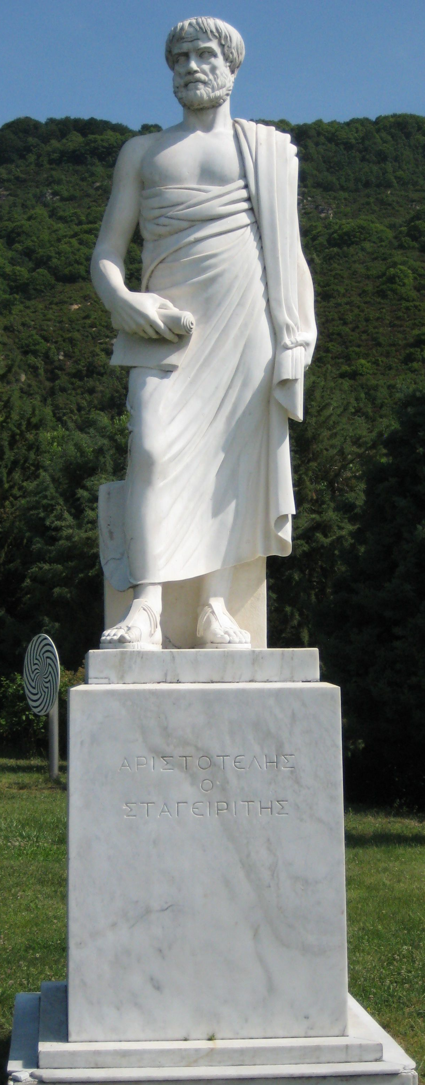
Look at this statue of Aristotle which you can visit in Greece. Write down:
a) What you can see.
b) What you can infer about Aristotle.
c) Questions you would like to ask about Aristotle.
image: commons.wikimedia.org

Slide 3
Use non fiction books or the Internet to find out more information about Aristotle.
Can you put the following events in his life in chronological order?
image: commons.wikimedia.org

Slide 4
Look at some of Aristotle’s ideas. Can you sort them into groups of ideas about similar things? Which idea do you think is the most/least significant? Why?
The aim of human life is to develop virtues which help you to do the right thing at the right time.
Humans are unique because they can reason and use logic (unlike animals).
Animals can be put into different groups based on their characteristics.
Animals’ bodies are adapted to their environment eg webbed feet help ducks to swim.
Bigger animals have less offspring.
There are five elements that make up everything: earth, fire, water, air and aether.
He explained why earthquakes, volcanoes and evaporation happen (but he has since been proven wrong).
We should find out about things but observing them carefully and not just thinking about them. We should test out ideas.
The Earth is round.

Slide 5
Thinking about what you have learned, what 3 words would you use to describe Aristotle?
Why have you chosen those words?
image: commons.wikimedia.org

