Slide 1
What is a good life?

Slide 2
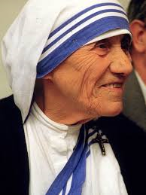
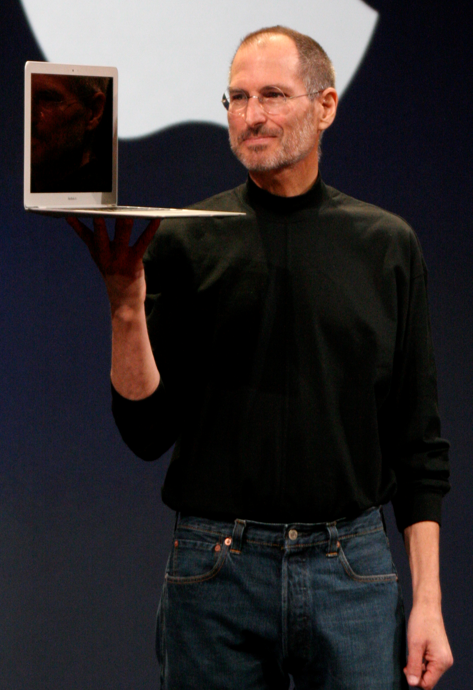
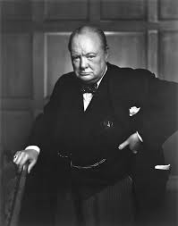
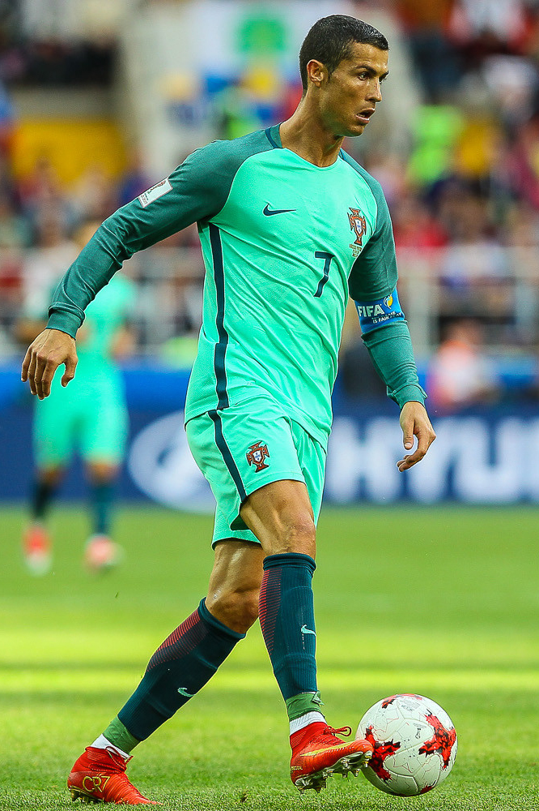
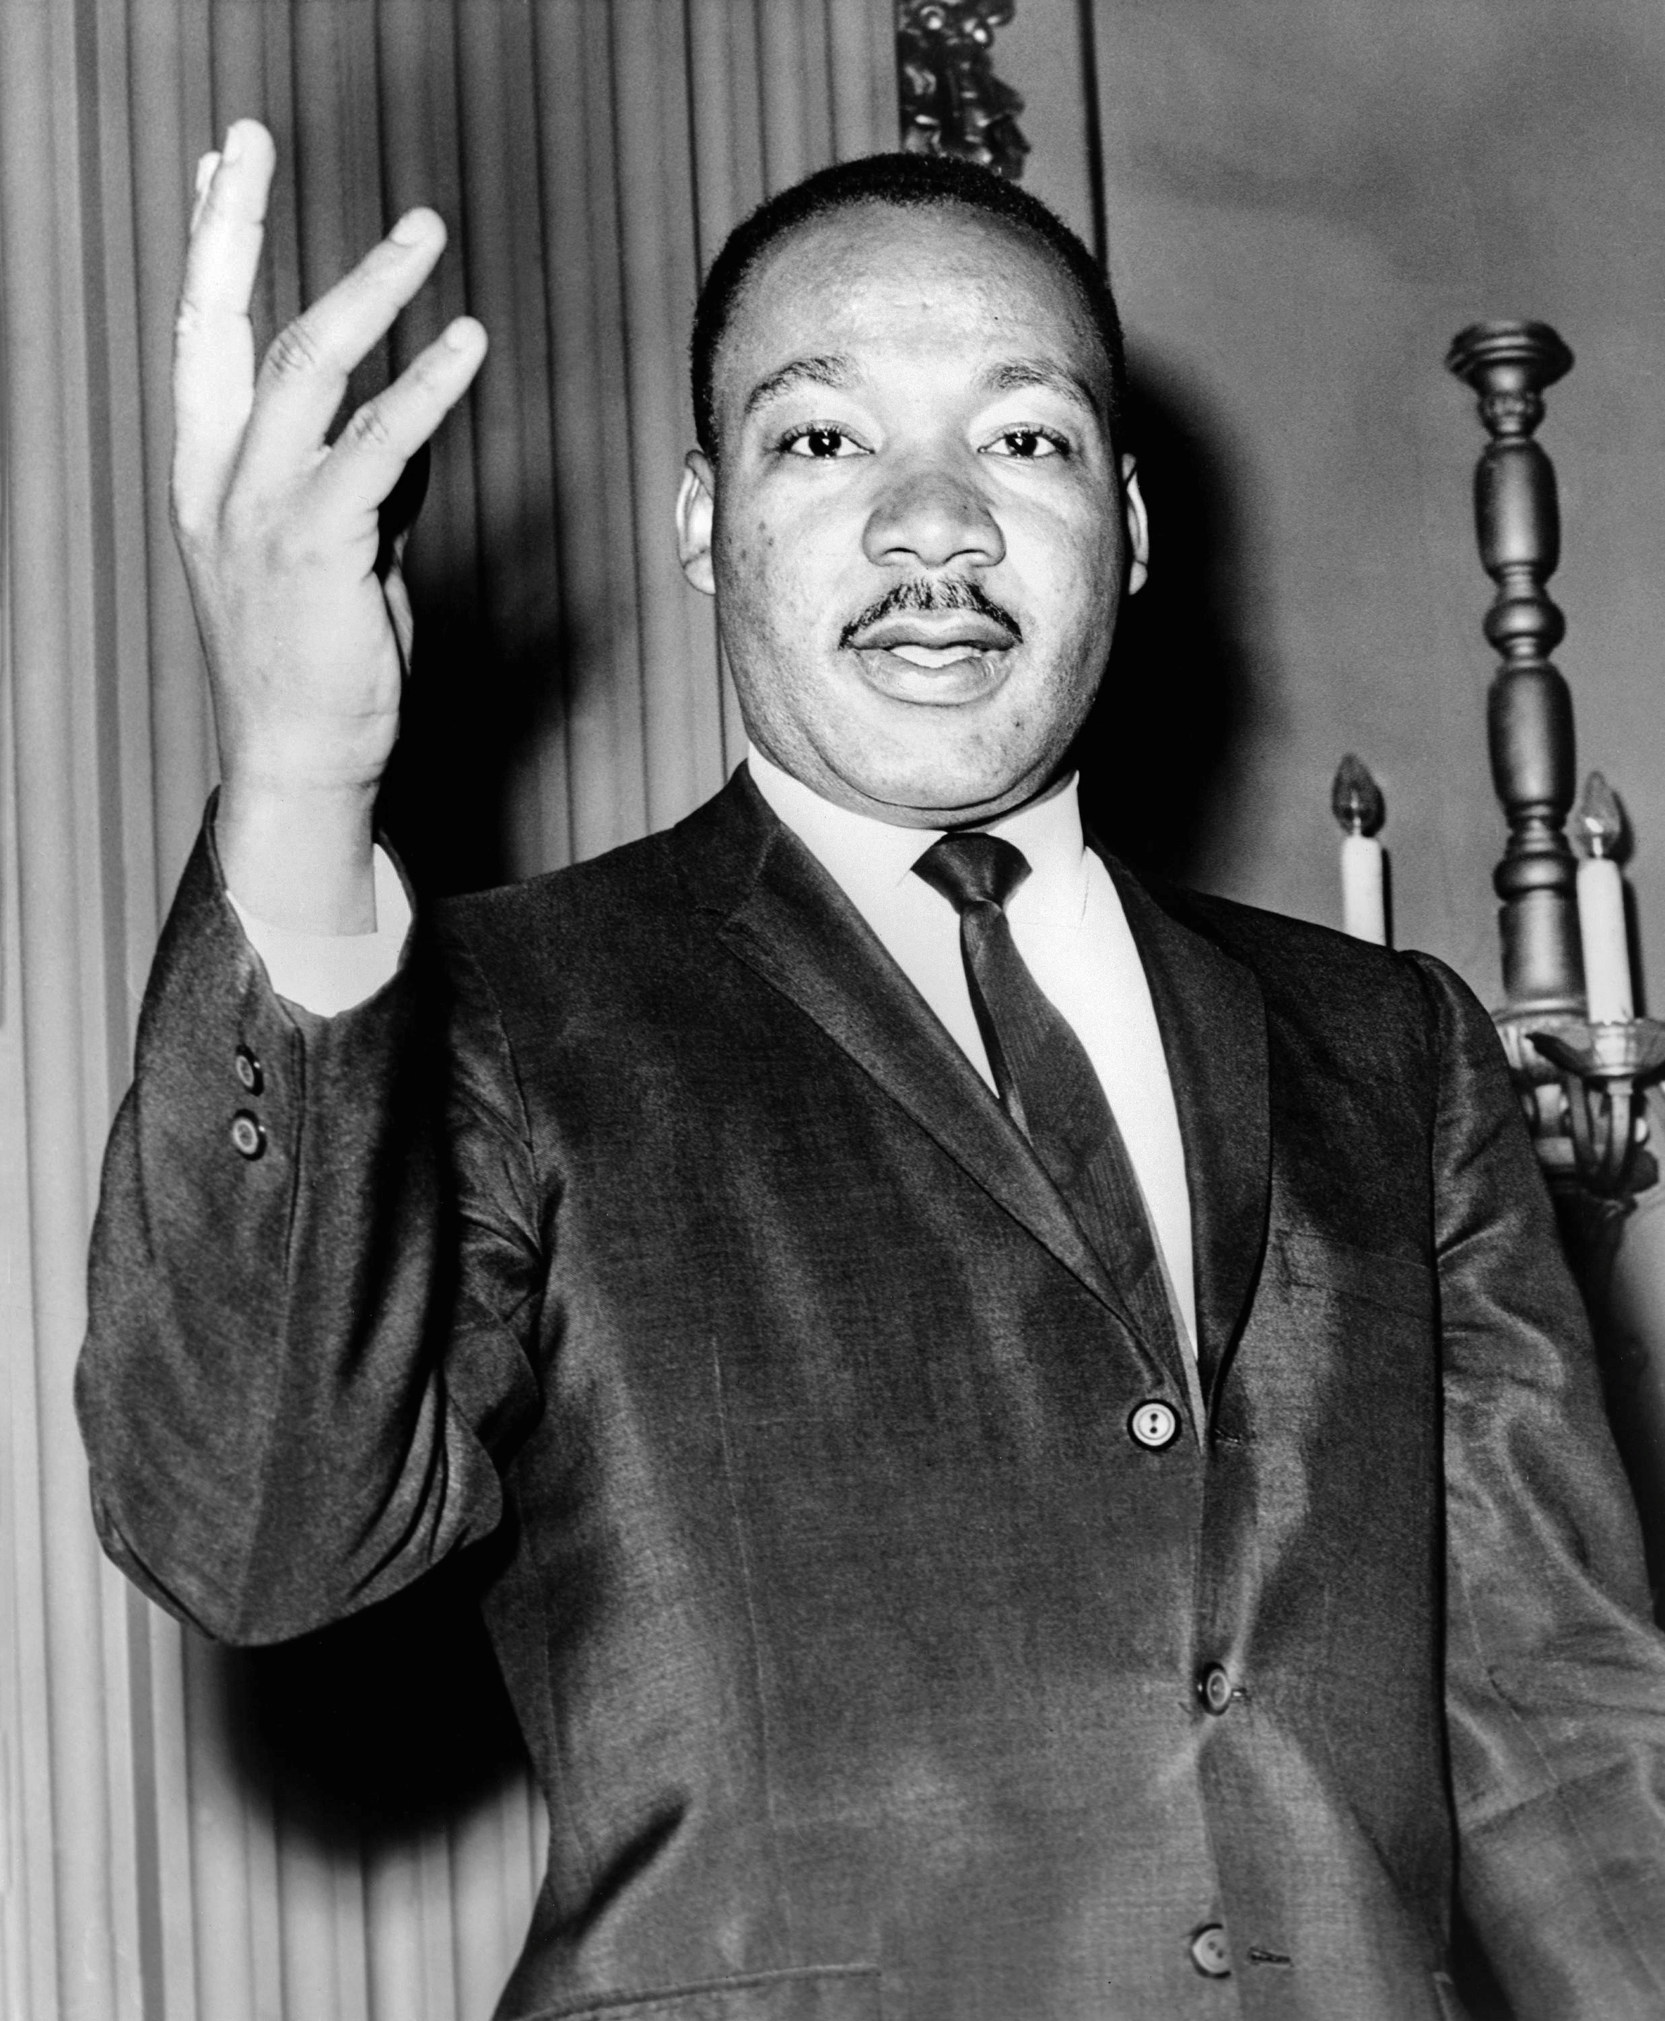
Can you think of someone that you think has led a good life? Why do you think their life was good? Did it happen by accident or were there specific decisions/actions that led to a good life?
Images: commons.wikipedia.org

Slide 3
How important are the following things to you for a good life? a) Making a lot of money b) Having a family c) Having friends d) Being influential/important e) Having lots of fun
Very important
Quite important
Not important

Slide 4
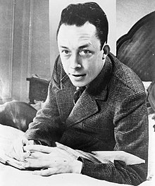
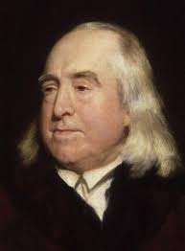
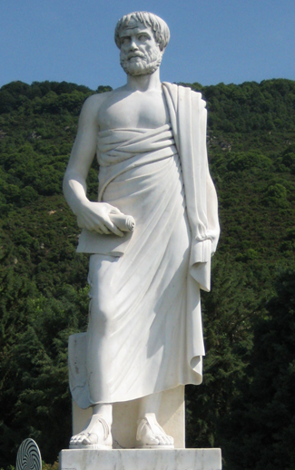
Philosophers have been discussing how to live a good life for thousands of years and have some very different ideas!
Albert Camus is an existentialist. He believes that you make your own life good by choosing to do things that you think are meaningful.
Jeremy Bentham is a utilitarian. He believes that a good life is one which has the maximum pleasure and the minimum pain.
Aristotle believes that a good life is one in which you practice and show good character traits (virtues) e.g. generosity, courage and kindness.
Images: commons. wikipedia.org

Slide 5
Complete the sentence for yourself: My life will be a good life if…..

