Slide 1


How do our feelings affect our actions?

Slide 2
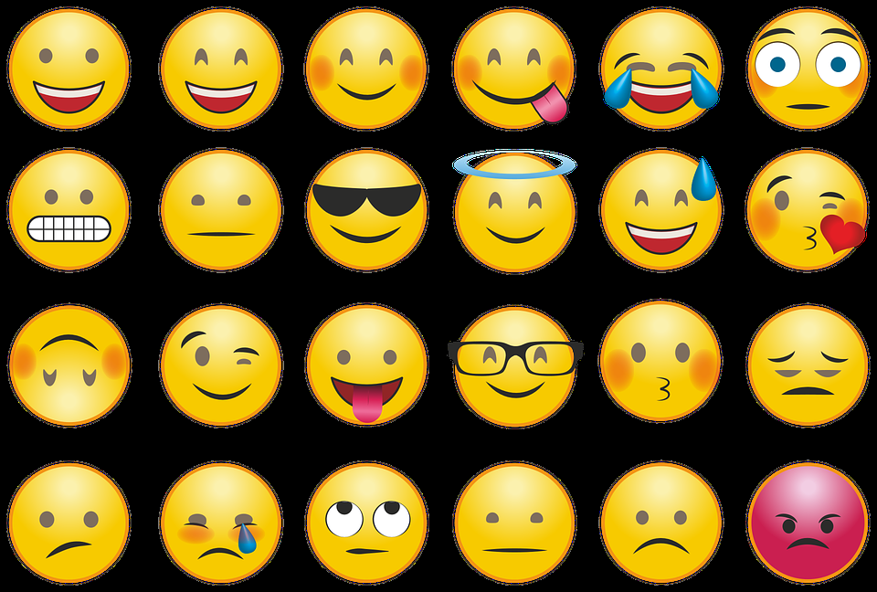
How many different emotions can you name? You can use the emojis as a starting point – but you might think of others!
Image: pixabay.com

Slide 3
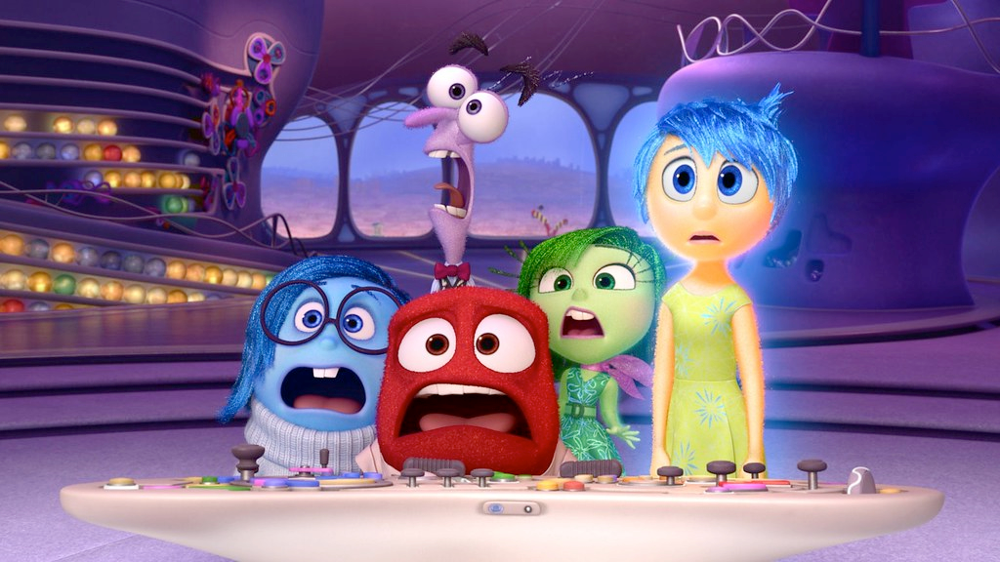
Watch a trailer for Inside Out. How do feelings affect the characters’ actions?
Image: flikr.com

Slide 4
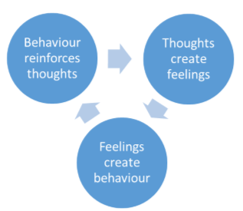
I can’t believe they left me out of the game. I don’t have any real friends.
I storm off and cry.
I feel angry and upset.

Slide 5
Think about the scenario. What might James be: Thinking Feeling Doing?
James has joined the cricket club at school. At the end of the session, an older pupils says that James played really well and he should be on the cricket team.

Slide 6
Think about the scenario. What might Amit be: Thinking Feeling Doing?
Amit has worked really carefully on his art work all afternoon. Just as he is finishing it off, another pupil deliberately spills water over it.

Slide 7
Think about the scenario. What might Sunil be: Thinking Feeling Doing?
Sunil has worked really hard on his homework. His teacher tells him that it is his best work yet and lets him Mum know at the end of the day.

Slide 8
Stand in a line. If you agree with the statement, step forward, if you disagree with the statement stay where you are.
- I can choose how I feel.
- It is important to show people how I feel.
- It is important to be able to control my emotions
- I am confident that I can control my emotions.

Slide 9
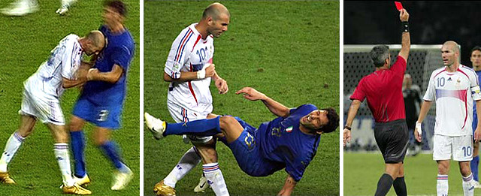
Sometimes, when we experience very strong emotions such as anger or disappointment, we can act quickly and do something that we regret.
Image: flikr.com

Slide 10
What strategies can we use to help us ‘pause’ before we act?

Slide 11
Think about these scenarios. What might an emotional response be? What might you do if you pause before acting?
You get the best score in the class in the spelling test.
The teacher tells you off for something you didn’t do.
There is a new pupil in the class and your best friend spends all breaktime with them instead of you.

