Slide 1
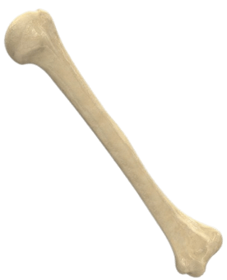
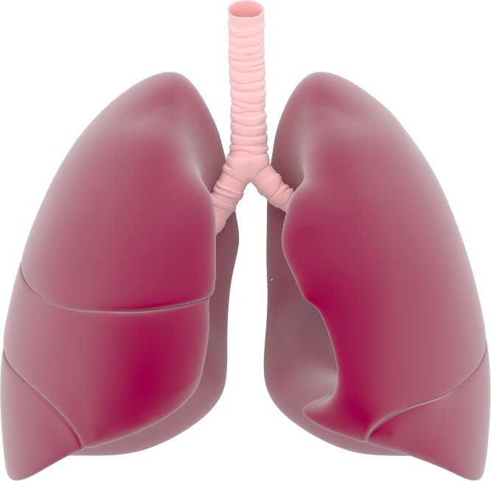
Image: medicalgraphics.de
Image: pngimage.com
Image: pngimage.com
Image: flikr.com
Image: publicdomainimages.com

