Slide 1






 | You are walking home from school and you need to cross a busy road. Who could help you?
 | You are shopping with your parents on a busy high street. You stop to look at something in a window but, when you turn around, you can’t see your parents. Who could help you?
 | You see smoke coming from a building on your road. Who could help you?
 | You have had a bad pain in your ear for a few days and it does not seem to be getting better. Who could help you?
Image: publicdomainvectors.org
Image: publicdomainvectors.org
Image: pngimg.com
Image: clipart.email.com

Slide 2


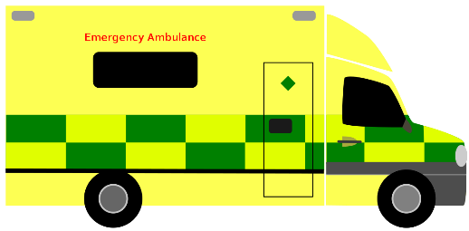

 | You have fallen out with your friend at school and it is making you feel very worried. Who could help you?
 | You are not sure if you have enough money to buy something in the shop. Who could help you?
 | Your pet seems to have a sore leg and is limping. Who could help you?
 | Someone is very badly hurt or injured. Who could help you?
Image: flikr.com
Image: pngimg.com
Image: commons.Wikimedia.org
Image: publicdomainvectors.org

