Slide 1
What is a community?

Slide 2
The Oxford dictionary says that a community is ‘a group of people living in the same place or having a particular characteristic in common.’

Slide 3
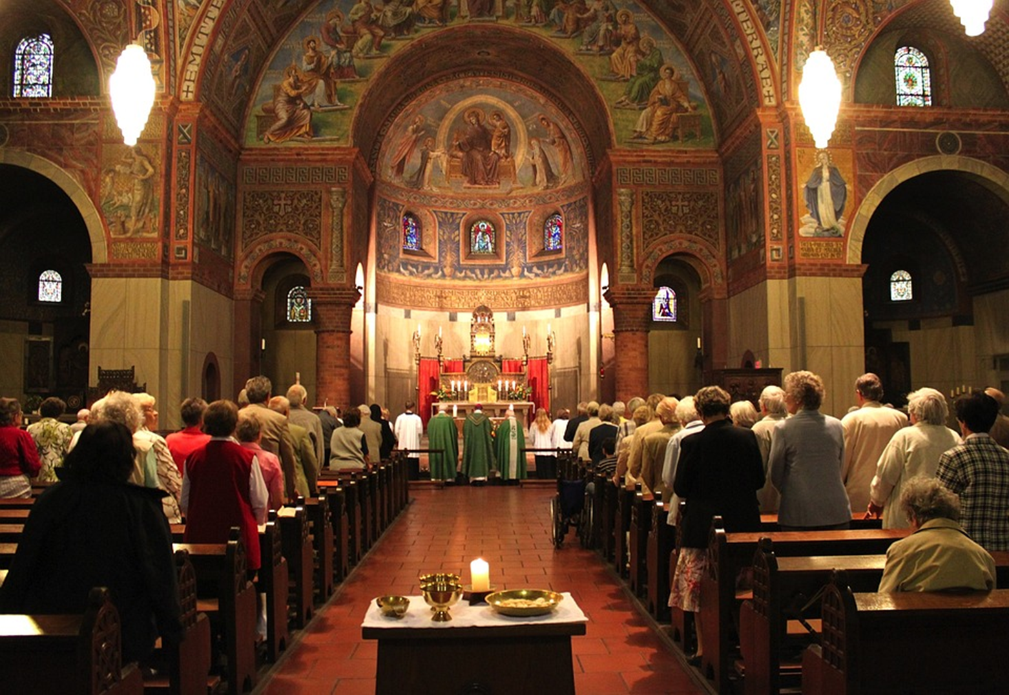
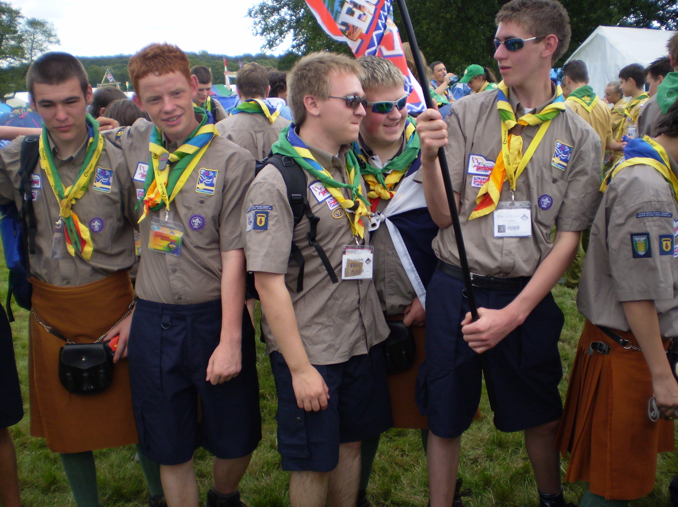
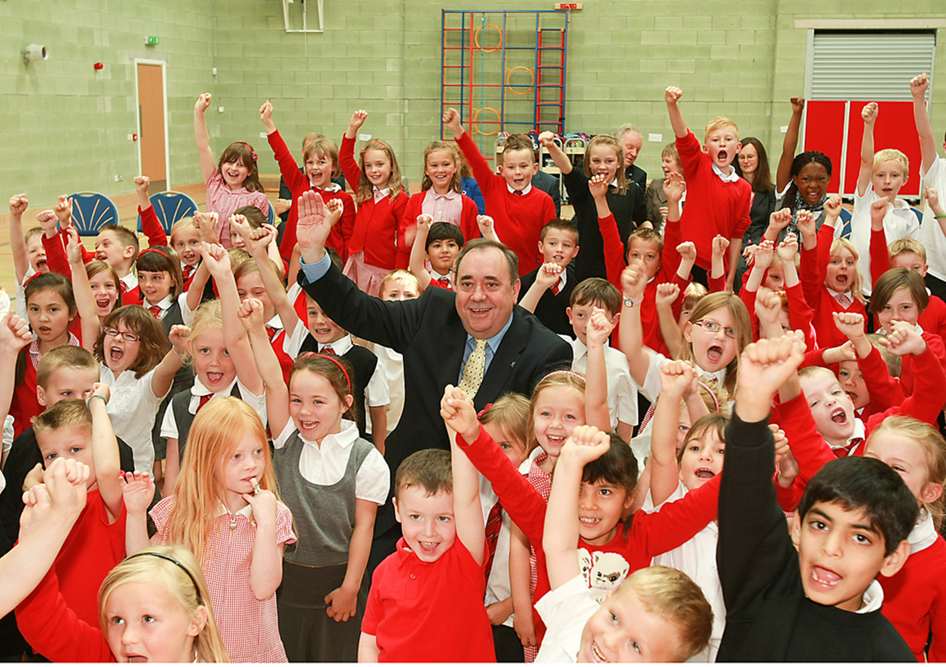
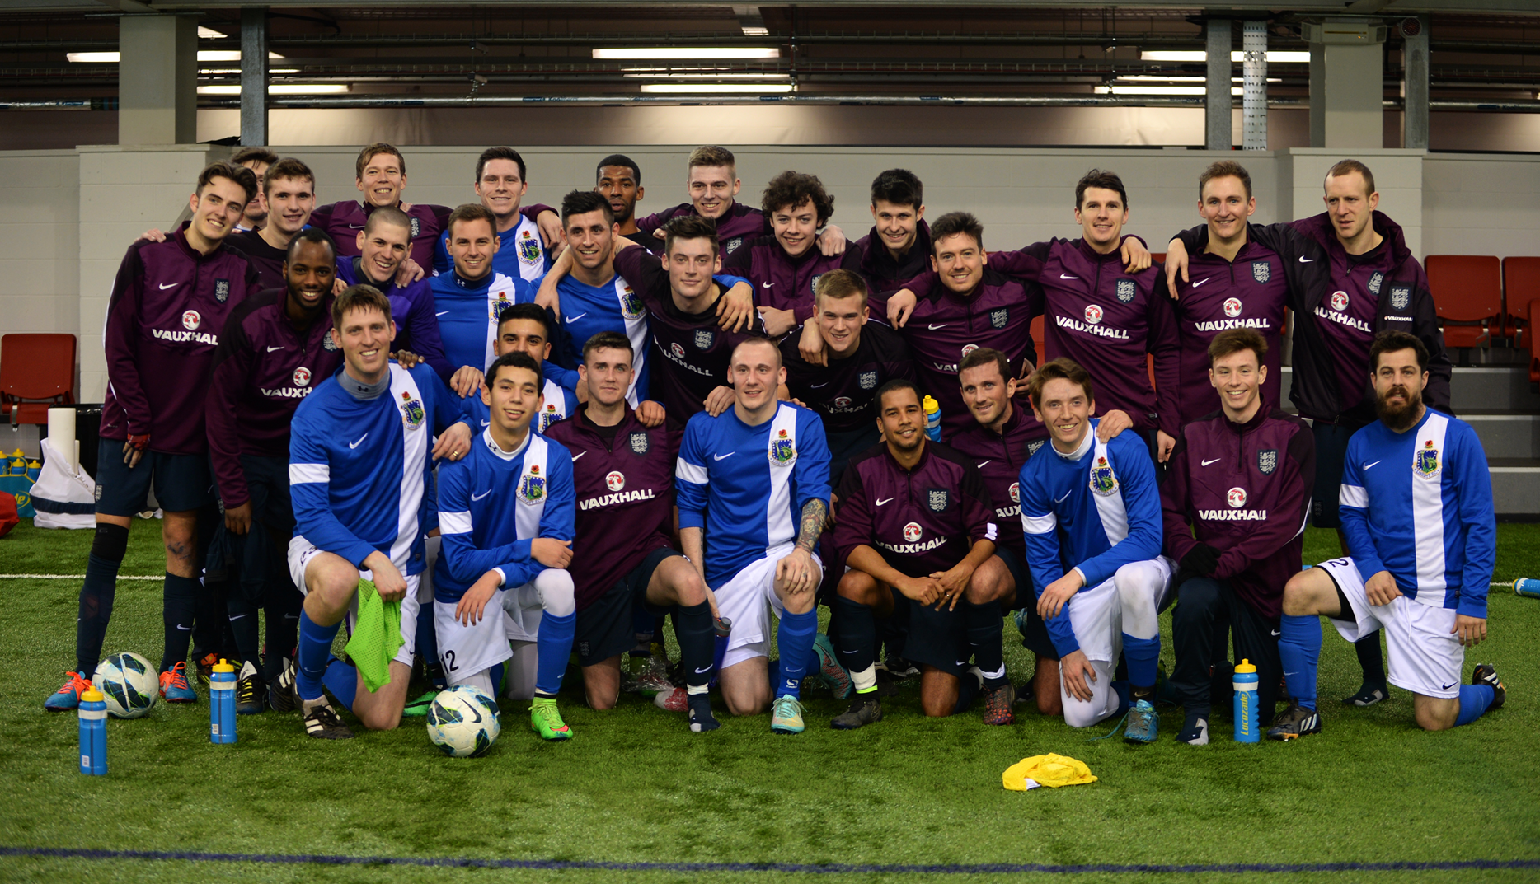
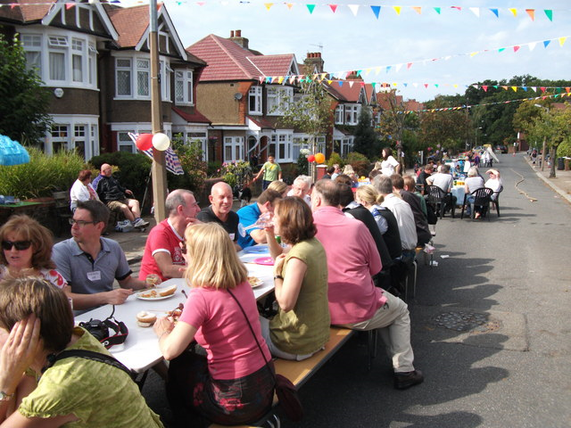
Look at the communities below. What do the people in the community have in common?
Images: commons.wikimedia.org

Slide 4
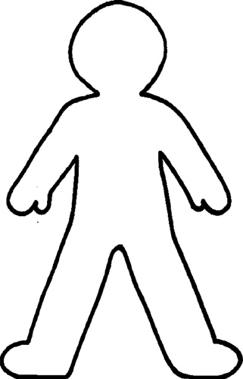
What communities are you part of? Draw yourself in the middle and list the communities that you are a part of around the outside.
Image: clipartlibrary.com

Slide 5
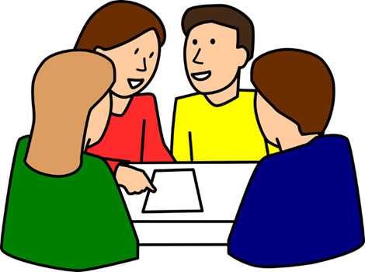
Thinking of the communities you are a part of:
What activities do these communities do together?
How do people know you are a part of the community?
What values or virtues are important to the community?
Image: pixabay.com

Slide 6
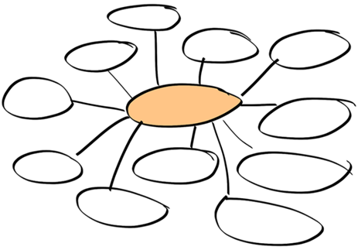
What virtues are needed to be a good member of a community? Why? Create a brainstorm with your class.
Image: pixabay.com

Slide 7
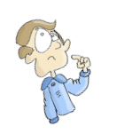
Choose one of the communities that you are a part of. This week, how can you show some of the virtues that we need for good communities?

