Slide 1
What makes a good friend?

Slide 2
A good friend should be…
The same age as you?
Funny?
Kind?
Strong?
Good at football?
Good at listening to you?
Able to help you with your homework?
Are there any missing characteristics?
Are any of these characteristics more or less important than others?

Slide 3
A good friend should be…
Write around the person, the virtues that are needed to be a good friend.
If you have finished, write down some examples of how good friends could show these virtues.
Image: clipartlibrary.com

Slide 4
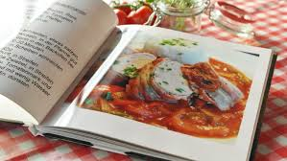
A recipe for friendship:
Choose 5 virtues to be your ingredients for friendship. How much of each do you need?
What are the instructions for your recipe?
Image: pxhere.com

Slide 5
Which virtue do you think is the most important to be a good friend? Why have you chosen that one?

