Slide 1
How do good friends act?

Slide 2
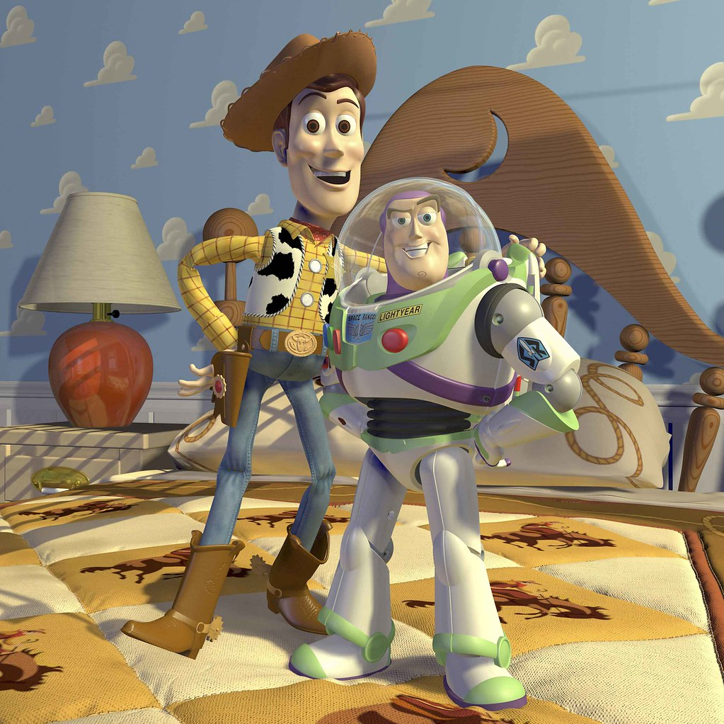
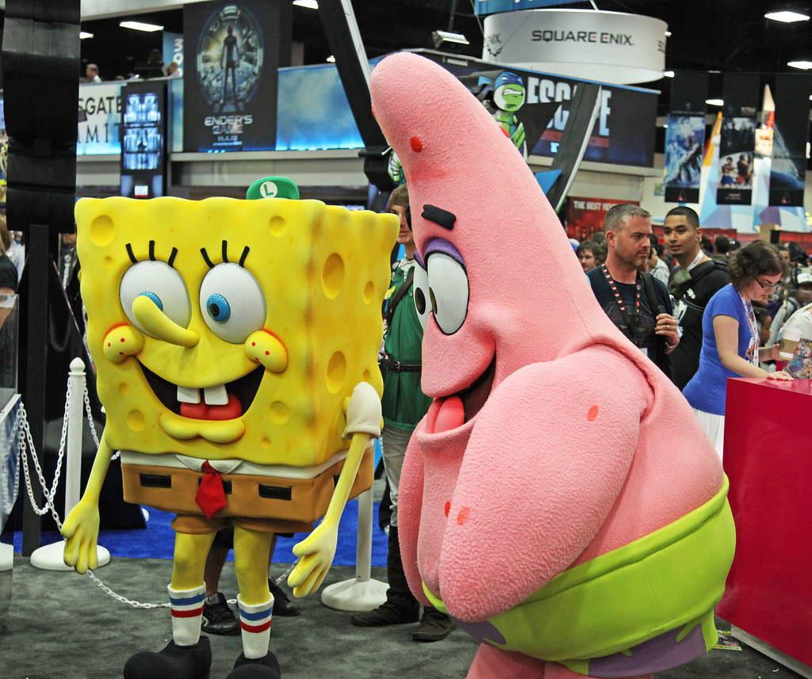
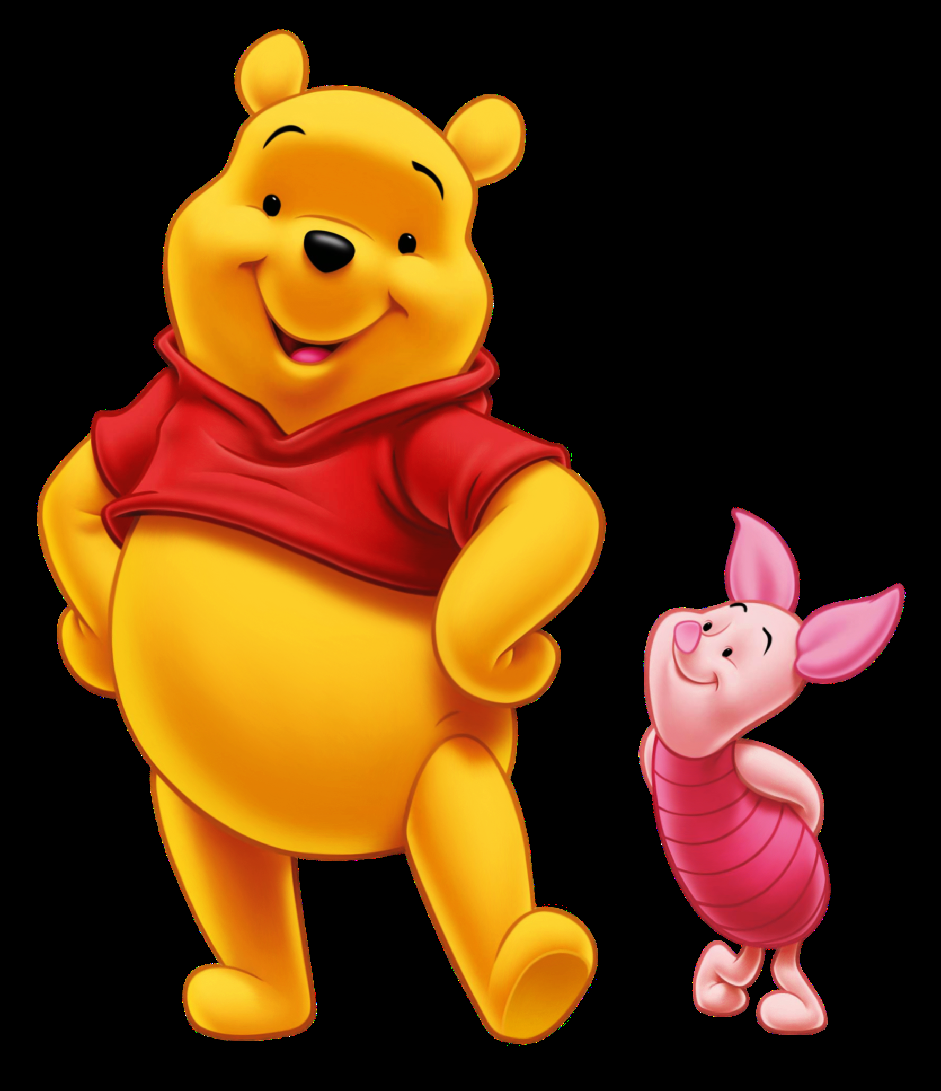
Can you think of any examples of famous friends? How do you know they are friends?
Image: flickr.com
Image: pngimg.com

Slide 3
Fox, Tortoise and Leopard It was rather unusual for Fox and Tortoise to be such good friends because they were so different. Fox was clever and quick, but Tortoise was slow and thoughtful. However, they loved being together, they laughed a lot and their differences didn’t matter. One evening, when they were sitting and chatting by the riverbank, a ravenous leopard leapt out of the bushes. Fox quickly darted away and Tortoise pulled into his shell. Leopard started furiously scratching at Tortoise’s shell to try and eat him. Tortoise shivered and shook. Fox suddenly shouted, “Stop leopard! That’s not how to eat a tortoise! I’m an expert and will show you how to do it.” Tortoise was very upset that his friend might be about to help leopard eat him. “Before you can eat tortoise, you need to soften his shell by throwing him into the river,” said Fox. The leopard did exactly what Fox suggested and, as soon as Tortoise hit the bottom, he stretched out his legs and sneaked away along the riverbed. “How long should I wait?” asked the leopard. “Until dark, “ Fox replied. “The longer you wait, the softer the shell will be!” So the leopard waited, pacing up and down, getting angrier and hungrier. At midnight, as he fished in the riverbank for Tortoise, he realised that he had been tricked! Fox and Tortoise, however, had another story to laugh about together.
Fox, Tortoise and Leopard
It was rather unusual for Fox and Tortoise to be such good friends because they were so different. Fox was clever and quick, but Tortoise was slow and thoughtful. However, they loved being together, they laughed a lot and their differences didn’t matter.
One evening, when they were sitting and chatting by the riverbank, a ravenous leopard leapt out of the bushes. Fox quickly darted away and Tortoise pulled into his shell. Leopard started furiously scratching at Tortoise’s shell to try and eat him. Tortoise shivered and shook.
Fox suddenly shouted, “Stop Leopard! That’s not how to eat a tortoise! I’m an expert and will show you how to do it.” Tortoise was very upset that his friend might be about to help the leopard to eat him.

Slide 4
Fox, Tortoise and Leopard It was rather unusual for Fox and Tortoise to be such good friends because they were so different. Fox was clever and quick, but Tortoise was slow and thoughtful. However, they loved being together, they laughed a lot and their differences didn’t matter. One evening, when they were sitting and chatting by the riverbank, a ravenous leopard leapt out of the bushes. Fox quickly darted away and Tortoise pulled into his shell. Leopard started furiously scratching at Tortoise’s shell to try and eat him. Tortoise shivered and shook. Fox suddenly shouted, “Stop leopard! That’s not how to eat a tortoise! I’m an expert and will show you how to do it.” Tortoise was very upset that his friend might be about to help leopard eat him. “Before you can eat tortoise, you need to soften his shell by throwing him into the river,” said Fox. The leopard did exactly what Fox suggested and, as soon as Tortoise hit the bottom, he stretched out his legs and sneaked away along the riverbed. “How long should I wait?” asked the leopard. “Until dark, “ Fox replied. “The longer you wait, the softer the shell will be!” So the leopard waited, pacing up and down, getting angrier and hungrier. At midnight, as he fished in the riverbank for Tortoise, he realised that he had been tricked! Fox and Tortoise, however, had another story to laugh about together.
“Before you can eat Tortoise, you need to soften his shell by throwing him into the river,” said Fox. The leopard did exactly what Fox suggested and, as soon as Tortoise hit the bottom, he stretched out his legs and sneaked away along the riverbed.
“How long should I wait?” asked the leopard.
“Until dark,” Fox replied. “The longer you wait, the softer the shell will be!”
So the leopard waited, pacing up and down, getting angrier and hungrier. At midnight, as he fished in the riverbank for Tortoise, he realised that he had been tricked! Fox and Tortoise, however, had another story to laugh about together.

Slide 5
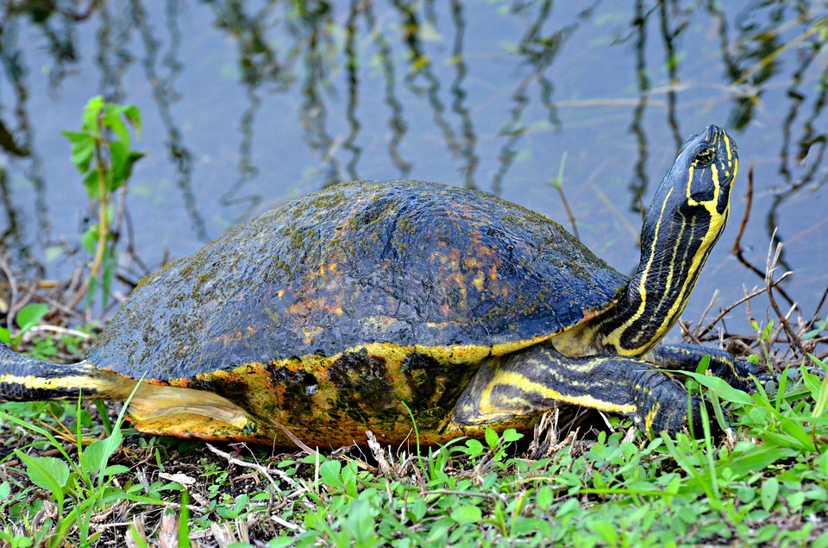
Fox, Tortoise and Leopard
Why are Fox and Tortoise good friends?
Which virtues does Fox show?
Which virtues does Tortoise show?
What can we learn about friendship from this story?
Image: pixabay.com

Slide 6
Fox, Tortoise and Leopard It was rather unusual for Fox and Tortoise to be such good friends because they were so different. Fox was clever and quick, but Tortoise was slow and thoughtful. However, they loved being together, they laughed a lot and their differences didn’t matter. One evening, when they were sitting and chatting by the riverbank, a ravenous leopard leapt out of the bushes. Fox quickly darted away and Tortoise pulled into his shell. Leopard started furiously scratching at Tortoise’s shell to try and eat him. Tortoise shivered and shook. Fox suddenly shouted, “Stop leopard! That’s not how to eat a tortoise! I’m an expert and will show you how to do it.” Tortoise was very upset that his friend might be about to help leopard eat him. “Before you can eat tortoise, you need to soften his shell by throwing him into the river,” said Fox. The leopard did exactly what Fox suggested and, as soon as Tortoise hit the bottom, he stretched out his legs and sneaked away along the riverbed. “How long should I wait?” asked the leopard. “Until dark, “ Fox replied. “The longer you wait, the softer the shell will be!” So the leopard waited, pacing up and down, getting angrier and hungrier. At midnight, as he fished in the riverbank for Tortoise, he realised that he had been tricked! Fox and Tortoise, however, had another story to laugh about together.
What is the problem?
How would you feel?
What virtues are involved in this scenario?
What do you think a wise thing to do is? Why?
You have two best friends in school, but they aren’t really friends with each other. At break time one of your friends starts saying unkind things about your other friend. She says that, if you tell your other friend, she will say it was you who said unkind things. She said that good friends keep secrets.

Slide 7
Fox, Tortoise and Leopard It was rather unusual for Fox and Tortoise to be such good friends because they were so different. Fox was clever and quick, but Tortoise was slow and thoughtful. However, they loved being together, they laughed a lot and their differences didn’t matter. One evening, when they were sitting and chatting by the riverbank, a ravenous leopard leapt out of the bushes. Fox quickly darted away and Tortoise pulled into his shell. Leopard started furiously scratching at Tortoise’s shell to try and eat him. Tortoise shivered and shook. Fox suddenly shouted, “Stop leopard! That’s not how to eat a tortoise! I’m an expert and will show you how to do it.” Tortoise was very upset that his friend might be about to help leopard eat him. “Before you can eat tortoise, you need to soften his shell by throwing him into the river,” said Fox. The leopard did exactly what Fox suggested and, as soon as Tortoise hit the bottom, he stretched out his legs and sneaked away along the riverbed. “How long should I wait?” asked the leopard. “Until dark, “ Fox replied. “The longer you wait, the softer the shell will be!” So the leopard waited, pacing up and down, getting angrier and hungrier. At midnight, as he fished in the riverbank for Tortoise, he realised that he had been tricked! Fox and Tortoise, however, had another story to laugh about together.
What virtues make you a good friend?
Choose one virtue that you would like to work on to make your friendships stronger. What could you do today to practice that virtue?

