Slide 1
Do friends fall out?

Slide 2
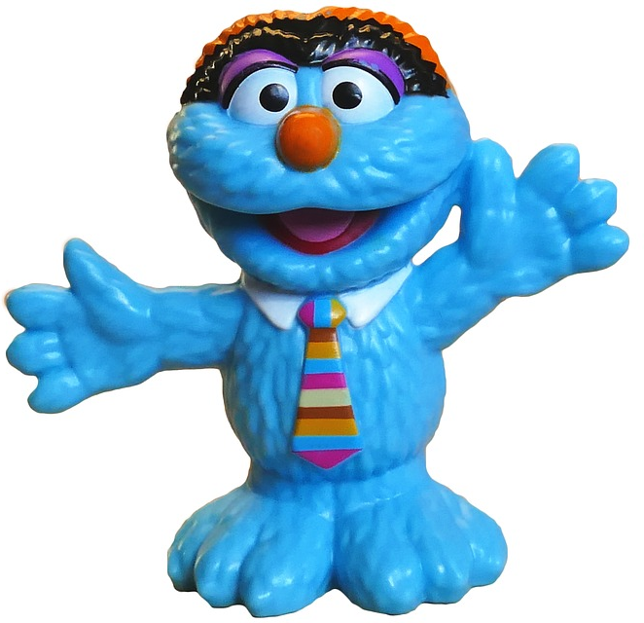
Watch the video: https://www.youtube.com/watch?v=Gl3e-OUnavQ [accessed 26.05.2020].
What causes conflict in friendships? Brainstorm as many ideas as you can.
Image: pixabay.com

Slide 3
Discuss the following questions in pairs: Why is it important to solve conflict in friendships? What will happen if we don’t or if we solve them badly? What stops us from resolving conflict well? What methods do you know already for solving conflict?
Image: pixabay.com

Slide 4
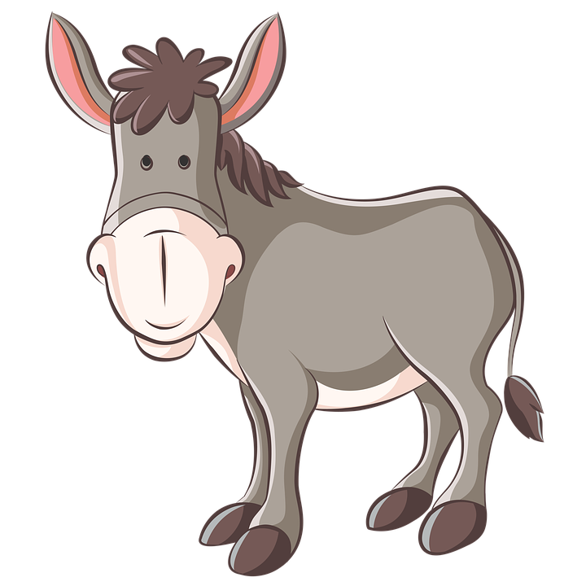
Two Donkeys Once upon a time there were two donkeys. They were tied together in the farmyard, and they were very hungry. Then, the farmer left two boxes of food in the yard for them: one for the first donkey on the left and one for the other donkey on the right. Each donkey saw that the food had been left, but they were still tied together.
Image: pixabay.com

Slide 5
They each tried to reach their food, but they couldn’t. They were just as strong as each other, so however hard they pulled on their rope, they would never get the food. Feeling tired and out of breath, they sat down next to each other, even hungrier than before.
Image: pixabay.com

Slide 6
How could the donkeys solve the problem? What will happen if they don’t?
Image: pixabay.com

Slide 7
Choose one of the scenarios to act out in a group. Act it out with a positive outcome and with a negative outcome.
A new person joins your class and your friend only wants to play with them and ignores you.
A friend won’t let you join in their game at playtime.
A friend starts teasing you about how you look.

Slide 8
Are there opportunities at school to support others to be friends? This might be a friendship bench, peer mediators etc. If there are not, could you start one?
Image: commons.wikimedia.org

