Slide 1


Do adverts control what we eat?

Slide 2
Which companies do these logos represent?

Slide 3
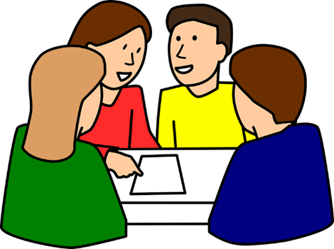

Did you find this easy or hard?
Why do you think this is?
Why do you think advertisements target children?

Slide 4
Watch: https://www.bbc.com/bitesize/clips/zsqkxnb [accessed 25.05.2020].
What techniques do advertisements use to sell us their products? Create a list.

Slide 5
What virtues are the following advertisements showing? https://www.youtube.com/watch?v=2uP9uQ-l-TI (McDonalds) https://www.youtube.com/watch?v=OPi9nTE70aA (Coca Cola) https://www.youtube.com/watch?v=l0eEqeizNCA (Cadbury’s)

Slide 6
What is the problem?
How would you feel?
What virtues are involved in this scenario?
What do you think a wise thing to do is? Why?
You are a manager in a large fast food chain. You know that your meals are not a healthy choice for children but are ok as a treat. If you use cartoons in your advertisements, more children come into the restaurant and you make more money. This allows you to pay your workers more. Should you use cartoons in your advertisements?

Slide 7
Some people believe that advertisements for fast food should be banned before 9pm.
Why do you think they want to do this?
Do you agree?

