Slide 1
What career could I have?

Slide 2
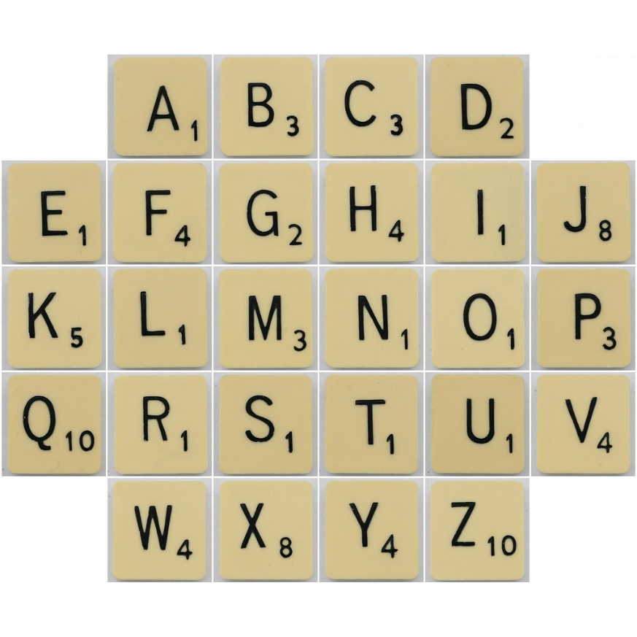
In pairs, write the alphabet on a piece of paper with space beside each letter to write. You have 5 minutes to write down a career/job for each letter that you can think of.
How do we find out information about what jobs are available?
Image: flikr.com

Slide 3
How do we choose what job we want to do? Write down 3 things that you think are important in a job (e.g. helping people, money, working with people, being creative, using particular skills).
Image: pixabay.com

Slide 4
Thinking about what you have decided is important in a job, you are now going to research different jobs that fit what you think is important. The following websites might be helpful. All websites accessed on 27.05.2020. www.bbc.com/bitesize/careers https://www.ucas.com/careers-advice https://nationalcareers.service.gov.uk/ https://www.prospects.ac.uk/job-profiles/browse-sector https://www.youthcentral.vic.gov.au/jobs-and-careers/career-profiles

Slide 5
Using your research, create a profile of a job you are interested in that includes:
Title
What the job involves
Qualifications needed
Interests needed
Character qualities needed

Slide 6
Draw a sketch of you doing your dream job in 20 years’ time.
Write a short explanation of what it is, why you would like to do it and what skills/interests/virtues you will need.

