Slide 1


What should we do about cyber bullying?

Slide 2
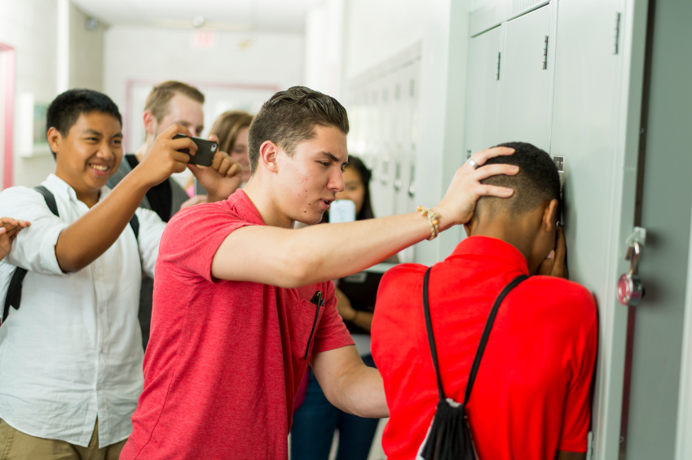
What do you think a ‘bystander’ is?
What responsibility do they have?
What might being a ‘bystander’ look
like when cyber bullying is happening?

Slide 3
Although ‘bystanders’ might not be actively involved in bullying, they are allowing it to continue.
We want to be ‘upstanders’ – people who take action to do what is right.
What virtues are needed to be an ‘upstander?’

Slide 4
Look at the following scenarios and discuss:
What would a ‘bystander’ do?
What would an ‘upstander’ do?

Slide 5
Owais is playing an online game and hears someone telling another person that they suck at the game and shouldn’t bother. This happens every time this person logs on.

Slide 6
Someone posts a picture of Claire that she doesn’t like on Instagram. Lots of people like it and are posting mean comments underneath.

Slide 7
You see that someone in your class has lots of tweets about them which make fun of the way they answered a question in class.

Slide 8
What is the problem?
How would you feel?
What virtues are involved in this scenario?
What do you think a wise thing to do is? Why?
Bethany, in your class, is having a sleepover for her birthday but is only allowed to invite 5 people. Two of your friends, who weren’t invited, are really upset and are not speaking to Bethany anymore. You discover that they have been posting nasty comments online about her and they are encouraging others not to go to the sleepover. You understand why they are upset and they’ve said that they won’t be your friend any more if you tell on them.

Slide 9

What type of person do you want to be online? You could choose one key virtue you would like to show.
Are there any habits you need to start in order to be this person?

