Slide 1


What do family members do for each other?

Slide 2
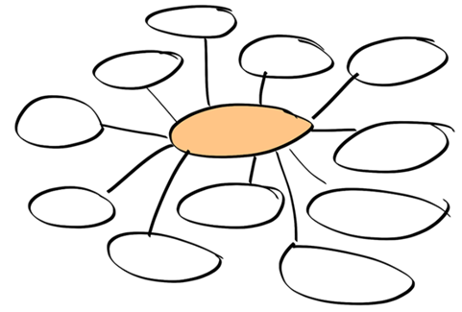
What do human beings need (to survive)? Create a class brainstorm.
Image: pixabay.com

Slide 3
Maslow’s hierarchy of needs
Morality, creativity, problem solving
Confidence, self-respect, respect for others
Friendship, family, belonging
Safety, home, health
Food, water, sleep, breathing
How do our families help us to meet these needs?

Slide 4

What are the different jobs or roles in your family? What do you think your role is? What do you do to help your family to be a caring, happy place?
Image: pixabay.com

Slide 5

Helping out is a habit. What one new habit could you start to help your family?

