Slide 2
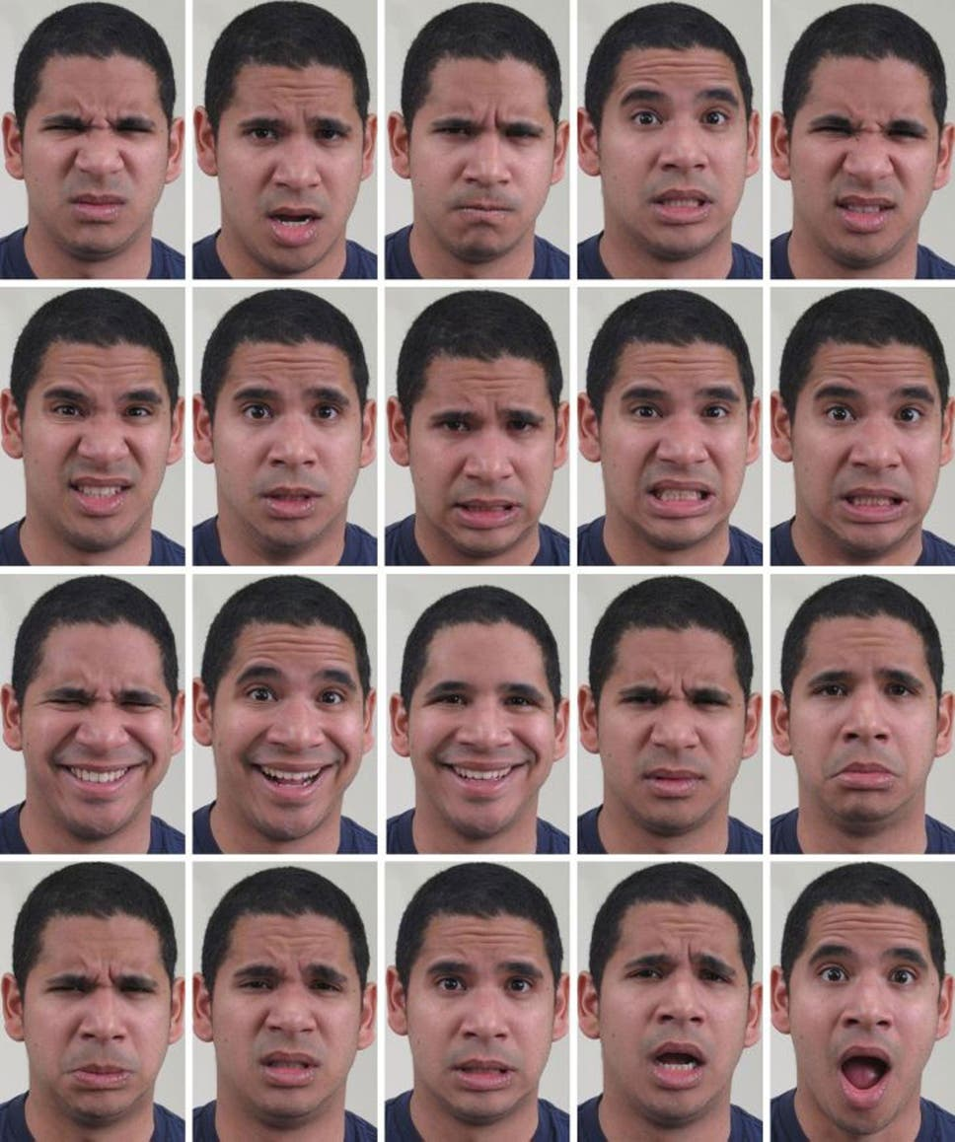
Feeling disgustedly surprised? Scientists identify 21 facial expressions
The Independent Newspaper, Antonia Molloy, Tuesday 1 April 2014
If you ever have trouble reading someone’s mood it could be because you haven’t learned how to interpret the full range of human emotion. From happy to disgustedly surprised, scientists have identified 21 different facial expressions. The research, which was carried out using new computer software, more than triples the long-accepted figure of six emotional states.
Dr Aleix Martinez, from Ohio State University in the US, said: ‘We've gone beyond facial expressions for simple emotions like “happy” or “sad.” We found a strong consistency in how people move their facial muscles to express 21 categories of emotions’.
Since ancient times, leading thinkers have tried to understand how and why our faces betray our feelings. Scientists such as Aristotle and Darwin have long promoted the idea that people’s faces express only a handful of basic emotions - happy, sad, fearful, angry, surprised and disgusted. But restricting emotions to just six categories is like painting only using primary colours, said Dr Martinez. The new study, published in the journal Proceedings of the National Academy of Sciences, has tripled the colour palette available to researchers.
Tagging prominent landmarks for facial muscles, such as the corners of the mouth or the outer edge of the eyebrow, enabled the scientists to match emotions to movement. Putting on a “happy” face was done the same way by almost everyone, with 99 per cent of study participants drawing up the cheeks and smiling. “Surprise” involved widening the eyes and opening the mouth 92 per cent of the time.
https://www.independent.co.uk/news/science/feeling-disgustedly-surprised-scientists-identify-21-facial-expressions-9227589.html

Slide 3
21 Emotions that your face can share…
Happy
Sad
Fearful
Angry
Surprised
Disgusted
Happily Surprised
Happily Disgusted
Sadly Fearful
Sadly Angry
Sadly Surprised
Sadly Disgusted
Fearfully Angry
Fearfully Surprised
Fearfully Disgusted
Angrily Surprised
Angrily Disgusted
Disgustedly Surprised
Appalled
Hatred
Awed
Can you think of situations that might trigger some of these emotions?
How might you be able to know if someone is feeling one of these emotions?
Why is taking time to see how other people feel important?

Slide 4
Naming Emotions
Spend a couple of minutes discussing different emotions that people may have been feeling over the last few months.
Now think about some of the feelings people may be having coming back to school.
Being able to recognise how we are feeling and how others are feeling takes practice and can require courage, honesty and reflection.

Slide 5
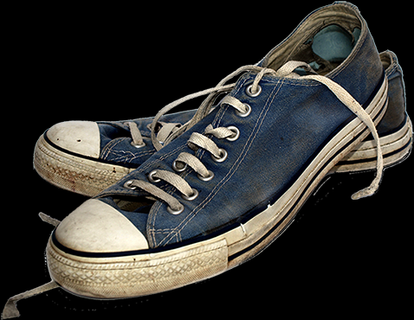
The Virtue of Empathy
Understanding how other people feel is called empathy. It’s a virtue you can practice and get better at. It’s about learning what it feels like to walk in other people’s shoes.
A charity called ‘The Empathy Museum’ actually allows you to borrow someone’s shoes and walk in them whilst you listen to a podcast of their life – you can read a bit more about it here – but you don’t have to go that far!
Research has shown that reading or listening to audio books, watching TV and just really listening to your friends’ and family’s stories can develop your capacity to show empathy.
Why is empathy important?
‘Empathy is a glue that enables families, communities and countries to function in a civil and civilised manner. If you can see things from someone else’s point of view, then you can go on to act compassionately towards them’. - Peter Bazalgette

Slide 6
‘The biggest deficit that we have in our society and in the world right now is an empathy deficit. We are in great need of people being able to stand in somebody else’s shoes and see the world through their eyes.’ — Barack Obama
Do you agree with Barack Obama?
Do you think we have shown more or less empathy as a society over the last few months?
What would happen if we all practised the virtue of empathy a little more?

