Slide 1
Learning Objective: To identify how resilience helps us to overcome challenges

Slide 2
Tribute to Unsung Heroes of Coronavirus Pandemic
www.youtube.com/watch?v=NqiKdkhqRIE
What character strengths have these heroes shown?

Slide 3
Resilience
What do you know about resilience?
What does it mean to you?
Have you ever shown resilience?

Slide 4
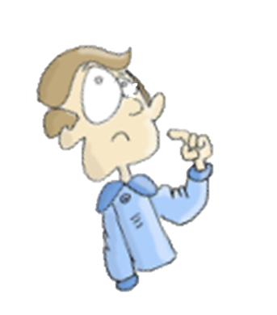
We should show resilience when we are faced with a challenge.
How can challenges make us feel?

Slide 5
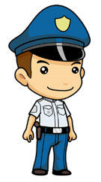
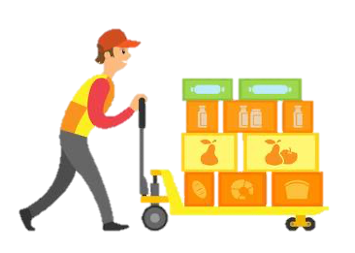
The NHS have shown an incredible amount of resilience in their fight against the coronavirus.
How do you think these people have shown resilience during the coronavirus pandemic?
Image: 123rf.com
Image: publicdomainvectors.org
Image: pngimg.com
Image: pngimg.com

Slide 6
Think of a time when you have shown resilience:
What was the challenge you faced?
How did you overcome it?
How did it make you feel when you overcame it?

Slide 8
When may we need to show resilience in school?
How can we become more resilient?

Slide 9
Virtue Focus Reflection
Resilience: Being able to recover quickly from struggles and setbacks.
Determination: Focusing your energy on finishing a task, especially when it’s difficult.
Perseverance: Not giving up when facing difficulties.
Courage: Acting with bravery in fearful situations.

