Slide 2
Ella’s family have just moved house and she is starting in Year 8. Her accent is very different to the other children’s and she is worried. | O’Shae has been put in a different class to all his friends and he feels they have forgotten all about him.
Musa’s dad has lost his job. He isn’t able to afford new uniform and the trousers he is wearing are really short. | Rupert has been really stressed and thinks that vaping may help him to calm down.
Scarlett has posted a video on TikTok and everyone is teasing her about it. | Precious really wants to play basketball with the boys but doesn’t have the courage to ask.

Slide 3
What are the signs you might be getting angry?
heart beats faster
muscles tense
teeth clench or grind
hands make fists
stomach churns
feel like shouting
feel hot
Anything else?

Slide 4
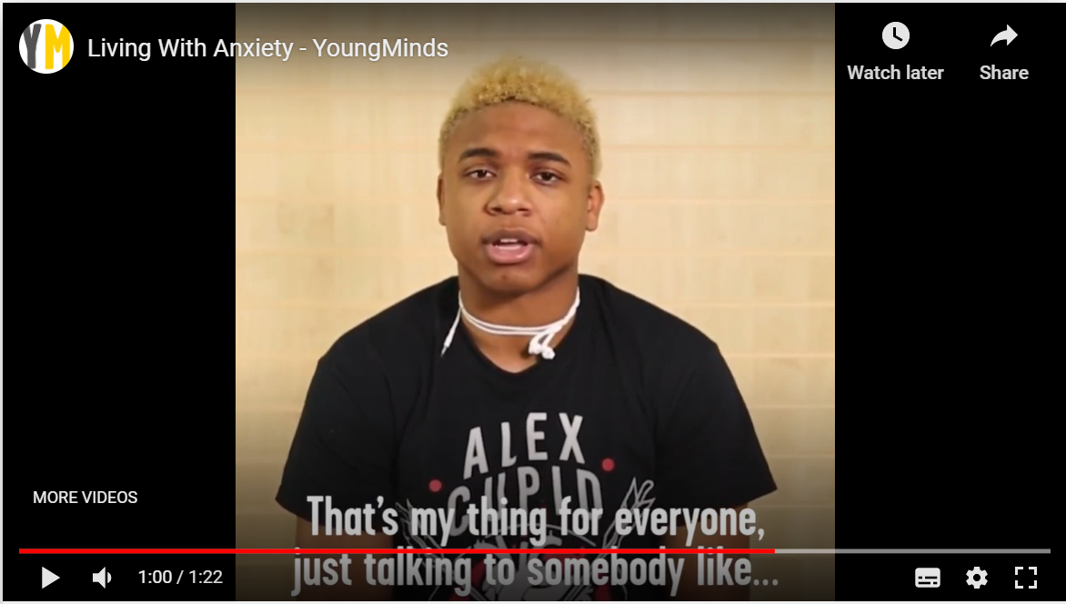
‘The important thing is remembering that you can’t control the situation, but you can control how you react to it and how you choose to think about it.’
A ‘grounding’ activity to stop your thoughts spinning out of control. Sit back and focus on what’s going on around you. Try and name five things you can see, four things you can feel, three things you can hear, two things you can smell, and one thing you can taste.
Find a distraction that takes your mind off things, like going for a walk, listening to happy music or talking to someone. These can help you when you notice you’re worrying about the past or future.
Find a mindfulness activity to help you stay in the moment. You could try this breathing exercise – breathe in through your nose for four counts, hold it for two counts, and breathe out through your mouth for seven counts. If you repeat this, it can slow your breath and help keep you calm.
Watch this video to see how these young people
manage their uncomfortable feelings of anxiety.

