Slide 2
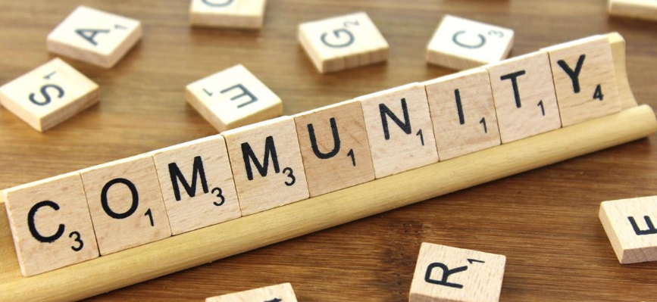
What is a Community?
What does a community mean to you?
What communities do you belong to?
What does it mean to be a part of these communities?
How does the community function in a practical way?
As a class, brainstorm these ideas and draw up your definition of what a community is.

Slide 3
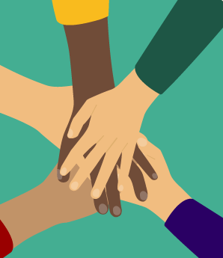
What communities do I belong to?
Look at how these young people have helped their communities around the world during lockdown: plan-uk.org/blogs/meet-five-amazing-people-making-a-difference-in-lockdown
Think of all the communities that you are a part of, write them on a spider diagram and compare them with your partner.
Do you and your partner cross over in any of your communities? What are the similarities and differences?
Choose one of your communities and feedback to the class about why you enjoy being part of it.

Slide 4
Diamond Nine
Look at the nine categories in the diamond
Number them from 1-9 with 1 being the most important.
What is most important in a community?
Why do you believe that?
Can you match any character virtues to the types of people you have ranked highest?

Slide 5
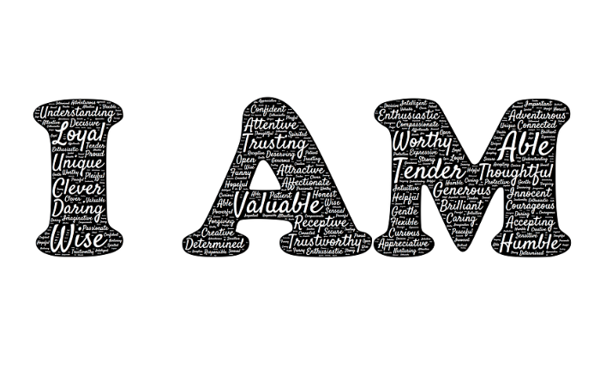
What would your ideal neighbour be like? Why would they be a good neighbour? What virtues or character traits would they display?
During lockdown, a lot of us have got to know our neighbours better. There are many examples of neighbours helping each other out in ways they may not have done before. Have any of you helped your neighbours or been helped by your neighbours?
Watch this short clip of neighbours clapping for the NHS. Why did communities come together to do this? www.youtube.com/watch?v=FB5GNMJQlFw

Slide 6
Journal Entry
How might you use your unique character, skills and attributes to play a role in your community?
Use your ‘Who am I’ exercise to reflect on your gifts and character and write a journal entry that outlines:
The role you play in the various communities that you belong to.
Practical ways you might serve your communities.
The virtues you would like to develop in order to make a difference in your communities.

Slide 7
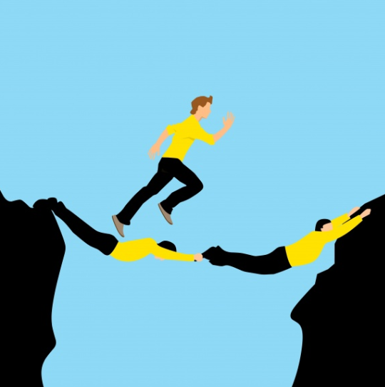
Promoting a Positive Community
In what ways could you employ the key virtues of gratitude, neighbourliness, respect, service, confidence or teamwork to promote a positive community?
How might this look in your school community?
Pick two virtues and explore some practical examples. Share these with the group for discussion.

