Slide 1
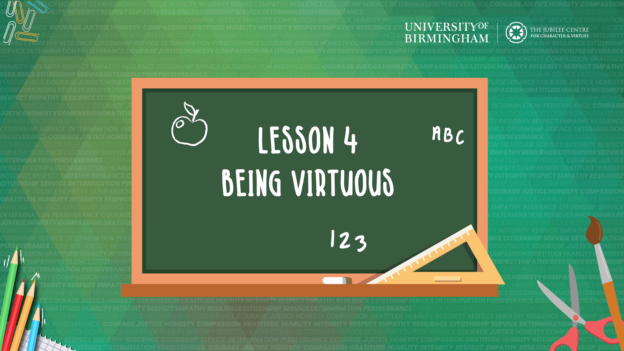
Learning Objective: To recognise how to be a virtuous person

Slide 2

What is a superhero?
Who are these people/characters?
What do they have in common?
What virtues do they show in their stories?
What makes them a hero?

Slide 3
Sir Thomas Moore (Captain Tom)
Image: bbc.com
What virtues did Captain Tom show?
What virtues does Captain Tom have in common with the virtues shown by the superheroes we have already discussed?
Would you consider Captain Tom to be a superhero? Why?
Can you think of a time when you have demonstrated one of the virtues shown by Captain Tom?
www.youtube.com/watch?v=n0tRq9j6xmM

Slide 4
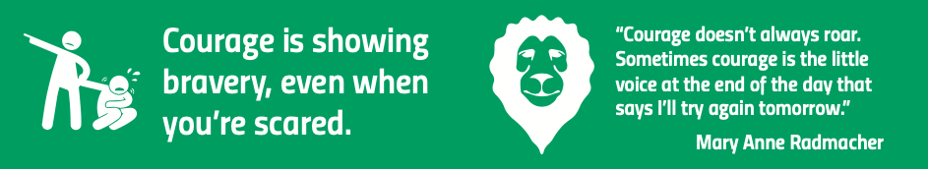
When we think about superheroes, the virtue that comes to mind is courage.
Have you ever showed courage?

Slide 5
We are going to be designing ourselves as superheroes, focusing on one of the virtues demonstrated by Captain Tom.
Your superhero must have a costume, mode of transport and nemesis.

Slide 6
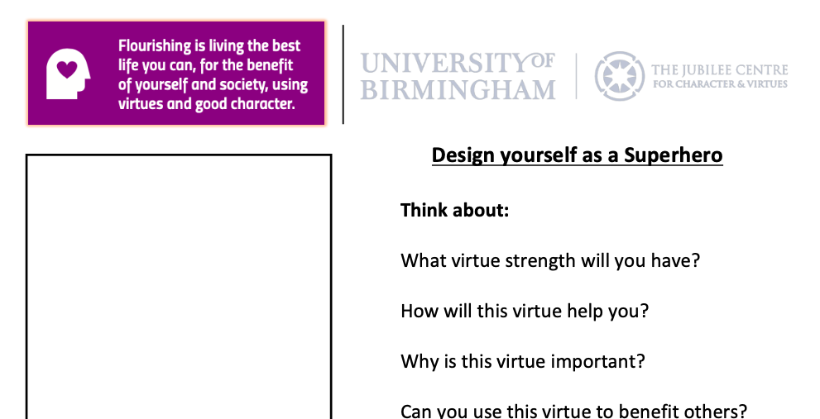

Slide 7
Next time you feel worried or scared, reflect on the virtues we have discussed today.
Can you think of a time you have used your virtues to help someone?
How did it make you feel?
How did it make the person you were helping feel?

Slide 8
Virtue Focus Reflection
Courage: Acting with bravery in fearful situations.
Honesty: Telling the truth and being sincere.
Generosity: To give something for someone else’s benefit.
Kindness: Being friendly, generous and considerate.
Resilience: Being able to recover quickly from struggles and setbacks.

