Slide 2
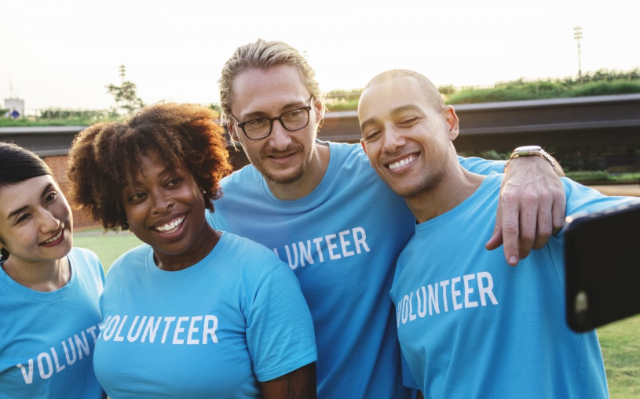
There are many organisations in your community that are staffed, led and run by volunteers. Can you think of any?
What roles do volunteers play in the organisations you’ve mentioned?
What does the organisation do? In what way does it benefit the local community?

Slide 3
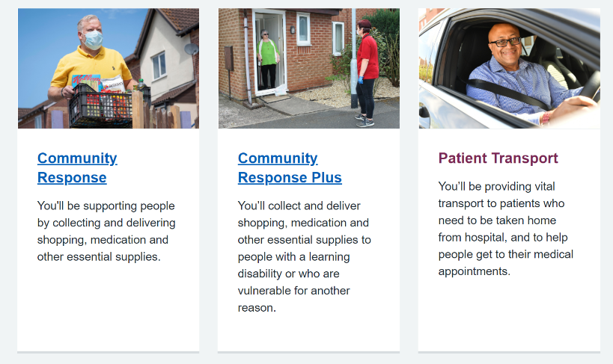
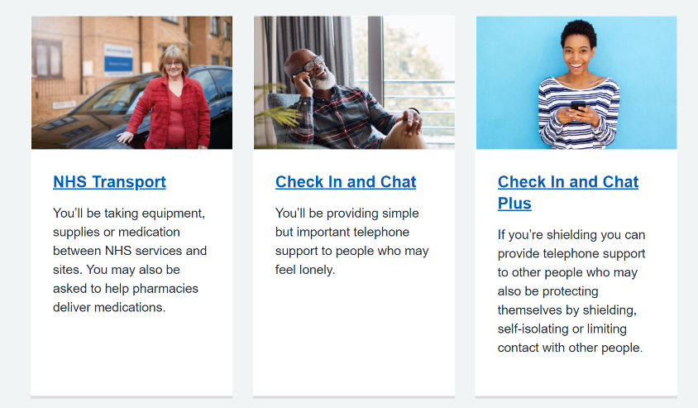
When the UK went into lockdown in March 2020, the National Health Service (NHS) called for volunteers to help in the community to look after those people who needed extra help and support. The response was incredible and 405,724 people signed up in one day to help vulnerable people stay safe.
Sir Simon Stevens said: ‘Times like this show just how generous the British people are and how much they value our health service – we are blown away by this response and the kindness of our country’.
Chief Executive of Royal Voluntary Service, Catherine Johnstone CBE, said: ‘In times like this you can really see the best in humanity – small gestures of compassion and connection that allow us to show who we are and what matters to us’.
Why do you think so many people signed up to volunteer to help the NHS and their local communities?

Slide 4
Come up with a definition of volunteering in a pair. Feed back these definitions and discuss.
It is sometimes more difficult to think about how you can volunteer as a young person, but there are lots of opportunities in school, on-line with a recognised organisation or in your community where young people can make a difference.
Are you involved in any activities like this in your school or community?
Do you know any young people who volunteer?

Slide 5
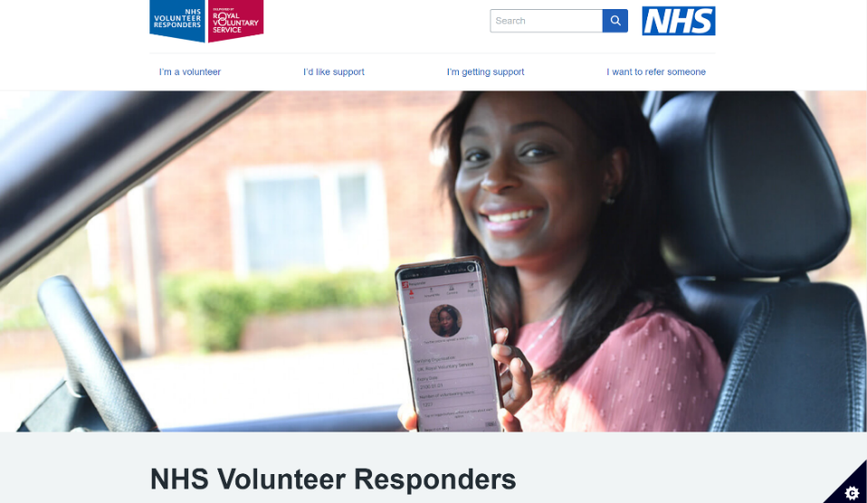
Write a short reflection on someone you know who volunteers, explaining who they volunteer for and their motivation behind volunteering for that organisation.
You could also think of some of the barriers they may have faced and how they have overcome them.

Slide 6
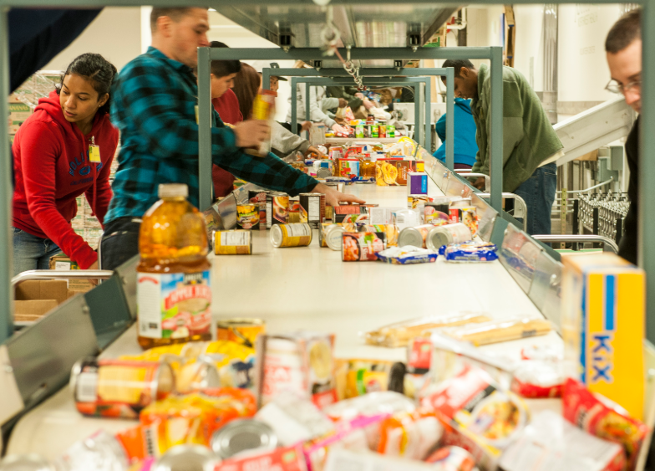
What virtues do you think a volunteer would need in the different organisations you have mentioned? Why?
What virtues might being a volunteer develop? How?
In what other ways might your character develop through volunteering?
What might people’s motivation be for volunteering? Are motives always good/virtuous?
What might be the consequences of people volunteering with negative motives?

Slide 7
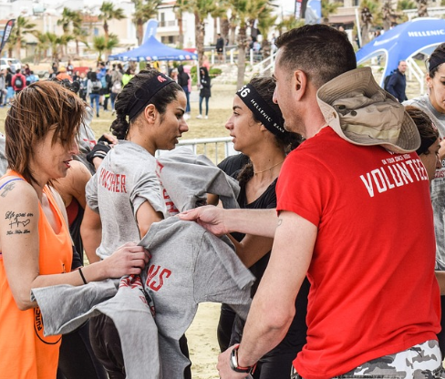
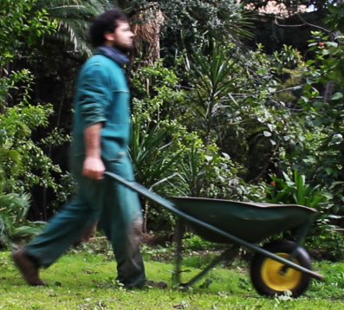
Your Community
How could volunteers help out to make your community a better place?
Using the ideas and discussions in the previous activities, design a new volunteering scheme in your community. The scheme needs to respond to an issue or an organisation in your community.
WHY it is needed
WHERE it is needed
HOW it would help the community and the individual
It needs to promote the benefits of volunteering both to the organisation/issue and the individual taking part.

