Slide 1
Learning Objective: To identify the virtues that are needed to be a volunteer and to understand why people volunteer.

Slide 2
How many logos/organisations can you identify?
Can you explain what each charity does?
What is the purpose of a charity?
What would happen if charities did not exist?

Slide 3
Many charities rely on volunteers. They would
not be able to do their work without them.
What is a volunteer/volunteering?
Do you/or anyone in your family do any volunteering?

Slide 4
750,000
More than 750,000 people in the UK offered to volunteer for the NHS in its fight against the coronavirus. These voluntary roles included delivering food and medicine to the vulnerable and supporting their community.
What virtues did these volunteers show?
What do you think motivated them to volunteer their time and experience to help others?

Slide 5
Who wants to help me?
Image: pixabay.com

Slide 6
Volunteers Stories
What are the reasons these people volunteered?
Is there anything that surprised you? Why?
How do you think they felt volunteering?
www.youtube.com/watch?v=roGRna2SkPw

Slide 7
I volunteer as a youth leader once a week. I think that helping others to choose the right path in life is worthwhile. I enjoy spending time with young people.
I volunteer so that I can get first-hand experience of what the job is like. It will be something interesting to talk about at an interview and may even help me get a similar job!
I volunteer as a charity fundraiser for my local cancer hospice. I decided to help this charity as my grandparents both received care there and I wanted to give something back to say thank you for looking after them.
We work at a homeless shelter once a week. It inspires us. It is great to see how some people can offer so much and expect so little. We are part of a Christian organisation and we believe that we should help others. It is a big part of our faith.
We have set up a drop-off point at our local school, where people can donate items for refugees. We then arrange for this to be taken to areas of need. We were horrified by the images that we saw on TV of the conditions that refugee children were living in, and we wanted to do something about it.
I became a volunteer at the Olympics because I was so proud and excited that our country was hosting it. I wanted to help make sure that the event ran smoothly.

Slide 8
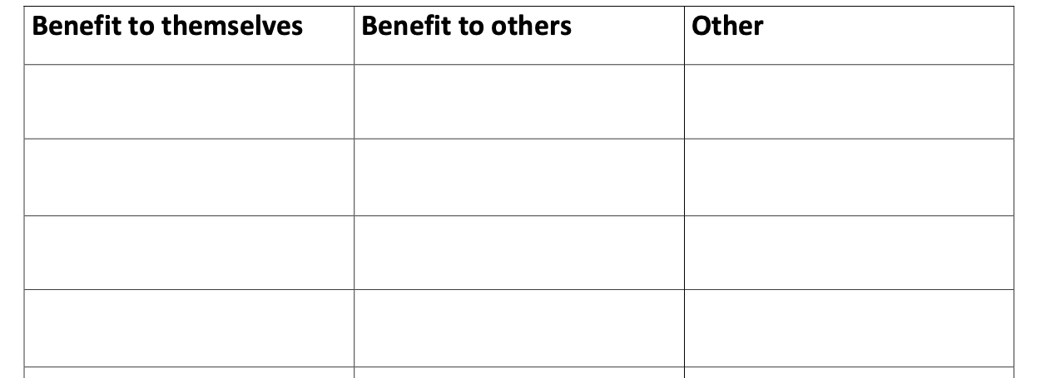
Using the case studies, in pairs, pull out the reasons these people volunteered and sort them into the table.

Slide 9
Volunteering opportunities in
School
Choose one of the volunteering opportunities we have discussed and reflect on the virtues that might be needed and the virtues that you could develop through doing the role.

Slide 10
Virtue Focus Reflection
Service: The act of doing work that benefits other people.
Volunteering: Performing a service willingly and without pay
Citizenship: Your involvement in your community and society.
Compassion: Showing care and concern for others.
Friendliness: The quality of being kind, thoughtful or affectionate towards another person.

