Slide 1
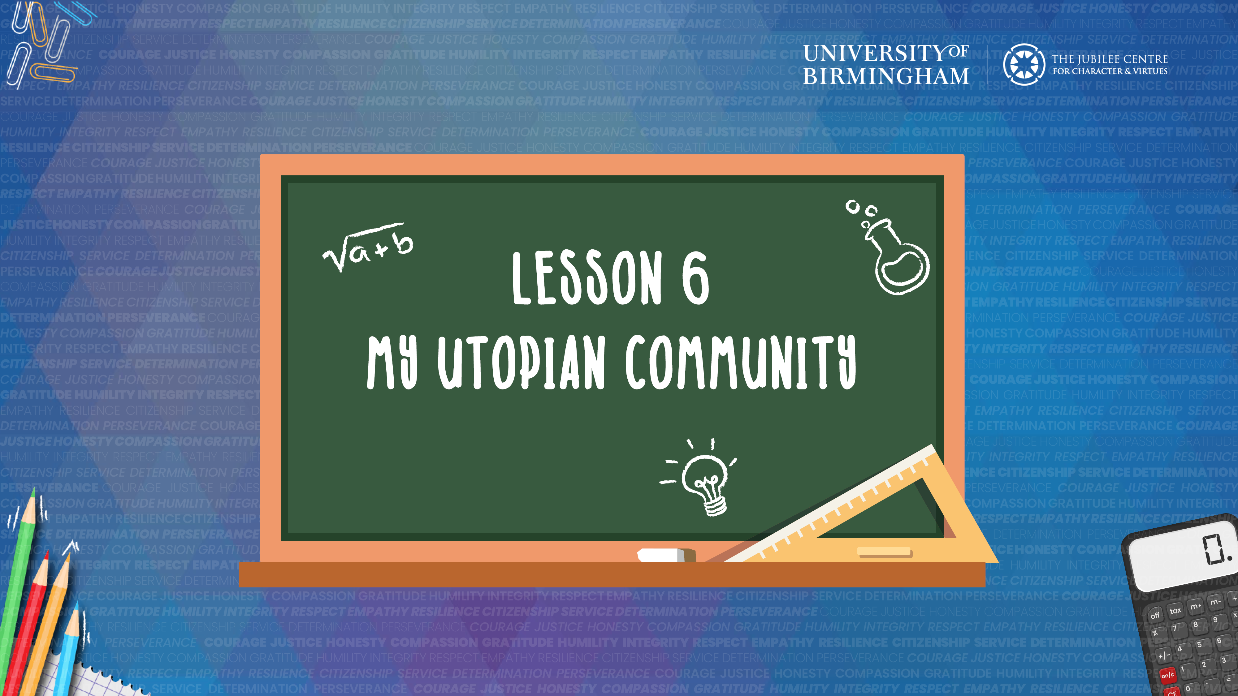

Slide 2

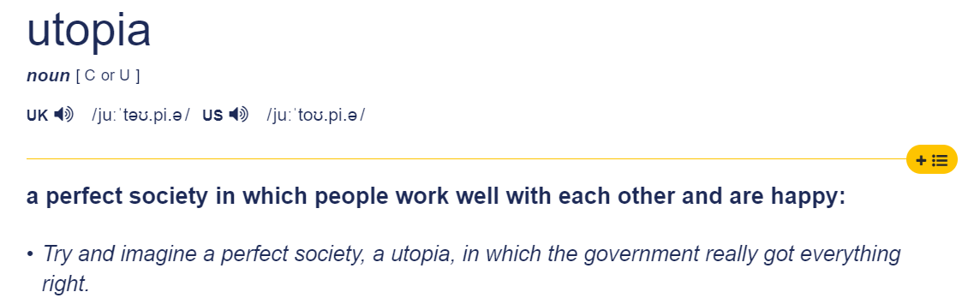

Slide 3
What would a Utopian community be like?
Imagine our school community as a Utopian community.
How would people treat each other?
What would happen if someone lost something or found something?
What would happen if someone was sad or angry?
What would happen in a lesson?
What would happen if someone fell over?
What other things would need to change?

