Slide 2
Lockdown Superhero 1: Resilience and Perseverance
As a class, come up with a definition of these virtues or other synonyms you may use instead.
In pairs, think of one example when you have used these virtues and how they have impacted you or others.

Slide 3
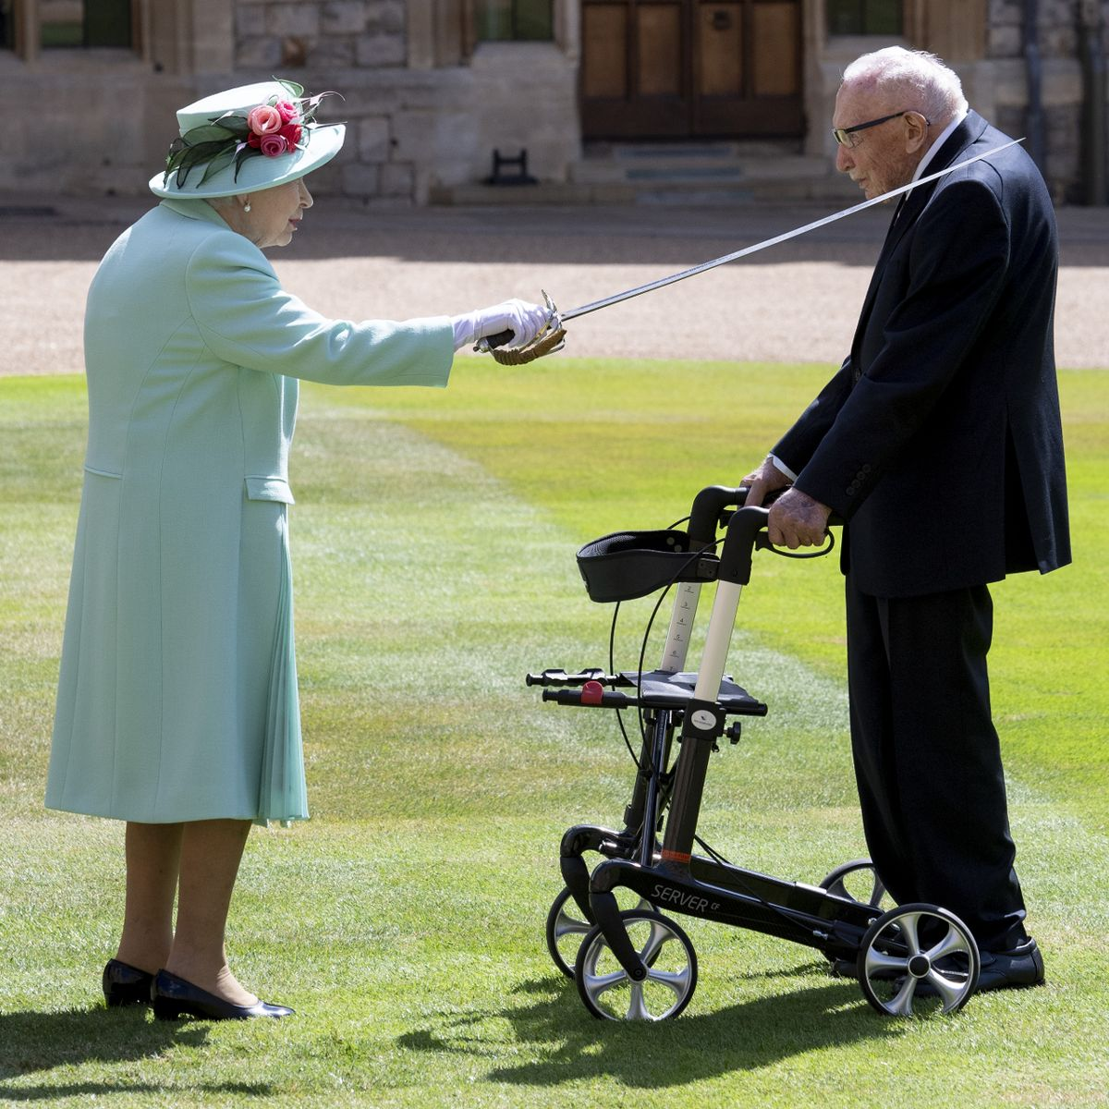
Do you recognise the people in this picture?
What do you think is happening in the picture?
Who is the lockdown superhero?

Slide 4
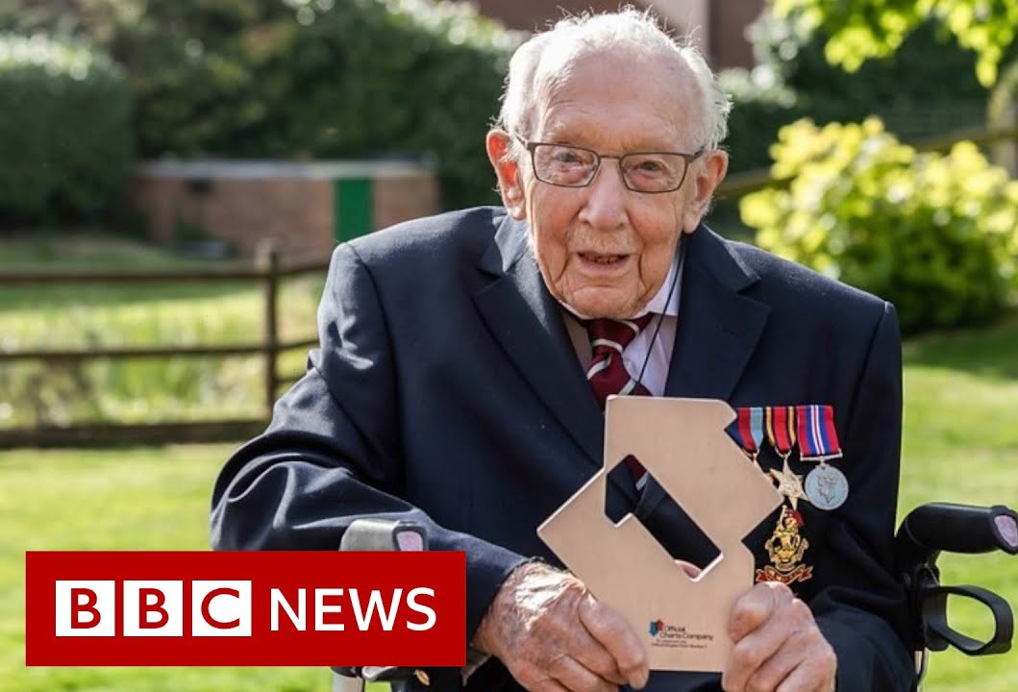
Captain Sir Thomas Moore (born 30 April 1920), popularly known as “Captain Tom”, is known for his achievements raising money for charity in the run-up to his 100th birthday.
On 6 April 2020, at the age of 99, he began to walk laps of his garden in aid of the NHS with the goal of raising £1,000 by his hundredth birthday.
In the 24-day course of his fundraising he made many media appearances and became a popular household name in the United Kingdom, generating much interest in his life story, earning a number of accolades and attracting over 1.5 million individual donations.
He featured in a cover version of the song "You'll Never Walk Alone", with proceeds going to the same charity. The single topped the UK music charts and made him the oldest person to achieve a UK number one.
On the morning of his hundredth birthday, the total raised by his walk passed £30 million, and, by the time the campaign closed at the end of that day, had increased to over £32.79 million.
His birthday was marked in a number of ways, including flypasts by the Royal Air Force and the British Army. He received over 150,000 cards, and was appointed as honorary colonel of the Army Foundation College. On 17 July 2020, he was invested as a Knight Bachelor at Windsor Castle.
en.wikipedia.org/wiki/Captain_Tom, August 2020
How has Captain Tom shown resilience and perseverance?
What barriers might have stopped him in his achievements and how do you think he has overcome them?
Who has benefited from his actions? What ripple effects may this have had?
REFLECTION: where might you need to show more resilience in your life? What virtues can help you accomplish your actions?

Slide 5
Extension Work
Find out more: Watch the documentary about Sir Tom here: www.itv.com/hub/the-life-times-of-captain-sir-tom/10a0447
Discussion question
Over 150,000 people sent birthday cards to Captain Tom, even though they had never met him. What do you think led to this outpouring of gratitude from strangers? What did people do it for? Is it something you would do?
What can I do?
Who might like to receive a card from you? Could you help celebrate someone’s birthday? Could you write a teacher, family member or friend a ‘thank you’ note?
Amnesty UK is an organisation that offers support to people who are the victims of Human Rights abuse in different parts of the world. They encourage people to send cards, particularly at Christmas, but also at other times of the year
to show solidarity and support and let victims know they are not forgotten. Maybe this is something you would like to find out more about or do together as a class. www.amnesty.org/en/get-involved/write-for-rights/

Slide 6
Lockdown Superhero 2: Compassion and Kindness
As a class, come up with a definition of these virtues or other synonyms you may use instead.
In pairs, think of one example when you have used these virtues and how it impacted you or others.

Slide 7
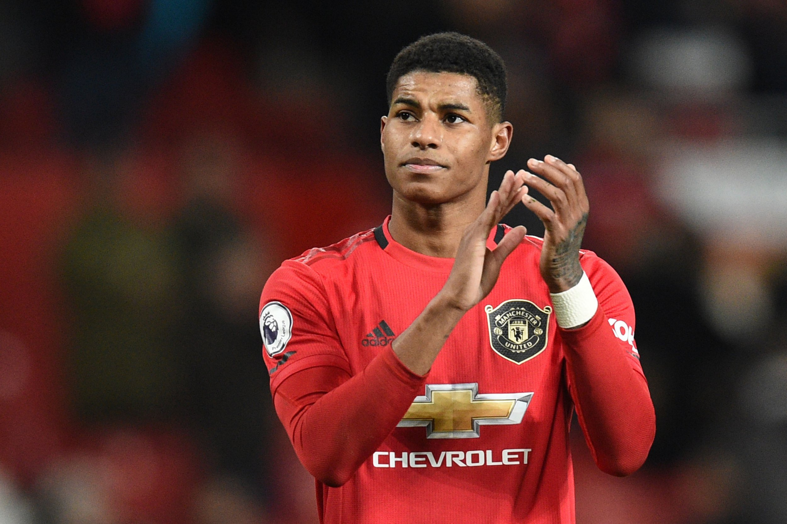
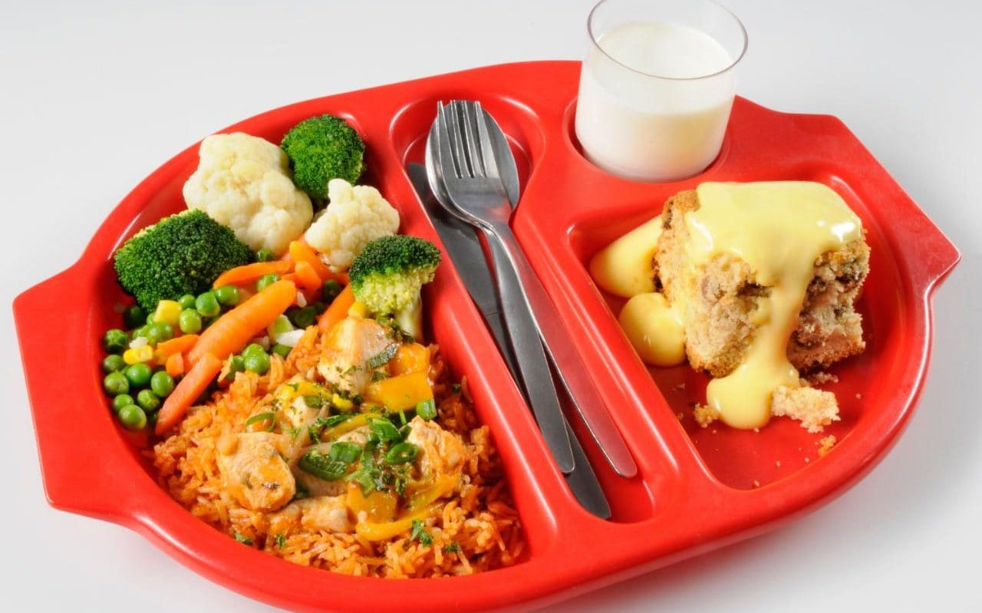
Do you know what story is represented by these pictures?
Who is the lockdown superhero and why?

Slide 8
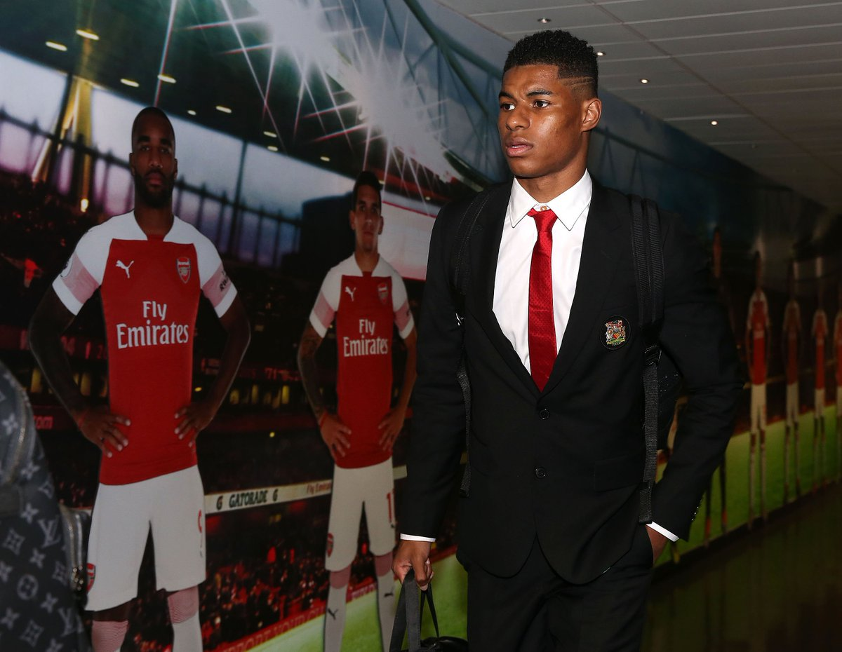
Marcus Rashford is an English professional footballer who plays for Manchester United and the England national team.
During lockdown, Marcus teamed up with the charity FareShare to raise money to provide food for children who were no longer receiving free school meals at school. Over £20 million was raised and over 3 million families supported.
On 15 June, Rashford wrote an open letter to the government calling on them to end child poverty in the United Kingdom and provide free school meals to children over the summer holidays. A day later, the government announced a change in policy regarding the extension of free school meals for children during the summer holidays, with Rashford's campaign credited as a major turning point in governmental talks.
“This was an issue I could relate to,” he says. “This was something I had experienced. That my mum had experienced. That we had experienced as a family. I always swore to my mum that if one day I was in a position to help, then I would, and an opportunity presented itself”.
You can watch him talk about his campaign here: https://www.bbc.co.uk/news/av/uk-53071371
How has Marcus Rashford shown kindness and compassion?
What barriers might have stopped him in his actions and how do you think he has overcome them?
Who has benefited from his actions? What ripple effects may this have had?
REFLECTION: where might you need to show more compassion or kindness in your life?

Slide 9
Extension Work
Find out more
You can read Rashford’s whole letter on Twitter here: twitter.com/MarcusRashford/status/1272302819819823105.
What are the key points that Rashford is making? Who does he show gratitude to, for enabling him to get to where he is today?
Discussion question
Should footballers be expected to be role models? As really high profile public celebrities, should we expect them to show better character than other people because they are in the public domain?
You can see how some footballers support charities here:
www.foottheball.com/football-top-10/top-10-footballers-prominent-for-their-charitable-side/207253.
What can I do?
If there is something you feel strongly about, do something about it! You can write to your MP or the Prime Minister, like Marcus Rashford did, or whoever could make a difference. You can also set up a petition either through
Change.org or https://petition.parliament.uk/. If you get 100,000 signatures, your proposal will normally
be debated in Parliament.

Slide 10
Lockdown Superhero 3: Empathy
As a class, come up with a definition of this virtue.
In pairs, think of one example when you have shown empathy and the impact it has had on you and others.

Slide 11
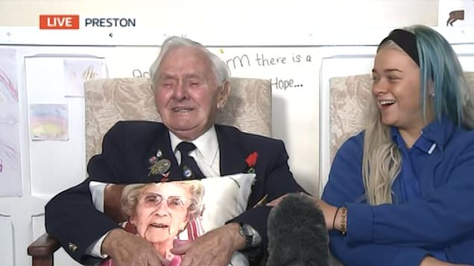
What can you see happening in this picture?
What can you see that might show someone showing empathy?
Do you know who this lockdown hero on the right is?

Slide 12
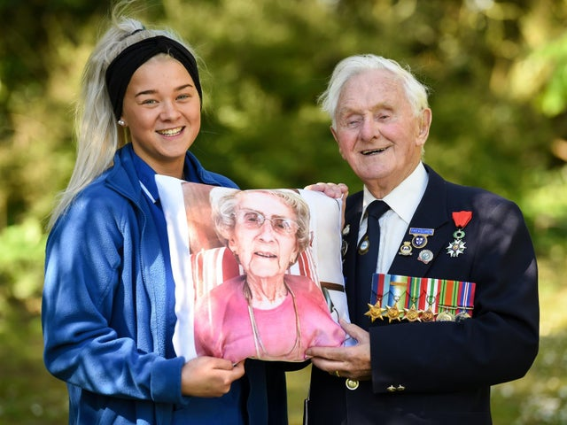
Kia Tobin is a 17 year old care home worker. During lockdown, she left her family home and moved in to a care home to keep the resident’s safe.
Whilst she was there, she looked after 94 year old resident Ken, whose wife Ada had died 9 months before. Ken and Ada had been married for 71 years and every night Kia saw him hug a picture of her before he went to bed.
Watch this short video clip to see what she did for him…
www.youtube.com/watch?v=8ISkk3mqAyk
How has Kia shown empathy?
What barriers might have made showing empathy difficult and which virtues have helped her overcome them?
Who has benefited from her actions? What ripple effects may this have had?
REFLECTION: where might you need to show more empathy in your life?

Slide 13
Extension Work
Find out more
There are many people like Kia who are employed in the social care sector. Social care is about providing physical, emotional and social support to help people live their lives. For various reasons and at different stages in their lives, some people need support to develop and maintain their independence, dignity and control.
You can find out more about careers in social care here: https://www.healthcareers.nhs.uk/working-health/working-social-care.
Discussion question
In some cultures, it is seen as the responsibility of the family to look after elderly relatives; in others, families feel the best care relatives can get is in a specialist care home. Being mindful of some of the sensitivities of the subject and remembering to respect others’ cultures and practices, what are your own thoughts? What would you like when you are older?
What can I do?
Melrose Stewart MBE from the University of Birmingham worked with Channel 4 to produce a series called Old People’s Home for 4 Year Olds, which showed how young people and older people working together benefits both communities. Although covid-19 has put some limitations on intergenerational projects, are there
things that you could do within your community or as a school to encourage young and older people to share more of
their experiences? Find someone to write to here: https://communityseniorletters.com/

Slide 14
Lockdown Superhero 4: Courage
As a class, come up with a definition of this virtue.
In pairs, think of one example when you have shown courage and the impact it has had on you and others.

Slide 15
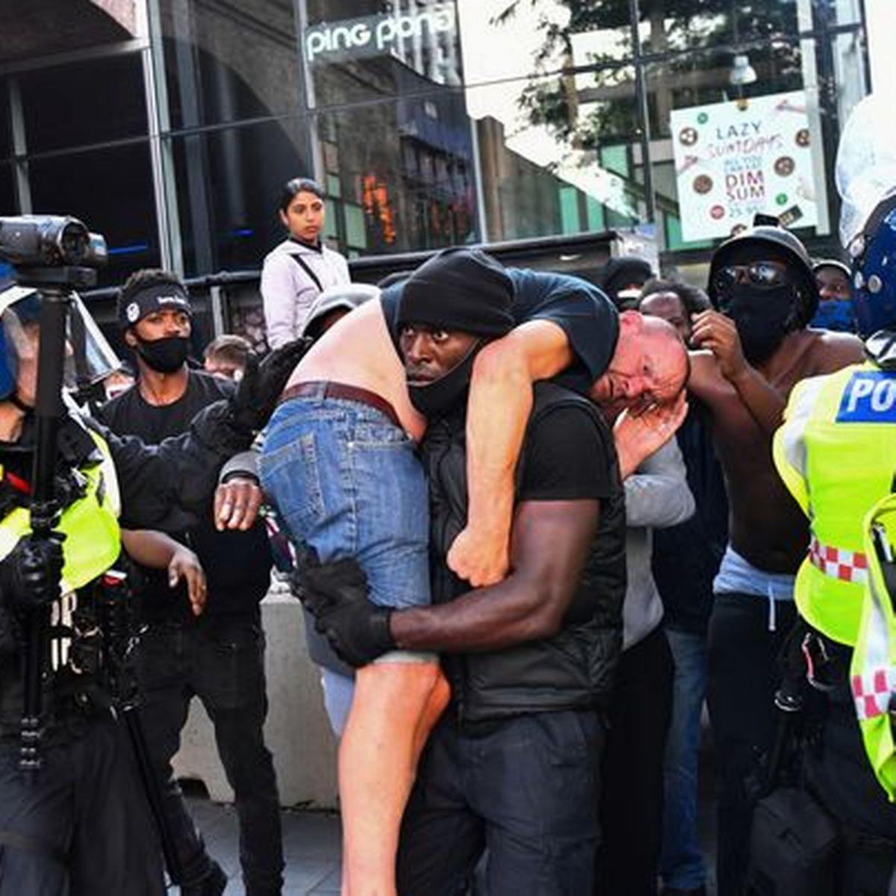
What can you see happening in this picture?
Do you know what is happening in the parts of the picture you cannot see?
Do you know who this lockdown hero is?

Slide 16
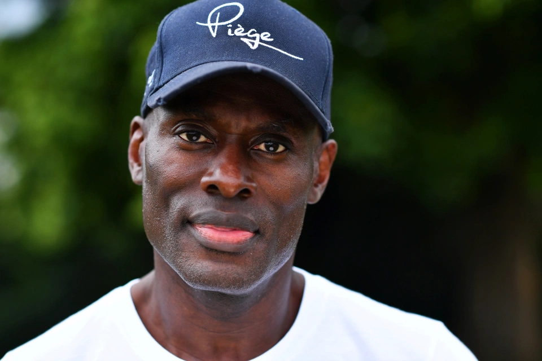
On 13 June 2020, Patrick Hutchinson, a black man, was photographed carrying a white injured man to safety during a confrontation in London between Black Lives Matter demonstrators and counter-protestors.
The image went viral and quickly travelled around the world with Patrick being widely praised for his actions.
The Home Secretary for the Government, Priti Patel, told the House of Commons: ‘Our country needs more people like him and his actions this weekend spoke volumes. I pay tribute to him and the way in which he conducted himself, the way in which he stepped in.’
Patrick talked to the Sun newspaper about what he was thinking when he and his three other friends went to save the injured man; ‘His life was under threat so I just scooped him up on to my shoulders and started marching towards the police with him. It was scary. But you don’t think about it at the time, you do what you’ve got to do.’
Patrick has since written a book entitled “Everyone versus racism: A letter to my children” focussing on the advice he wants to give the next generation to help break down barriers and unite everyone against racism.
How has Patrick shown courage?
What barriers might have made showing courage difficult and which virtues have helped him overcome them?
Who has benefited from his actions? What ripple effects may this have had?
REFLECTION: where might you need to show more courage in your life?
The Sun

Slide 17
Extension Work
Find out more
Patrick Hutchinson has been called a ‘Good Samaritan’. Read the original biblical story and a modern day interpretation here: www.jubileecentre.ac.uk/userfiles/jubileecentre/pdf/character-education/GratitudeAndCompassion/CultivatingCompassionStudentWorkbook.pdf.
You can find out more about the Black Lives Matter protests and see other examples of heroism here: https://no-outsiders-assembly.blogspot.com/2020/06.
Discussion question
Patrick wants to make the world more equal for his grandaughters and grandsons. What do you think needs to be changed? How can we make the world a more equitable place?
What can I do?
Find out more about the BLM movement by speaking to your friends, doing a google search and find out ways that you can contribute to a more equitable world.

Slide 18
Lockdown Superhero 5: Creativity
As a class, come up with a definition of this virtue.
In pairs, think of one example when you have shown creativity and the impact it has had on you and others.

Slide 19
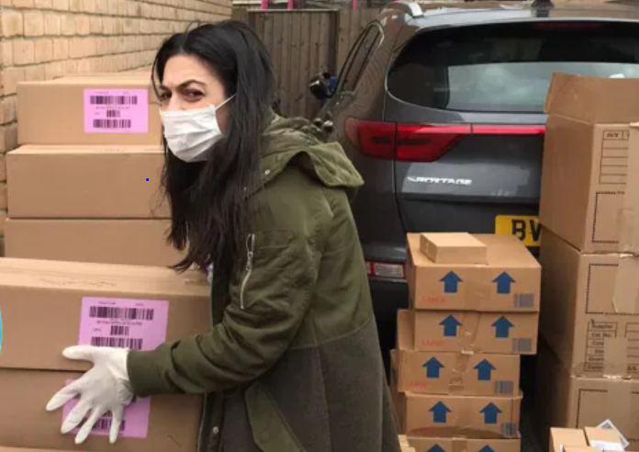
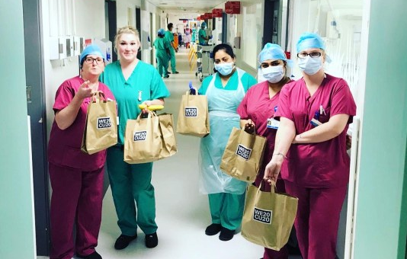
Lauren Ezekiel, this everyday hero, hasn’t been in the news much, so you may not know her story, but it is typical of thousands of people who have been creative during lockdown to try and use their skills and talents to help others.
If you knew she was an ex-beauty editor, can you think what story these pictures might be showing?
Who do you think she wants to help?
What do you think she might be doing?

Slide 20
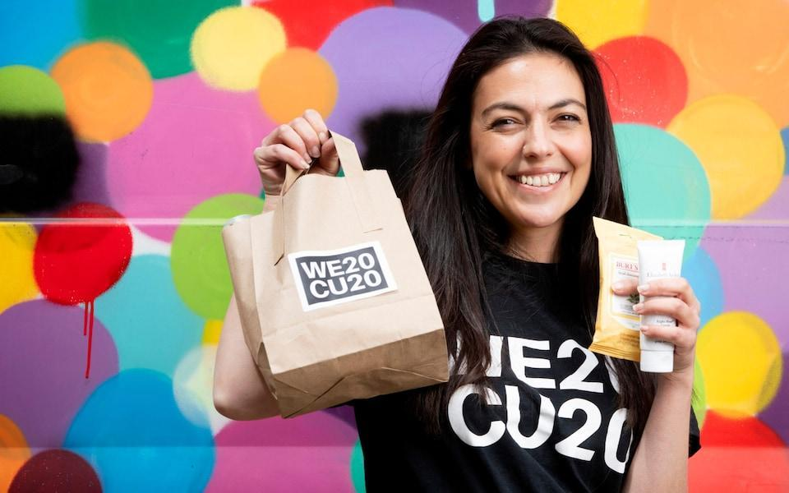
‘As an ex beauty editor, I wasn’t sure how much help I could be when the coronavirus pandemic started to hit – most people don’t need lipstick in an emergency! Then I started seeing online posts from doctors and nurses saying how they were desperately in need of not only gloves and masks, but toiletries, too. Nothing extravagant, just things like shower gel, deodorant and toothpaste, but they were working such long hours, there was no time to go home and shower or get supplies.
The first step was to create a formal fundraising campaign that I called WE C U 2020, with the aim of collecting and distributing toiletries and beauty products to NHS workers. I then emailed all my contacts I could think of at beauty brands asking for donations, hoping I could make around 1,000 goody bags to drop off at the local hospitals near me. I couldn’t have predicted the response. Straight away brands responded positively and in total, over £500,000 worth of products have been donated.
Hand lotion is one of the most frequently requested items. You wouldn’t think it’s a priority, but every NHS worker that I speak to asks for it. It makes sense though, as they are essentially washing their hands in chemicals day in and day out, so having something to moisturise their skin means they’re able to keep working without being in pain.
I’ve organised WE C U 2020 entirely from home, directing from my kitchen and it’s been a huge team effort – my mum, brother, sister, auntie, cousins and nan have all helped out. The kindness and generosity has been incredible – it’s left me feeling a bit numb. Our news feeds have been filled with the darker side of life recently, but the overwhelming good I’ve seen has been amazing.’
How has Lauren shown creativity?
What barriers might have made showing creativity difficult and which virtues have helped her to overcome them?
Who has benefited from her actions? What ripple effects may this have had?
REFLECTION: where might you need to show more creativity in your life?
Metro.co.uk visited August 2020

Slide 21
Extension work
Find out more
You can find out about many more creative everyday heroes who have used their talents in different ways in this feature article by the Metro: metro.co.uk/tag/everyday-heroes.
Discussion question
In 2018, people in the UK spent £27.2 billion on beauty products and beauty services (Oxford Economics ONS). Do you think that lockdown has made us re-evaluate what’s important in terms of how we look? Do you think people have thought differently about spending money on hair and beauty products? Have we begun to think differently about what’s important?
What can I do?
As a class, think about creative ways you could help the NHS. We have all worked together in communities that have clapped for the NHS but how can we continue to show gratitude and appreciation for them?
What creative ways can you think of?

Slide 22
Lockdown Superhero 6: Volunteering
As a class, come up with a definition of this virtue, which we may also call ‘service’.
In pairs, think of one example when you have shown service and the impact it has had on you and others.

Slide 23
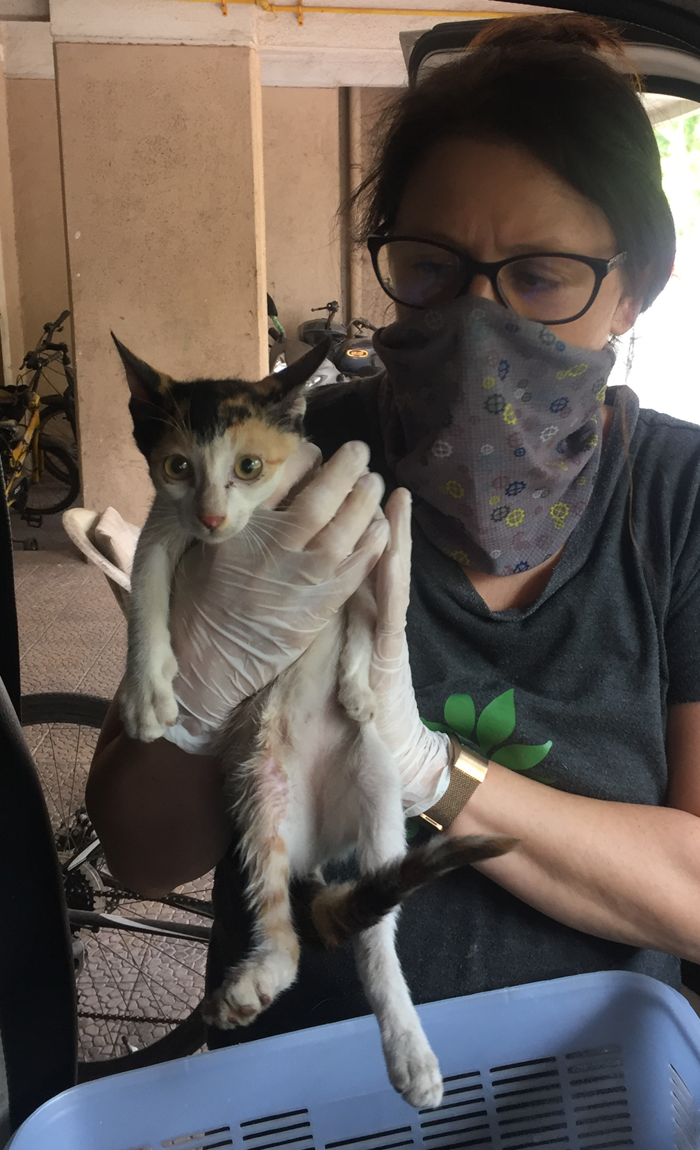
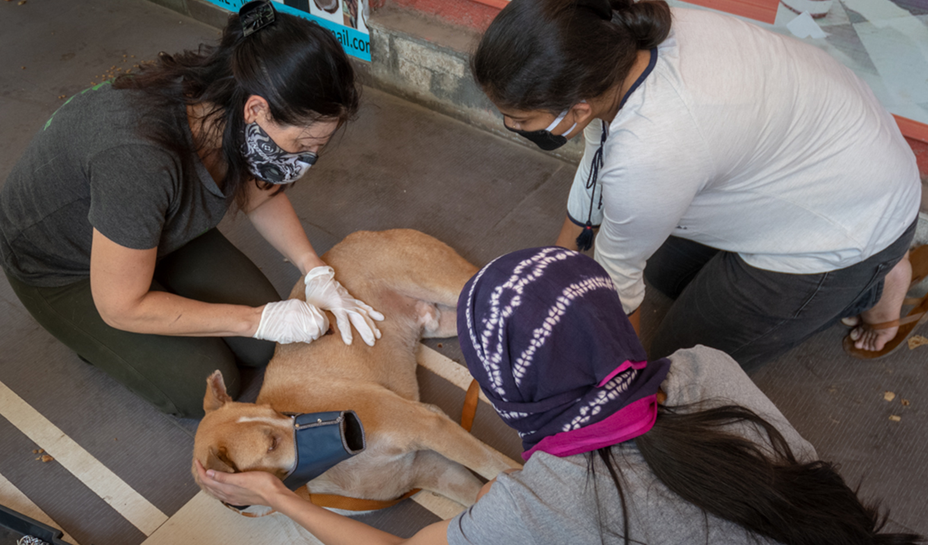
Can you think what might be happening in these pictures?
What do you think this lockdown superhero is doing?

Slide 24
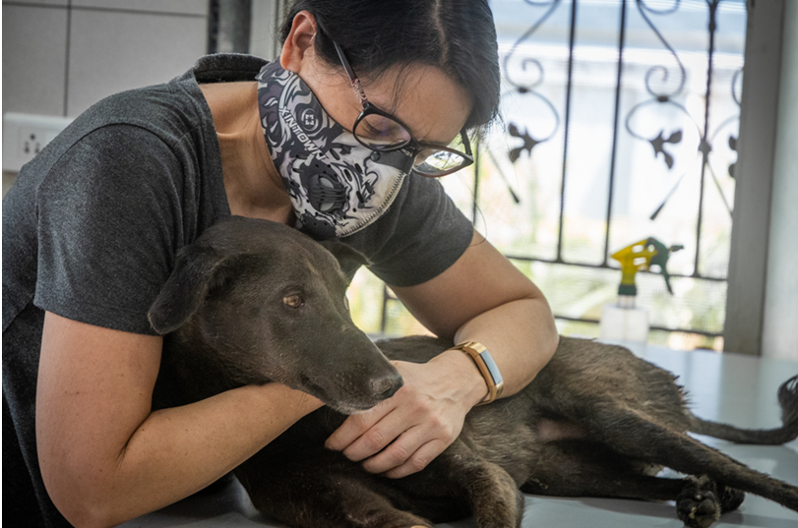
Susannah is from Cheshire and has been in India throughout the pandemic helping street animals in distress.
India has an estimated 30 million street dogs, many of which suffer diseases, injuries, infections, traffic accidents, malnutrition and starvation, and human cruelty.
During the lockdown, they have been suffering in greater numbers, as their food and water supplies have dwindled. Street animals often hang around street food stalls, cafes and restaurants hoping for leftovers, but with these shut, animals have been going hungry. Malnutrition then leads to low immunity and disease. Spay/neuter programmes have been on hold leading to a proliferation of puppies. Susannah works with a local charity called Tails 'N' Trees whose mission is Neuter, Vaccinate, Rescue. As they are classed as essential services, she has been able to go out with her team to provide food and water for starving animals and rescue critically injured animals. For less severe injuries, animals are treated on-site on the street itself. The charity relies on donations from people to pay for treatment, but the majority of people who work for the charity do so as volunteers.
How has Susannah shown service?
What barriers might have made showing service difficult and which virtues have helped her to overcome them?
Who has benefited from her actions? What ripple effects may this have had?
REFLECTION: where might you need to show more service in your life?

Slide 25
Extension Work
Find out more
There isn’t quite the same problem with street cats and dogs in this country as there is in India, but there are still problems of animal cruelty. Many puppies that are sold in the UK are actually from Puppy farms, which are illegal. Look at this article from the PDSA to see what the problem is and find out more here.
Discussion question
Anyone can buy a puppy. Do you think there should be some test or process that you have to pass before you are allowed to? What would a good test be?
What can I do?
How can you encourage responsible pet ownership in your school? What do children need to know before they get a pet? Could you produce some ‘Pet Care guides’ to put in the library?

