Slide 1

Anne Frank

Slide 2
Introduction to the Story
Anne Frank was a German girl, born in 1929, and moved to Holland with her family in 1933. Her family were Jewish, who were persecuted by the Nazis before and during the Second World War.
In July 1942, Anne and her family went into hiding. Anne began to keep a diary about her time in hiding. Anne was able to be completely honest in her diary, which she kept for over two years, until her and her family were captured by Nazi soldiers.

Slide 3

humility
Humility is to put the needs of others before your own, and be willing to take care of others as you take care of yourself.

Slide 4

honesty
Honesty is to be true to yourself and other people.

Slide 5


Slide 6


Slide 7

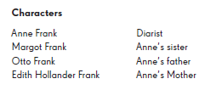
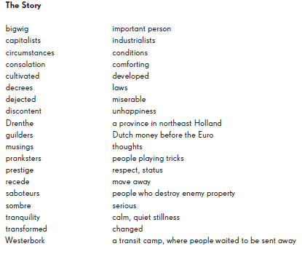
Characters and Glossary

