Slide 1

Beowulf

Slide 2

Introduction to the Story
Beowulf was a brave warrior who served his country by fighting monsters, giants and beasts who terrorised the people of Scandinavia.
No monsters was too scary, no giant too tall for Beowulf. When he heard that King Hrothgar wanted him to fight Grendel, he went straight to their aid.

Slide 3

courage
Courage is having the strength and will to know what you should do even though you may be afraid.

Slide 4
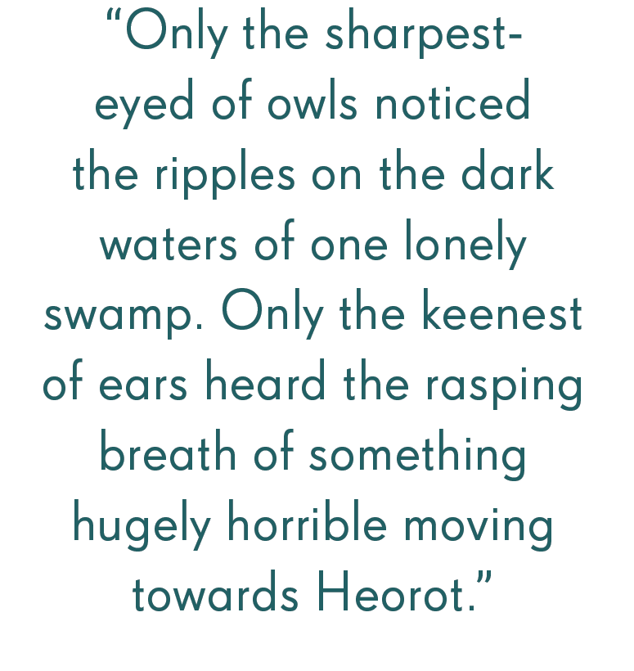

Slide 5
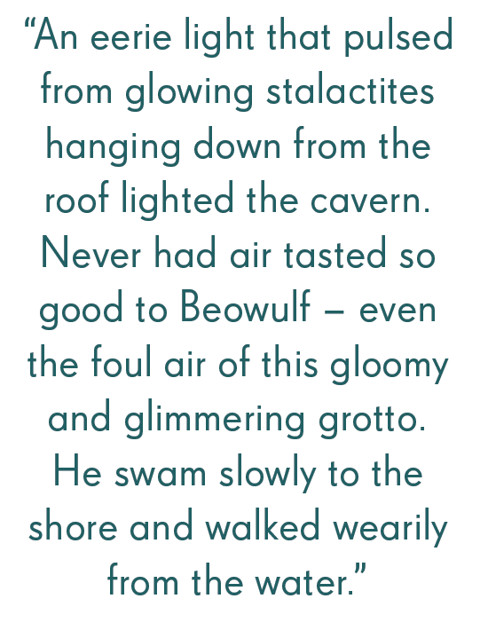

Slide 6
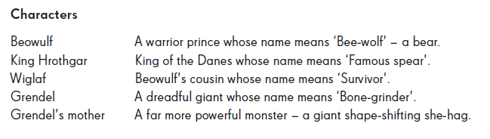
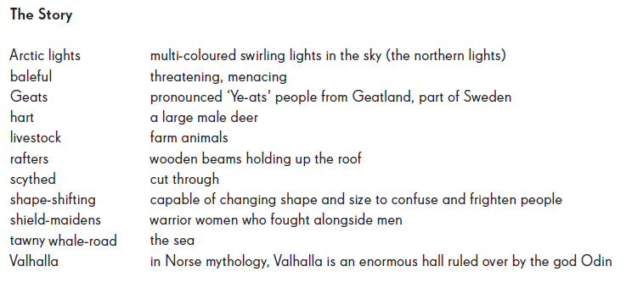
Characters and Glossary

