Slide 1
Don Quixote

Slide 2
Introduction to the Story
Quixada wants to be a knight.
With his imagination caught by the novels of knightly chivalry he loves to read, he sets out on an adventure to recreate the knightly quests of the past.

Slide 3
To his friends and family it appears he has gone mad – he mistakes inns and innkeepers for castles and kings, windmills for giants and herds of sheep for armies of enemy knights.
As Don Quixote, he possesses all the knightly virtues of his enchanted vision – he is courageous, fair, generous and courteous.

Slide 4
love
Love is to feel and show great affection for another person or group of people.

Slide 5
service
Service is working hard for a person, organisation or country. Helping other people.

Slide 6
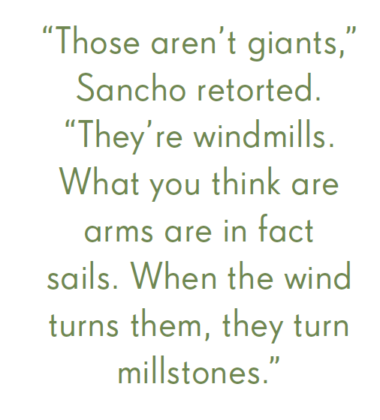

Slide 7
“It just shows,” replied Don Quixote, “on the edge of victory, my old enemy the enchanter turned the armies into a flock of sheep. Never mind, Sancho. Another adventure awaits us another day.”

Slide 8
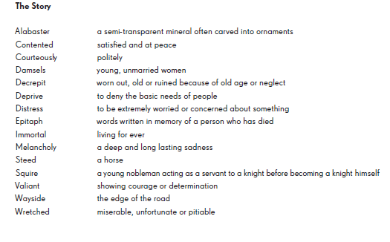
Characters and Glossary

