Slide 1

El Cid

Slide 2
Introduction to the Story
El Cid was an 11th Century Spanish knight. He lead large armies into battle with the Moors from North Africa. He was brave, courageous, but also honest and humble. He stood up to King Alfonso, challenged him to be honest, and was merciful with his enemies.

Slide 3

honesty
Honesty is to be true to yourself and other people.

Slide 4

humility
Humility is to put the needs of others before your own, and be willing to take care of others as you take care of yourself.

Slide 5
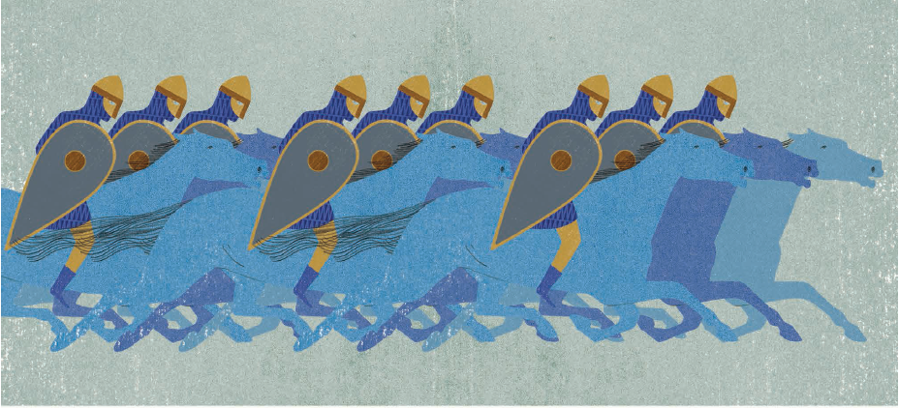

Slide 6
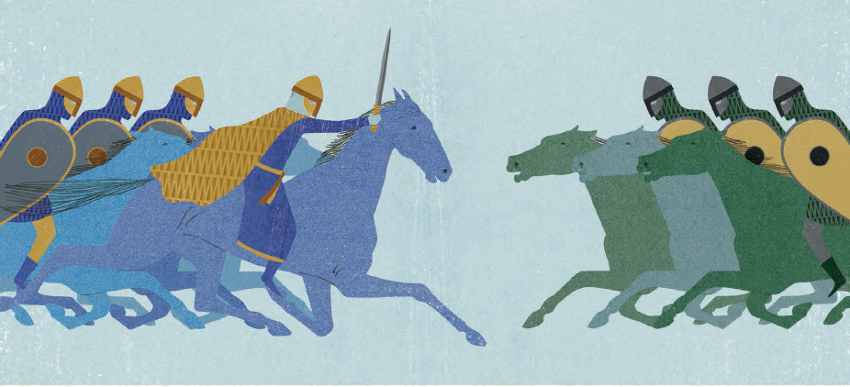

Slide 7
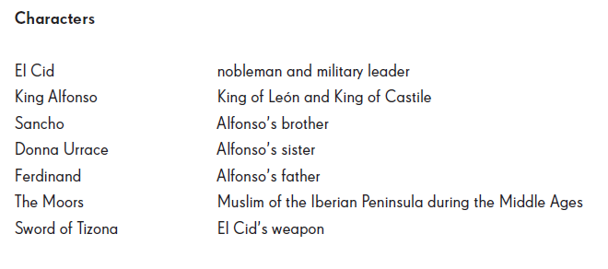
Characters and Glossary

