Slide 1

Gareth & Lynette

Slide 2
Introduction to the Story
Gareth is the younger son of the King or Orkney. His father is a knight, his older brothers are knights. He wants to be a knight. His mother eventually allows him to go on his own quest to prove himself as being worthy of becoming a knight.

Slide 3
Introduction to the Story
To become a knight, Gareth needs to be disciplined. He needs to work hard, and prove himself to others. He also needs to be brave. King Arthur gives Gareth a chance to prove himself, which he does.

Slide 4

Self-discipline
Self Discipline is the ability to control yourself and be very organised.

Slide 5

courage
Courage is having the strength and will to know what you should do even though you may be afraid.

Slide 6
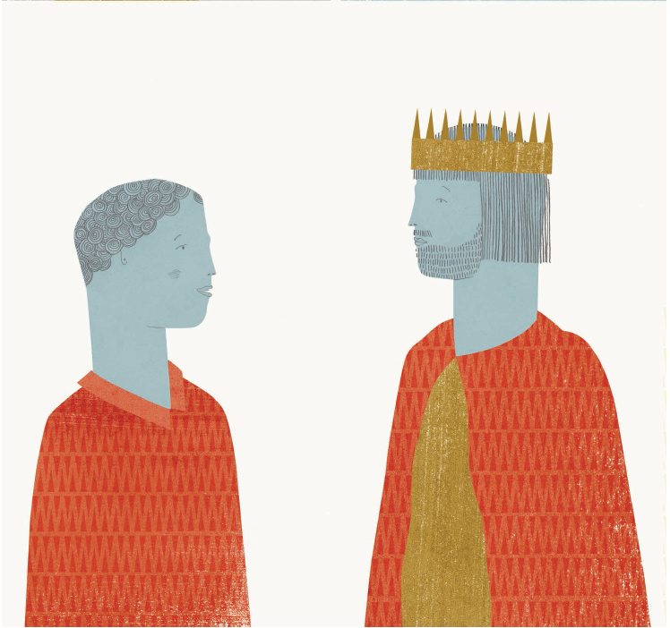
Gareth & King Arthur

Slide 7
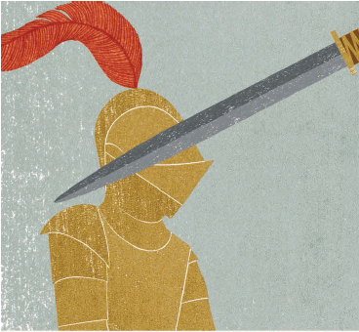
“Oh mercy!” said Lynette, “What a man you are! How patient, how dauntless! I am sure you must come of noble blood; for never did a woman treat a knight so shamefully as I have done you, and you have endured it all with gentleness and courtesy, never answering a word back again. I am sorry that I have treated you so.”

Slide 8
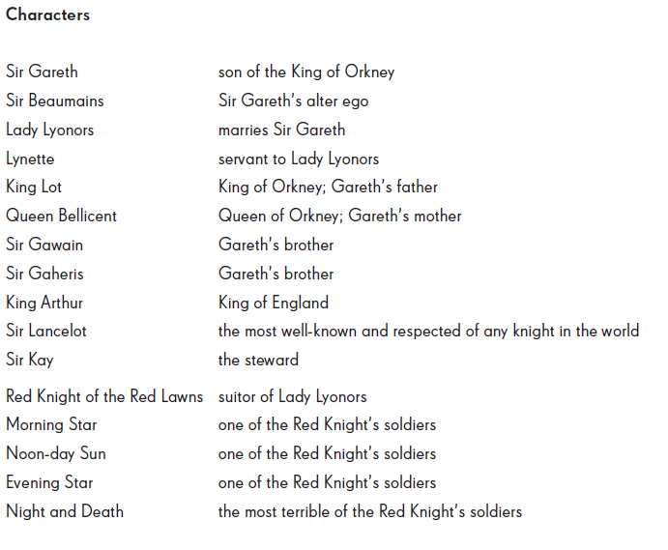
Characters and Glossary

Slide 9
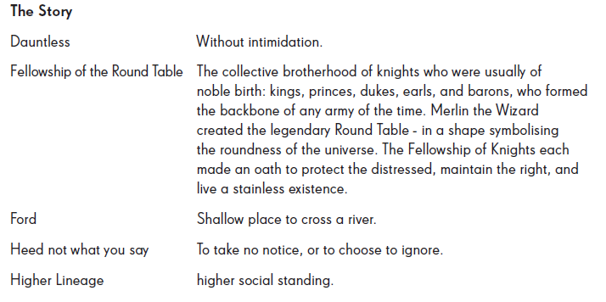
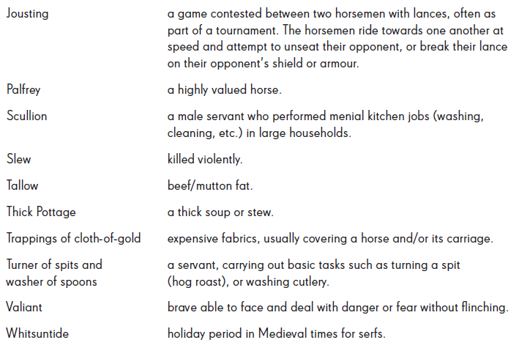
Characters and Glossary

