Slide 1
Joan of Arc

Slide 2
Introduction to the Story
Joan is a young peasant girl. She couldn’t read or write, and didn’t go to school. Before she turned 19 years old, though, she was leading armies of over ten thousand soldiers.

Slide 3
Introduction to the Story
Some people thought Joan was mad; others thought she was well-spoken and thoughtful. Some people even thought she was a witch. Joan inspired a nation, served her country, but gained many enemies, who would ultimately take her life.

Slide 4
service
Service is working hard for a person, organisation or country. Helping other people.

Slide 5
courage
Courage is having the strength and will to know what you should do even though you may be afraid.

Slide 6
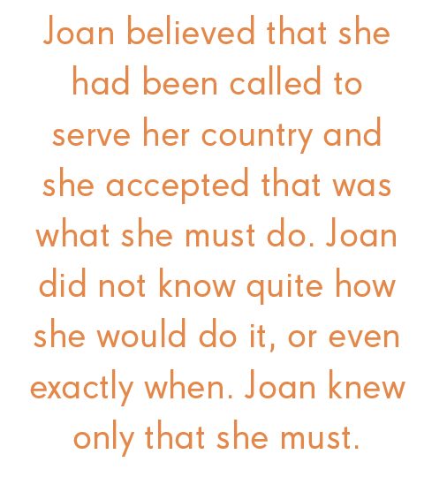

Slide 7
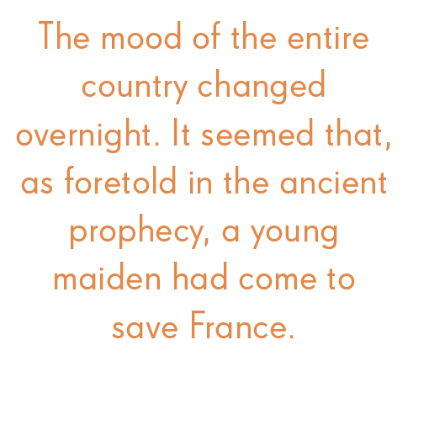

Slide 8
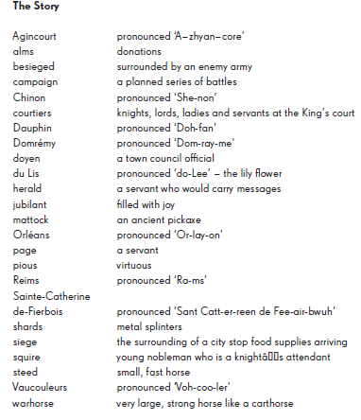
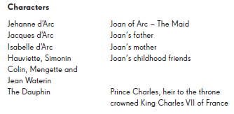
Characters and Glossary

