Slide 1



What is the ‘good life’?

Slide 2

With a partner discuss the following questions:
What is a good life?
What makes you happy?
What is the main aim of life?
What do people live for?

Slide 3
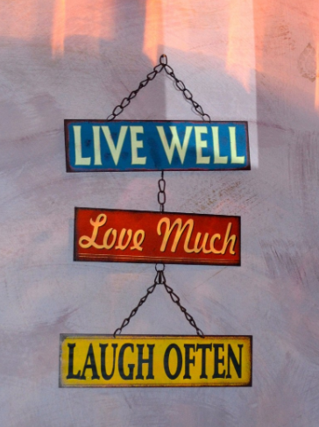
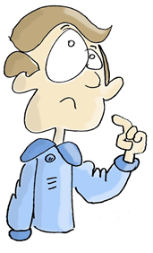
Think about your life and the people you know:
Describe someone from your life who you think lives a good life.
What is it about that person’s life that you think is attractive?
What features of their life would you like to emulate?

Slide 4

Journal Entry
Write a journal entry reflecting on the questions you discussed and describing the kind of person you would like to become.
Which values would you emphasise?
Why are these values the most important to you?

Slide 5

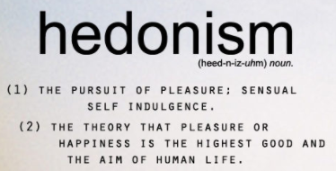



Read the information sheet about different philosophies on the meaning of life:
Which of the definitions do you most relate to at the moment?
Which do you think is most likely to lead to a well-lived life?
How will following the different philosophies affect how people live their lives and the choices they make?
What type of person might they become?
Are there any examples of the ‘good life’ not covered here? What might they be?

Slide 6


Watch the following video:
Is this a helpful overview of the positions?
What do you think of Aristotle’s idea of ‘eudaimonia’ (happiness/flourishing)?

Slide 7
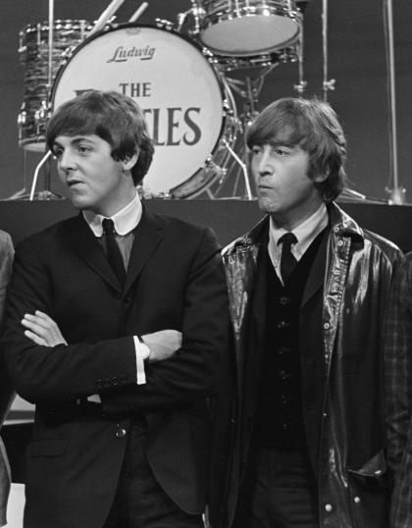
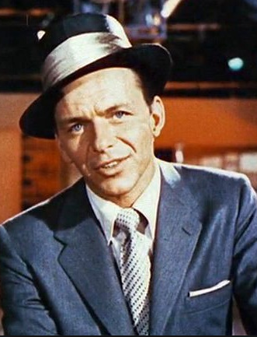
In 1965 Lennon and McCartney wrote a song called ‘In My Life’, performed by The Beatles. Listen to the song – how does their song answer the question ‘What is the Good Life?’
How did Frank Sinatra answer the question, ‘What is the Good Life?’ in his song, ‘My Way’?

Slide 8
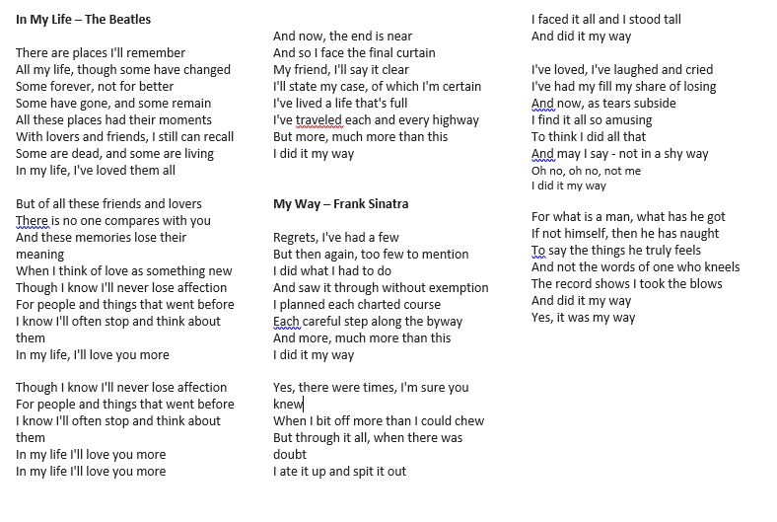
Compare the content of these two songs with each other: who came closer to setting out the most attractive vision of the ‘good life’ on this evidence, The Beatles or Frank Sinatra?
What would Aristotle make of:
The Beatles’ ‘In My Life’?
Frank Sinatra’s ‘My Way’?
Would it line up with his understanding of the good life?

Slide 9
Aristotle has in mind, as a minimum, a life that is marked by:
Courage, rather than rashness or cowardice;
Self-control, rather than self-indulgence, or insensibility;
Generosity, rather than miserliness, or wastefulness;
Friendliness and civility, rather than rudeness, or flattery;
Tact and discretion, rather than boorishness, or buffoonery;
Truthfulness, and integrity, rather than false modesty, or bragging;
Good temperedness, rather than prickliness, or indifference to the concerns of others;
Fairness, rather than unfairness.
      How do you think you can develop these virtues?
      Do you think it is possible to become more courageous, kind, generous, etc.?

