Slide 1
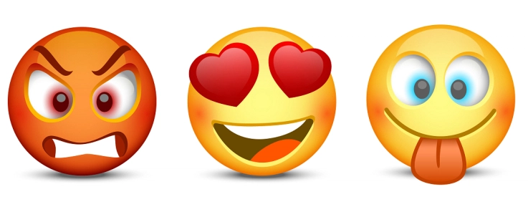
Emotions and Virtues

Slide 2
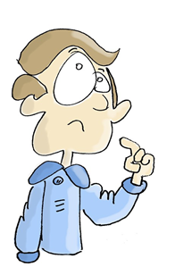
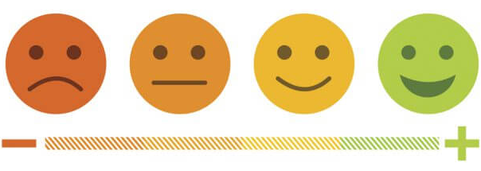
What do you think about when you hear the word ‘emotion’?
What does this word mean to you?
How many different types of emotions can you name?
Can you group the emotions you have named?
Do you ever feel more of one emotion or one type of emotion?

Slide 3
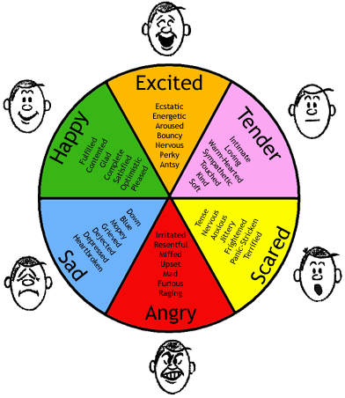
Emotion Video
Can you identify the 7 emotions in the video?
Watch the video and pause after every clip to discuss.

Slide 4
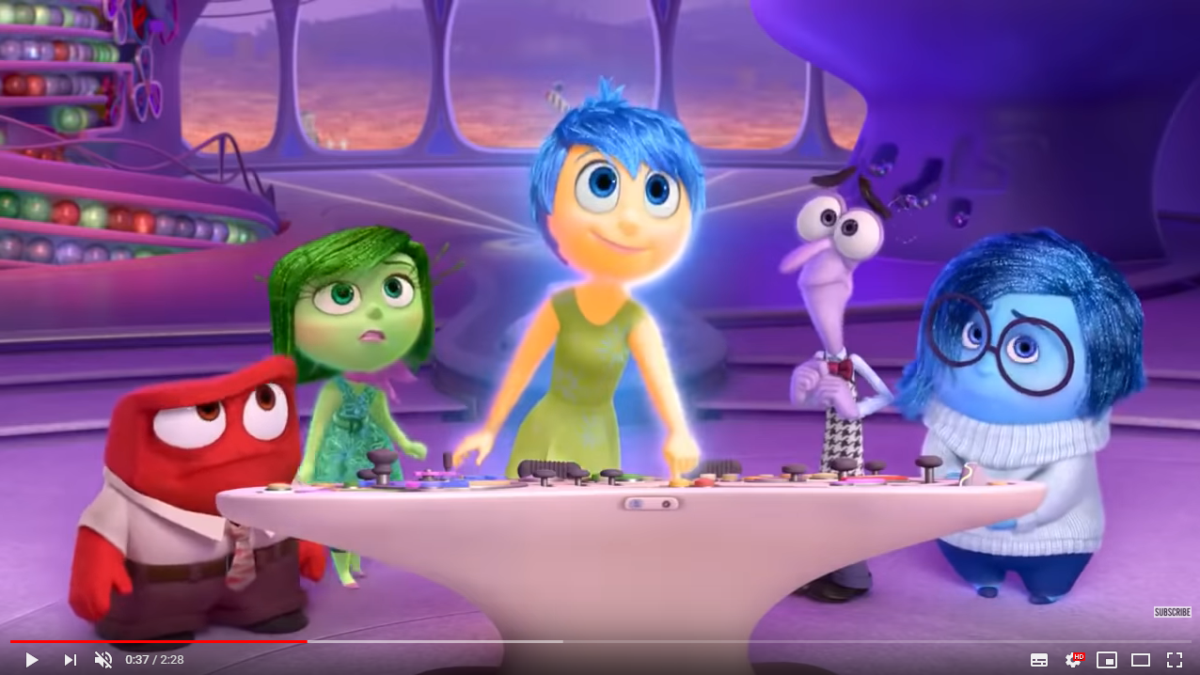
What do you think this film tells us about our emotions and actions?
Thoughts create feelings
Feelings create behaviour
Behaviour reinforces thoughts
Watch the video and pause after every clip to discuss.

Slide 5
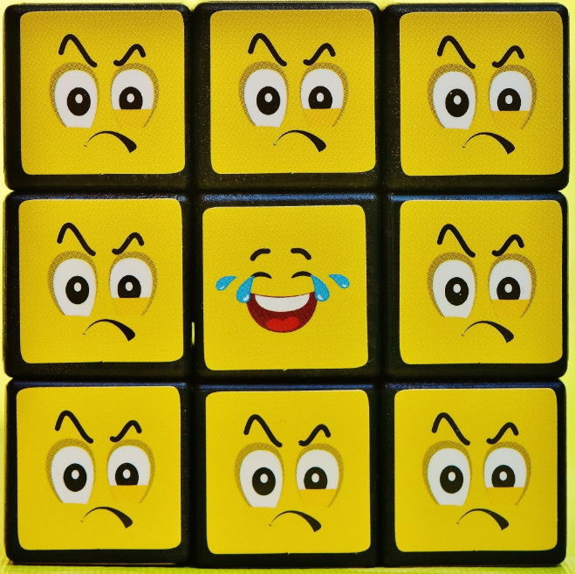
Look at the situation cards and think about what the person might be thinking, feeling and then doing in that scenario.
Identify the thoughts, feelings and actions of each character in the different situations.
Would it be possible for two people in the same situation to feel different emotions?

Slide 6
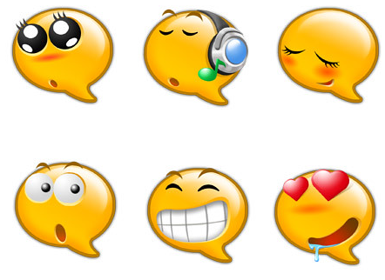
Read the following statements and decide to what extent you agree. Give reasons for your opinions.
I can choose how I feel.
It is important to show people how I feel.
It is important to be able to control my emotions
I am confident that I can control my emotions.

Slide 7
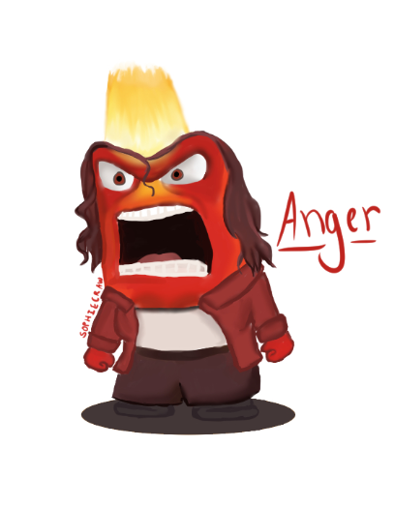
“Anybody can become angry, that is easy, but to be angry with the right person, to the right degree, at the right time, for the right purpose and in the right way… that is not easy.” - Aristotle
Do you agree with this statement from Aristotle?
Why is it so difficult for us to control our emotions?

Slide 8
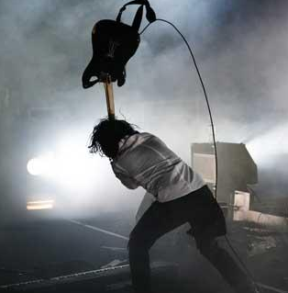
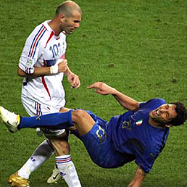
Sometimes, when we experience very strong emotions such as anger or disappointment, we can act quickly and do something that we later regret.
Can you think of any famous examples of people losing control of a situation because of their emotions?

Slide 9
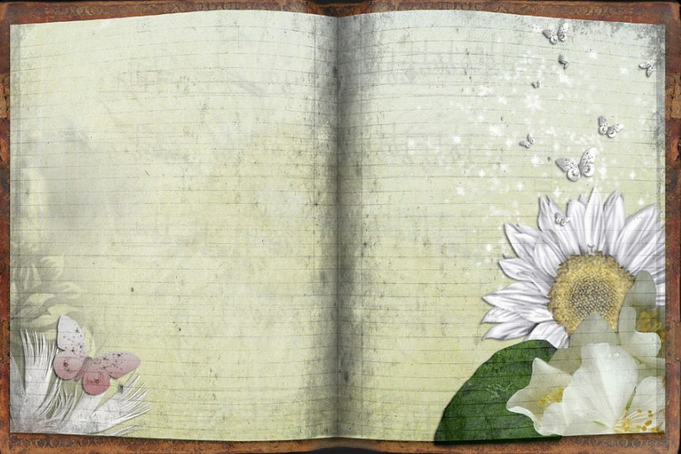
Life example
Can you think of an example from your life where you have experienced very strong emotions?
What were the circumstances surrounding that event?
Write a diary entry recording that event and how you responded.

Slide 10
Write up a follow-up paragraph to your journal entry describing an alternative response, demonstrating that you have reflected on the situation.
How might this different response have changed the situation for better or worse?
Can you think of some strategies to help you stop and think before you respond in any situation?
For Aristotle, doing the right thing starts with having the right emotion.

Slide 11
Look at the following scenarios. Think about what a purely emotional response would be and then what a more rational response might be:
A teacher blames you for something you didn't do;
The sports team you’re investing time and energy in keeps losing;
You’re expecting to meet a friend, and they back out at the last moment for no good reason;
You do poorly on a test because you didn't spend any time revising.
Another way of thinking about it would be to ask yourself these questions:
Name the feeling.
What's a helpful way to deal with it?
What's a harmful way to deal with it?

