Slide 1
1

Slide 2
2

Slide 3
3

Slide 4
The Knightly Virtues
4

Slide 5








The Knightly Virtues
5

Slide 6
8

Slide 7

Anne Frank

Slide 8
Introduction to the Story
Anne Frank was a German girl, born in 1929, and moved to Holland with her family in 1933. Her family were Jewish, who were persecuted by the Nazis before and during the Second World War.
In July 1942, Anne and her family went into hiding. Anne began to keep a diary about her time in hiding. Anne was able to be completely honest in her diary, which she kept for over two years, until her and her family were captured by Nazi soldiers.

Slide 9

humility
Humility is to put the needs of others before your own, and be willing to take care of others as you take care of yourself.

Slide 10

honesty
Honesty is to be true to yourself and other people.

Slide 11
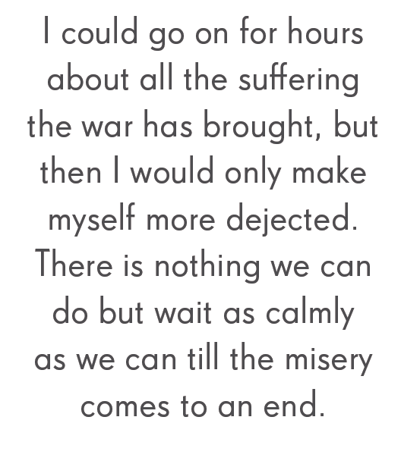

Slide 12
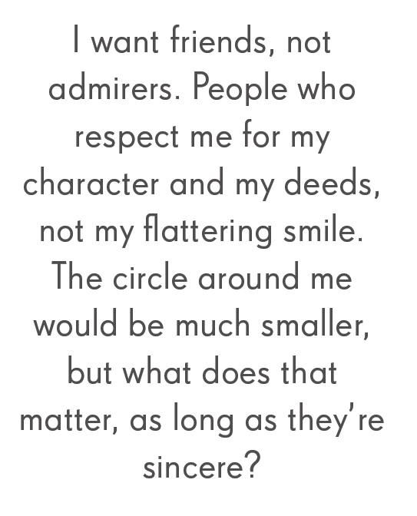

Slide 13

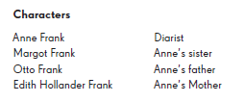
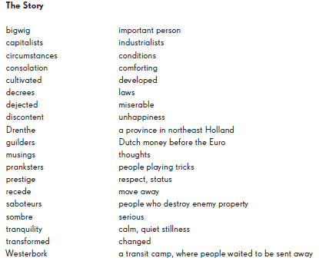
Characters and Glossary

Slide 14

Beowulf

Slide 15

Introduction to the Story
Beowulf was a brave warrior who served his country by fighting monsters, giants and beasts who terrorised the people of Scandinavia.
No monsters was too scary, no giant too tall for Beowulf. When he heard that King Hrothgar wanted him to fight Grendel, he went straight to their aid.

Slide 16

courage
Courage is having the strength and will to know what you should do even though you may be afraid.

Slide 17
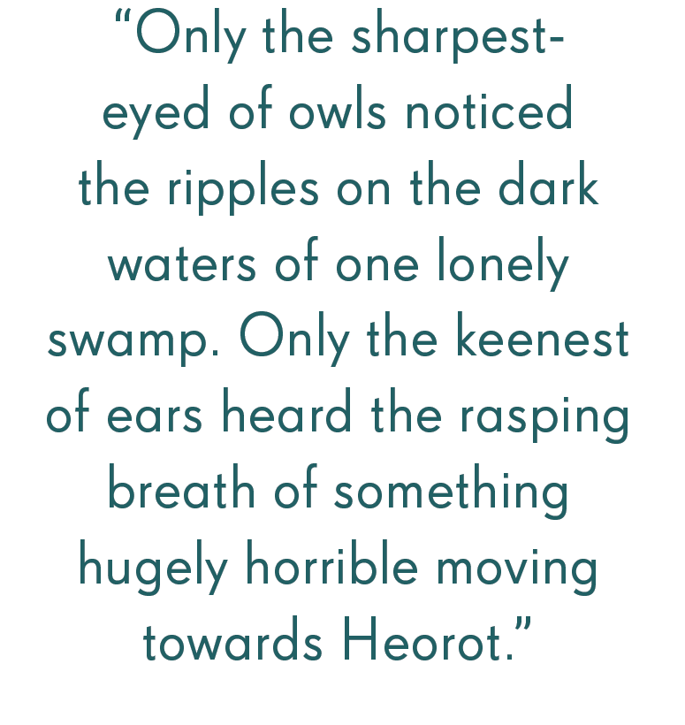

Slide 18
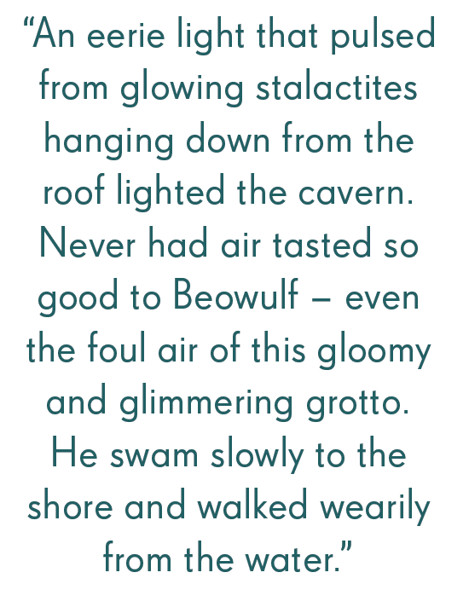

Slide 19
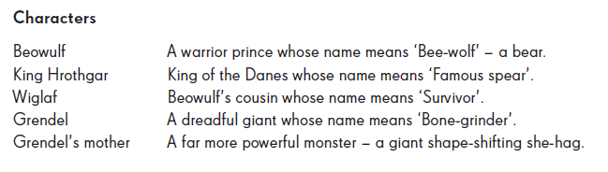
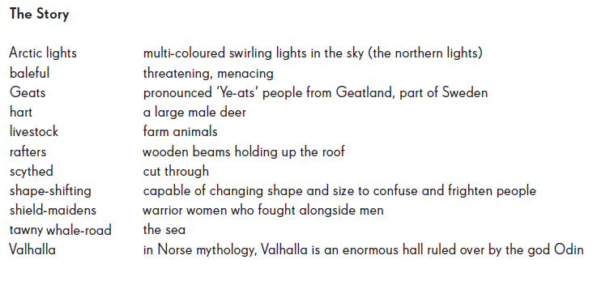
Characters and Glossary

Slide 20

Don Quixote

Slide 21

Introduction to the Story
Quixada wants to be a knight.
With his imagination caught by the novels of knightly chivalry he loves to read, he sets out on an adventure to recreate the knightly quests of the past.

Slide 22
To his friends and family it appears he has gone mad – he mistakes inns and innkeepers for castles and kings, windmills for giants and herds of sheep for armies of enemy knights.
As Don Quixote, he possesses all the knightly virtues of his enchanted vision – he is courageous, fair, generous and courteous.

Slide 23

love
Love is to feel and show great affection for another person or group of people.

Slide 24

service
Service is working hard for a person, organisation or country. Helping other people.

Slide 25
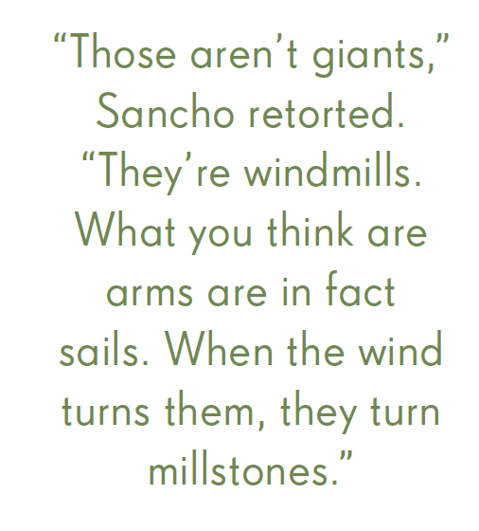

Slide 26
“It just shows,” replied Don Quixote, “on the edge of victory, my old enemy the enchanter turned the armies into a flock of sheep. Never mind, Sancho. Another adventure awaits us another day.”

Slide 27
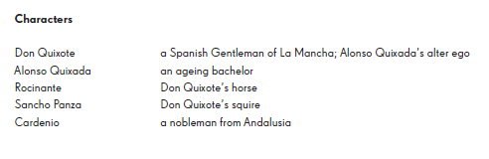
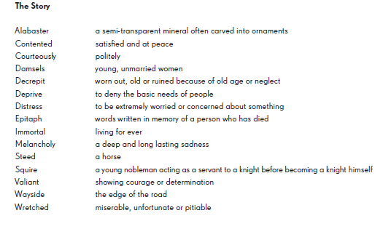
Characters and Glossary

Slide 28

El Cid

Slide 29
Introduction to the Story
El Cid was an 11th Century Spanish knight. He lead large armies into battle with the Moors from North Africa. He was brave, courageous, but also honest and humble. He stood up to King Alfonso, challenged him to be honest, and was merciful with his enemies.

Slide 30

honesty
Honesty is to be true to yourself and other people.

Slide 31

humility
Humility is to put the needs of others before your own, and be willing to take care of others as you take care of yourself.

Slide 32
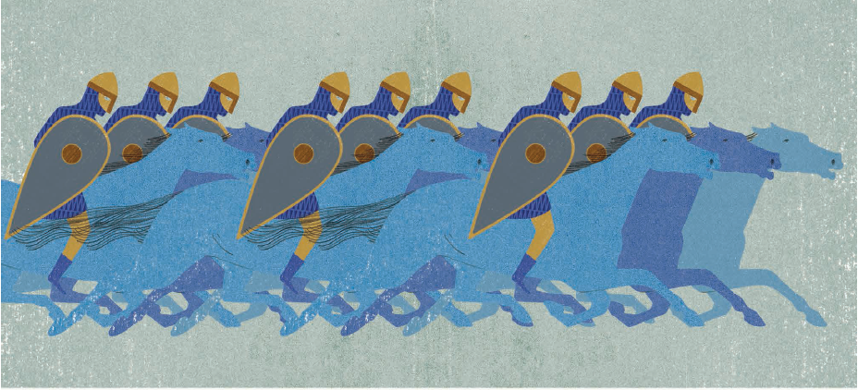

Slide 33
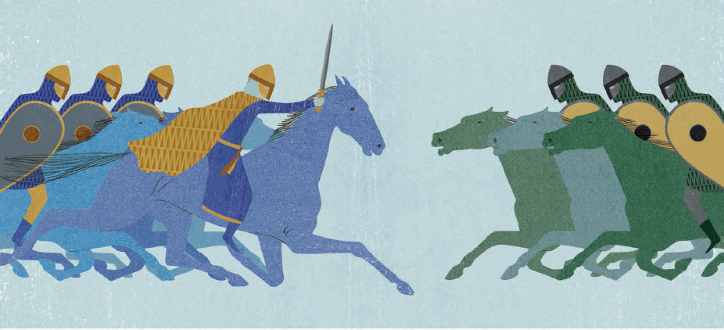

Slide 34
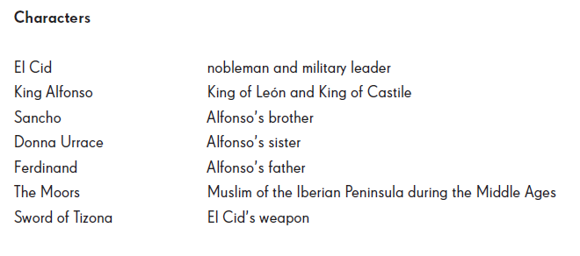
Characters and Glossary

Slide 35

Gareth & Lynette

Slide 36
Introduction to the Story
Gareth is the younger son of the King or Orkney. His father is a knight, his older brothers are knights. He wants to be a knight. His mother eventually allows him to go on his own quest to prove himself as being worthy of becoming a knight.

Slide 37
Introduction to the Story
To become a knight, Gareth needs to be disciplined. He needs to work hard, and prove himself to others. He also needs to be brave. King Arthur gives Gareth a chance to prove himself, which he does.

Slide 38

Self-discipline
Self Discipline is the ability to control yourself and be very organised.

Slide 39

courage
Courage is having the strength and will to know what you should do even though you may be afraid.

Slide 40
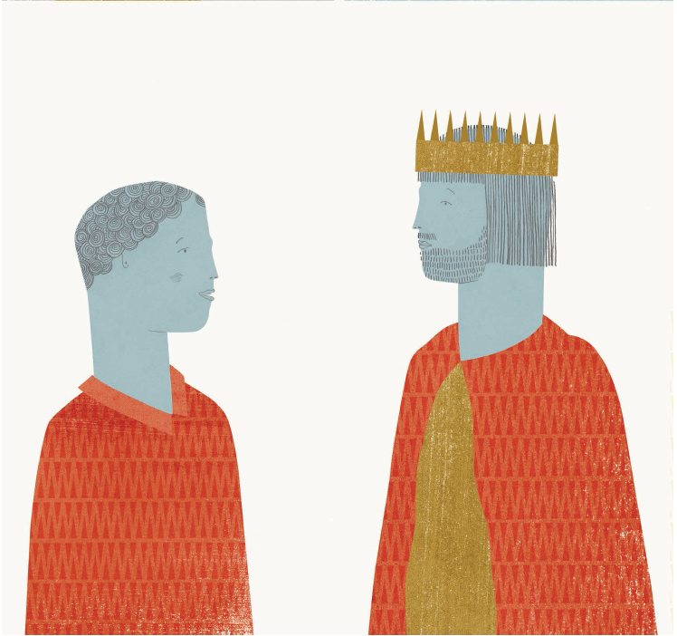
Gareth & King Arthur

Slide 41
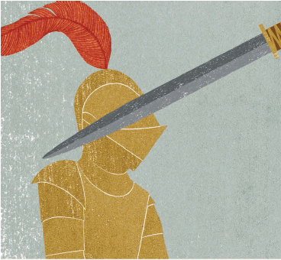
“Oh mercy!” said Lynette, “What a man you are! How patient, how dauntless! I am sure you must come of noble blood; for never did a woman treat a knight so shamefully as I have done you, and you have endured it all with gentleness and courtesy, never answering a word back again. I am sorry that I have treated you so.”

Slide 42
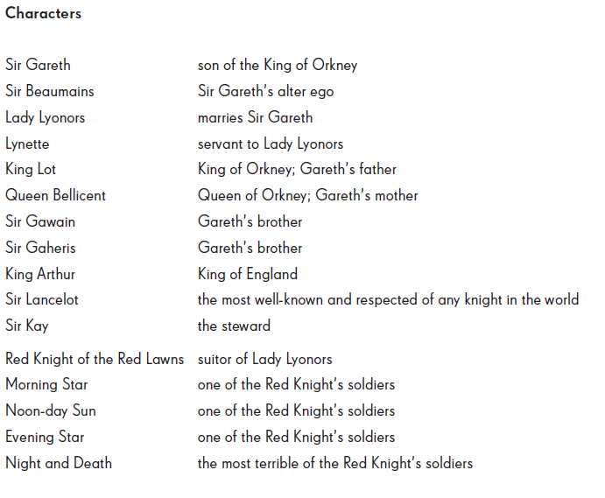
Characters and Glossary

Slide 43
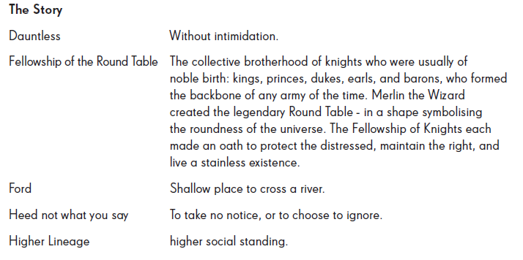
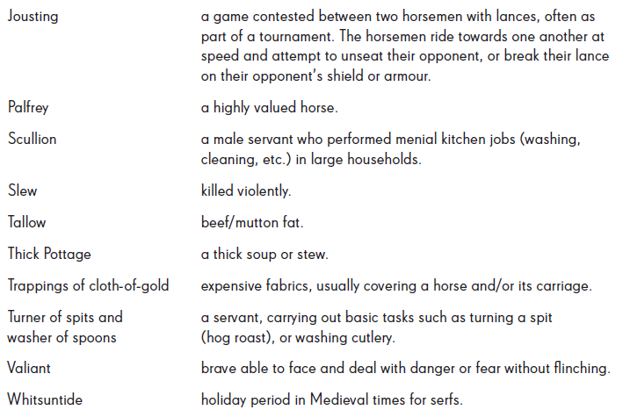
Characters and Glossary

Slide 44

Joan of Arc

Slide 45

Introduction to the Story
Joan is a young peasant girl. She couldn’t read or write, and didn’t go to school. Before she turned 19 years old, though, she was leading armies of over ten thousand soldiers.

Slide 46
Introduction to the Story
Some people thought Joan was mad; others thought she was well-spoken and thoughtful. Some people even thought she was a witch. Joan inspired a nation, served her country, but gained many enemies, who would ultimately take her life.

Slide 47

service
Service is working hard for a person, organisation or country. Helping other people.

Slide 48

courage
Courage is having the strength and will to know what you should do even though you may be afraid.

Slide 49
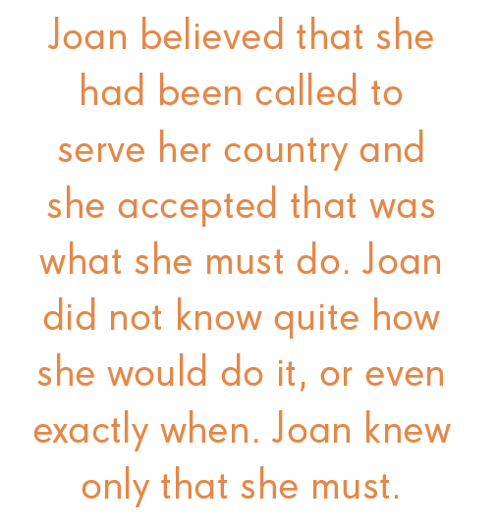

Slide 50
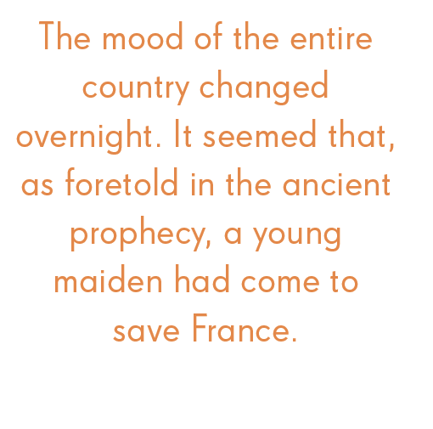

Slide 51
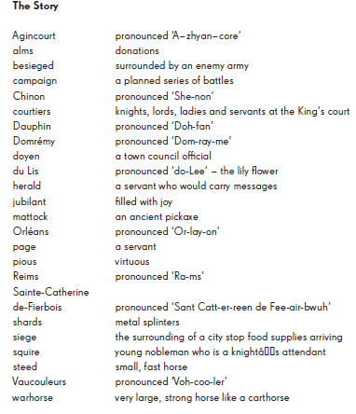
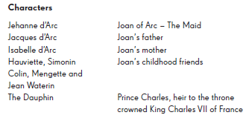
Characters and Glossary

Slide 52

The Merchant of Venice

Slide 53
Introduction to the Story
The Merchant of Venice is a famous play by William Shakespeare. Each character has his or her own moral challenges during the story. Portia is a very virtuous character throughout the story, and is famous for her virtue, self-discipline and gratitude.

Slide 54

gratitude
Gratitude is to feel or to show appreciation for something that has been done for you.

Slide 55

Self-discipline
Self Discipline is the ability to control yourself and be very organised.

Slide 56
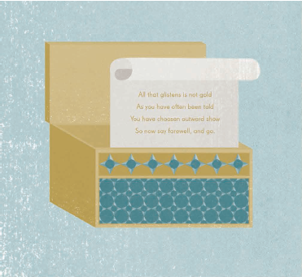
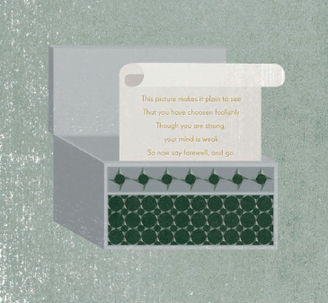
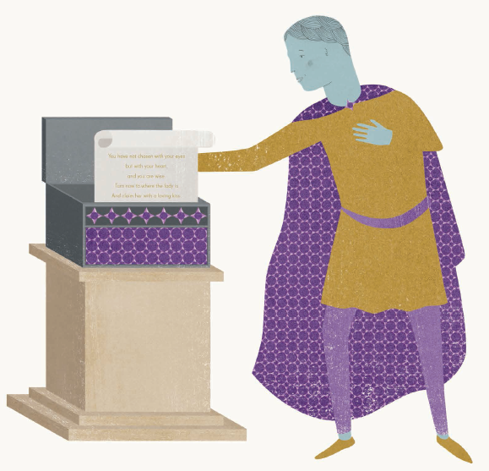

Slide 57
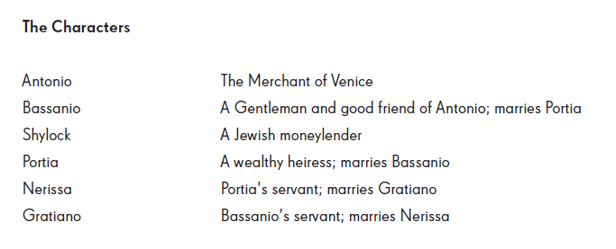
Characters and Glossary

Slide 58
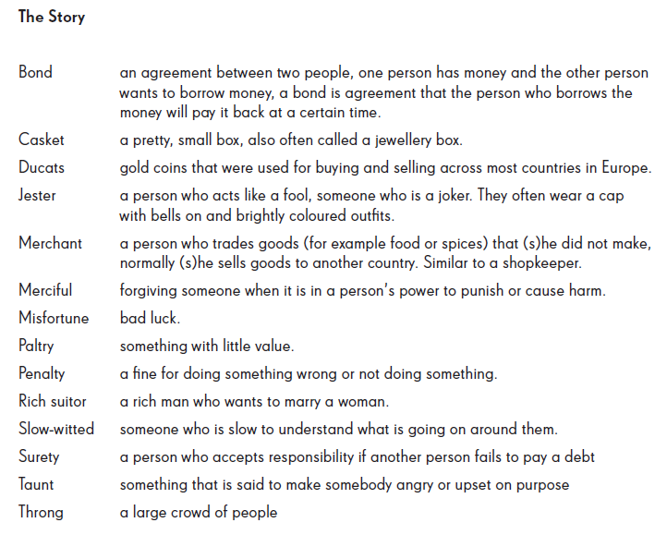
Characters and Glossary

Slide 59

Robin Hood

Slide 60

Introduction to the Story
Sir Robin of Locksley is better known as Robin Hood. He was a knight who served King Richard, and became a hero to the poor people of Nottingham. He and his followers believed in charity and justice for all, regardless of position of entitlement.

Slide 61

charity
Charity is to help other people, who are more in need than yourself.

Slide 62

justice
Justice is to have an understanding of what it is to uphold what is right.

Slide 63
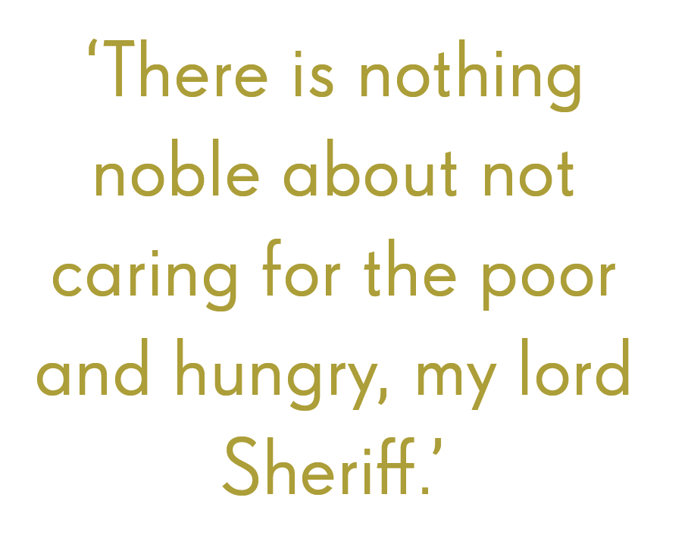

Slide 64
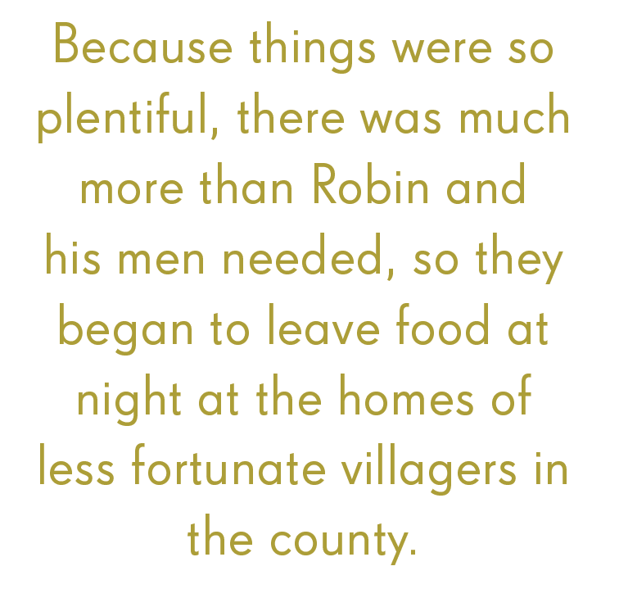

Slide 65
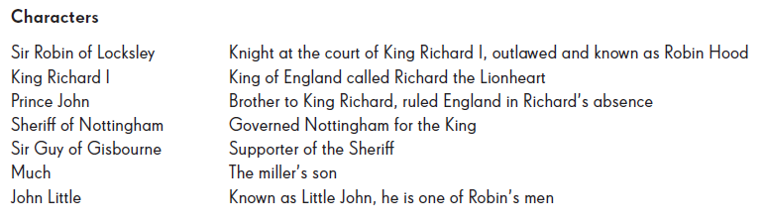
Characters and Glossary

Slide 66
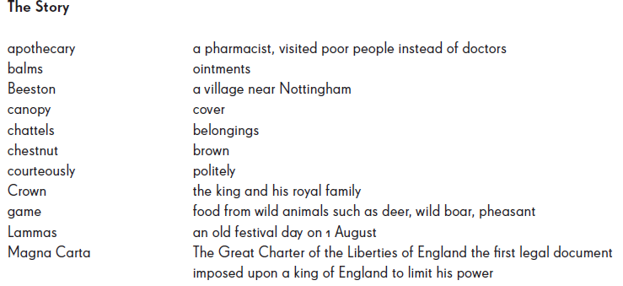
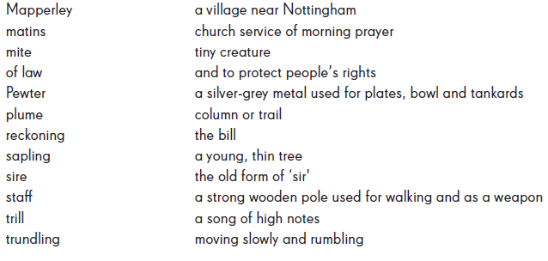
Characters and Glossary

Slide 67


Rosa Parks

Slide 68
Introduction to the Story
Rosa Parks was an African-American civil rights activist. She became famous in the 1950s, when she stood up to oppression and refused to give up her seat on a bus in Montgomery, Alabama. At that time, black people and white people lived in segregation. Rosa’s actions in Montgomery became a major part of the Civil Rights movement in America.

Slide 69

justice
Justice is to have an understanding of what it is to uphold what is right.

Slide 70

courage
Courage is having the strength and will to know what you should do even though you may be afraid.

Slide 71
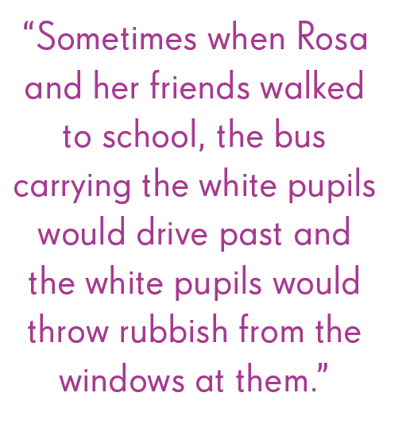

Slide 72
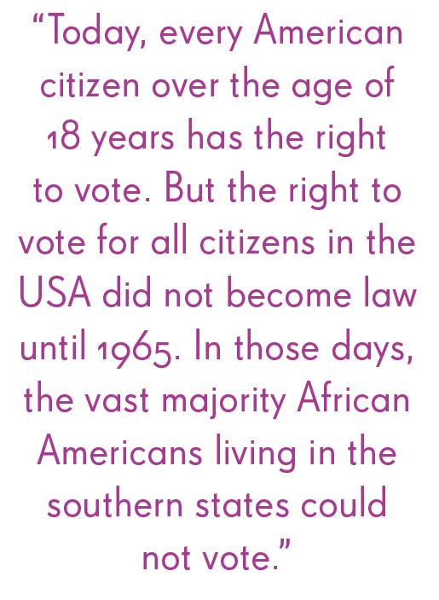

Slide 73
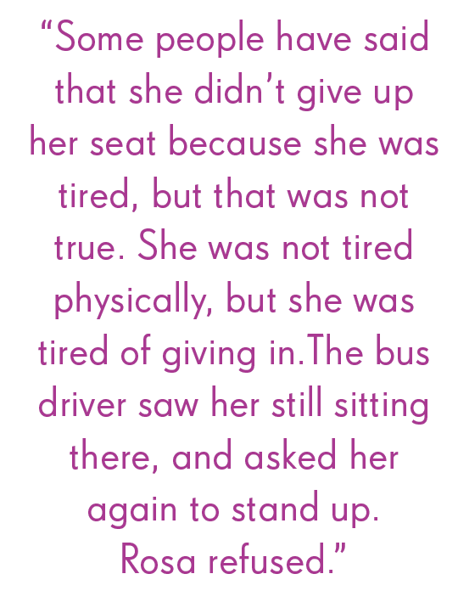

Slide 74
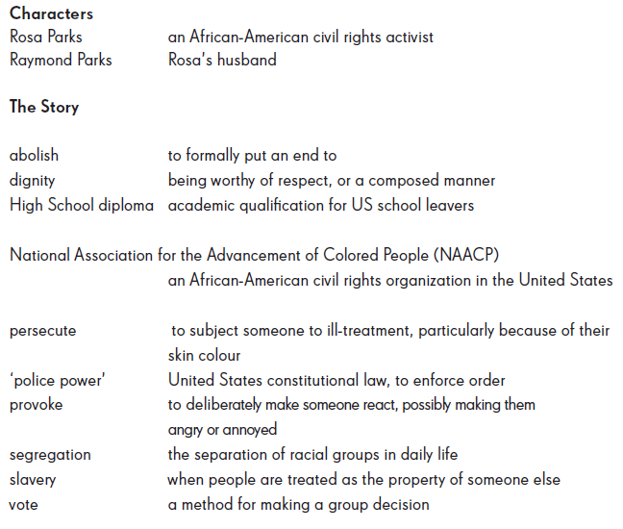
Characters and Glossary

