Slide 1

The Merchant of Venice

Slide 2
Introduction to the Story
The Merchant of Venice is a famous play by William Shakespeare. Each character has his or her own moral challenges during the story. Portia is a very virtuous character throughout the story, and is famous for her virtue, self-discipline and gratitude.

Slide 3

gratitude
Gratitude is to feel or to show appreciation for something that has been done for you.

Slide 4

Self-discipline
Self Discipline is the ability to control yourself and be very organised.

Slide 5

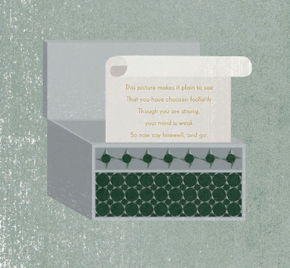
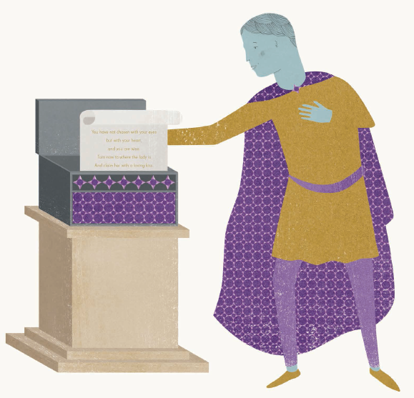

Slide 6
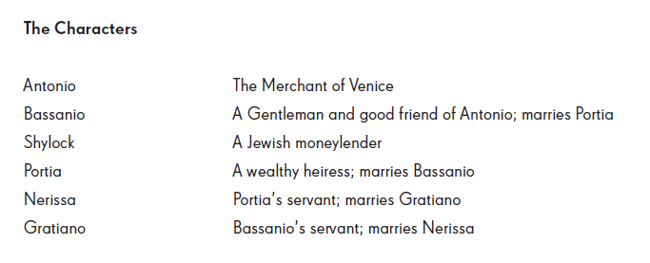
Characters and Glossary

Slide 7
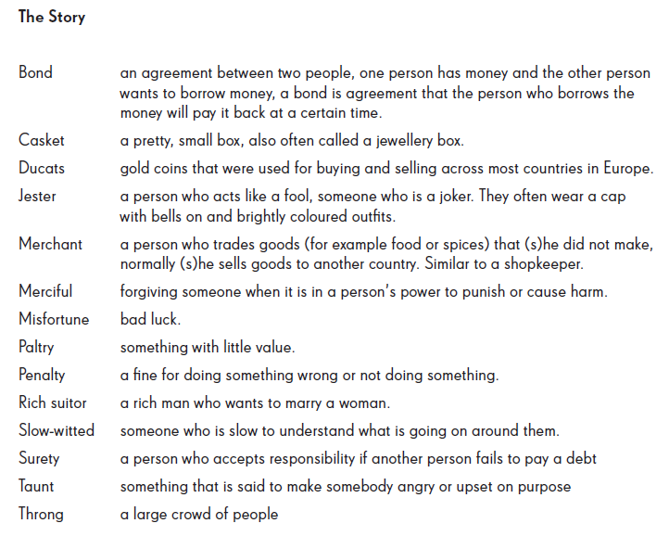
Characters and Glossary

