Slide 1
Robin Hood

Slide 2
Introduction to the Story
Sir Robin of Locksley is better known as Robin Hood. He was a knight who served King Richard, and became a hero to the poor people of Nottingham. He and his followers believed in charity and justice for all, regardless of position of entitlement.

Slide 3
charity
Charity is to help other people, who are more in need than yourself.

Slide 4
justice
Justice is to have an understanding of what it is to uphold what is right.

Slide 5
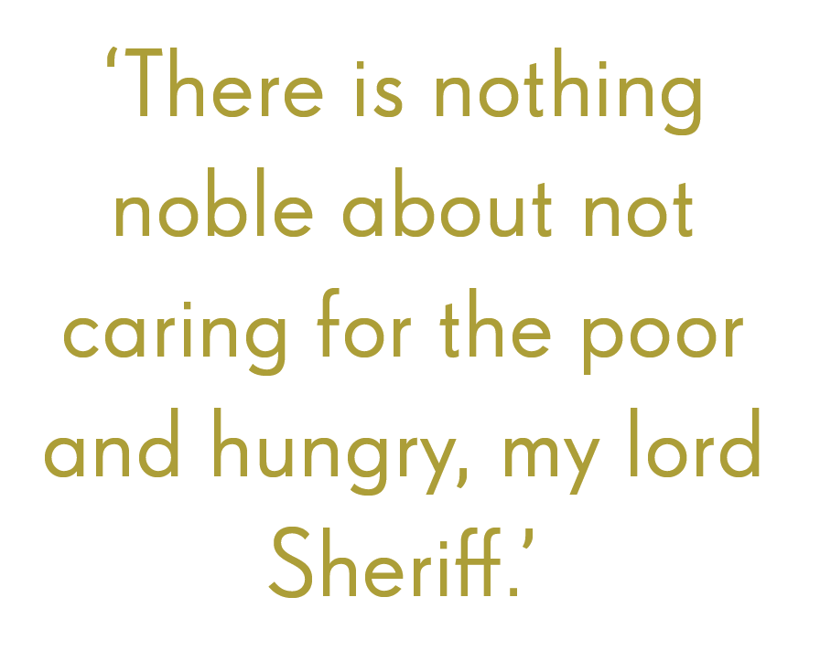

Slide 6
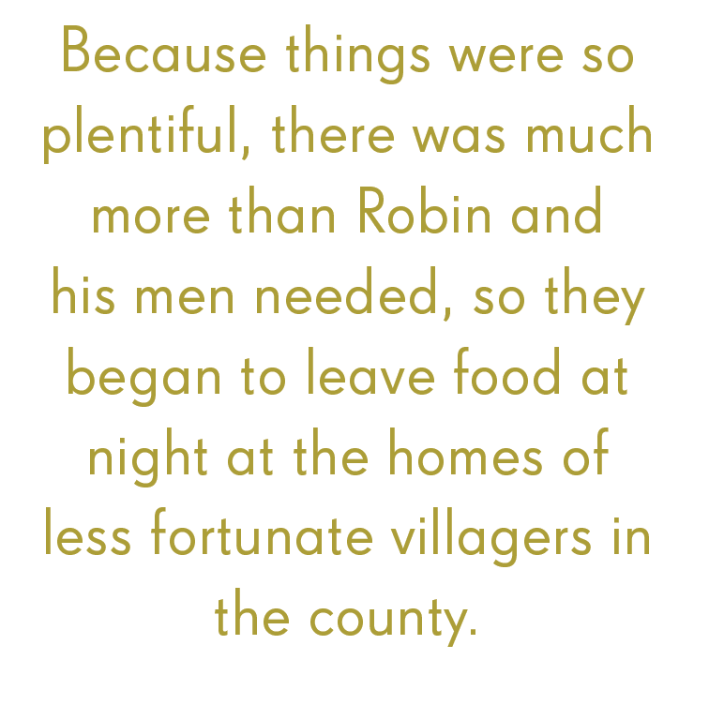

Slide 7
Characters and Glossary

Slide 8
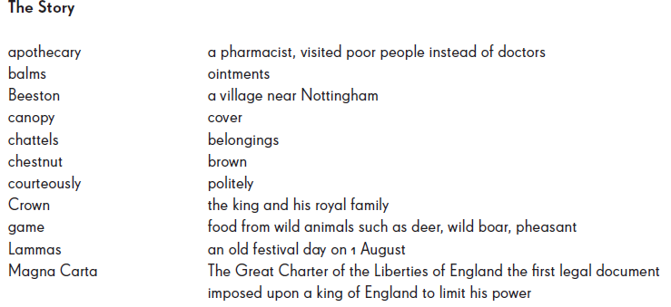
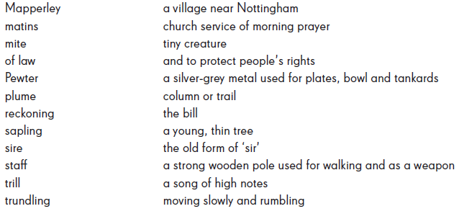
Characters and Glossary

