Slide 1


Rosa Parks

Slide 2
Introduction to the Story
Rosa Parks was an African-American civil rights activist. She became famous in the 1950s, when she stood up to oppression and refused to give up her seat on a bus in Montgomery, Alabama. At that time, black people and white people lived in segregation. Rosa’s actions in Montgomery became a major part of the Civil Rights movement in America.

Slide 3

justice
Justice is to have an understanding of what it is to uphold what is right.

Slide 4

courage
Courage is having the strength and will to know what you should do even though you may be afraid.

Slide 5


Slide 6
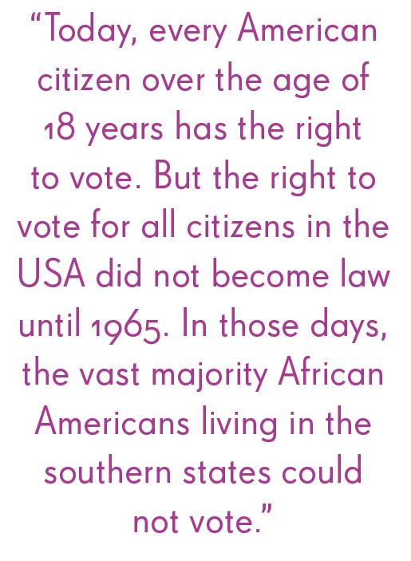

Slide 7
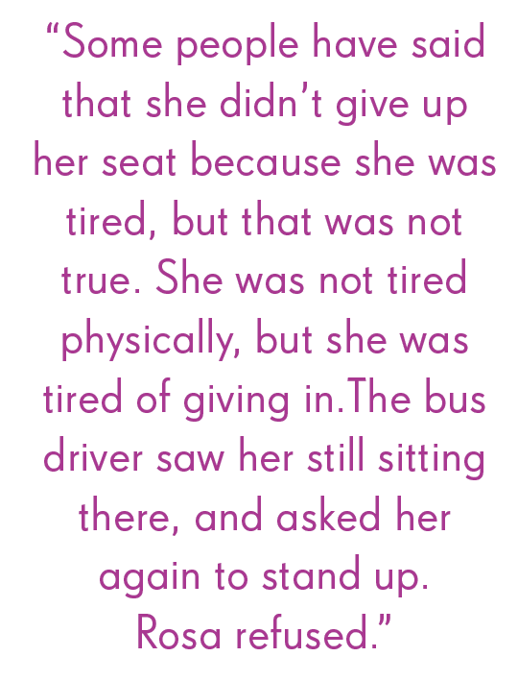

Slide 8
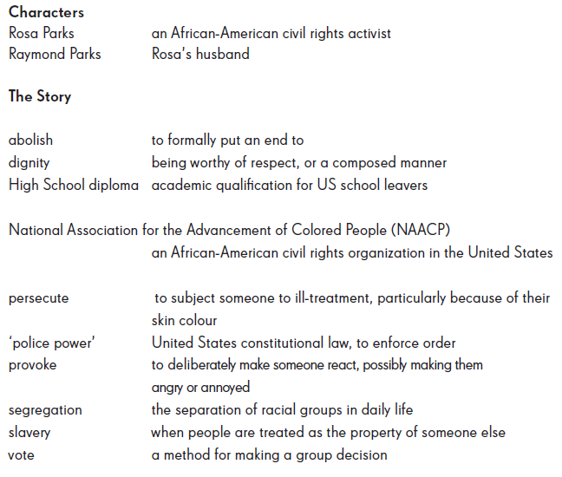
Characters and Glossary

