Slide 1
What makes a healthy relationship?

Slide 2
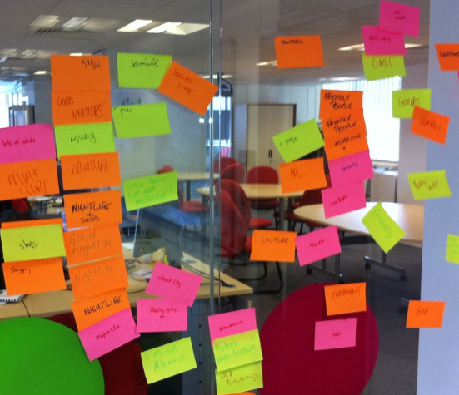
What words would you use to describe the features of a positive, healthy relationship?
Discuss with a partner.
Use post it notes to add to a ‘graffiti wall’ at the front of the class.
Write down a quick summary of the most common words on your wall, such as honesty, trust, respect, love and understanding.

Slide 3
Paper debate
Using the large A3 sheets with prompt questions – move around the room and write your ideas onto them. You are allowed to:
respond to the question by explaining your idea or viewpoint
respond to an idea or viewpoint someone else has written (either agreeing or disagreeing)
ask a question or respond to a question written by someone else.
All written comments must be respectful of others’ opinions, and they must not use inappropriate language or share personal experiences. Discuss the main themes from the responses as a group.

Slide 4
Paper debate questions
What are the features of an abusive relationship?
What should someone do if they think they are in an abusive relationship?
What could someone do if they were concerned that their friend was in an abusive relationship?
What are the emotional consequences for people involved in an abusive relationship?
What could happen to someone who was found to be abusive to their partner?

Slide 5
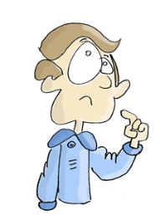
My Values
What matters to you in a relationship? Read the following statements and place each statement on a continuum from strongly disagree to strongly agree. Make this exercise a quiet, personal reflection.

Slide 6
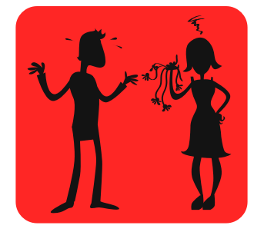
Everyone has a soulmate and dating is about trying to find “the one”
Being able to compromise is better than always getting your own way
A partner’s personality is more important than their looks
The most important thing in a relationship is to make your partner happy, no matter what
There is always likely to be one more dominant person in any relationship
If they really loved me, my partner would know what I wanted without having to be told

Slide 7
Share your reflections with the group and discuss:
Which of these beliefs is most likely to lead to a healthy relationship?
Why or how do you know?
Are there any beliefs that might lead to an unhealthy relationship?
Why or how do you know?
How might these beliefs affect how someone behaves in a relationship?

Slide 8
Features of a relationship
Read the six possible features of a relationship below. With a partner give an example of how each of these features of a relationship might be either healthy or unhealthy in practice.
Spending time together
Knowing each other’s family and friends
Having lots in common
Being open and honest
Humour
Never having an argument

Slide 9
Friends and family survey – ‘My Values’
Design a five-question survey for friends and family about their relationship values.
Make sure you are sensitive in your choice of questions and who you ask.
The questions should encourage debate about what makes a healthy relationship.

