Slide 1
Diet

Slide 2
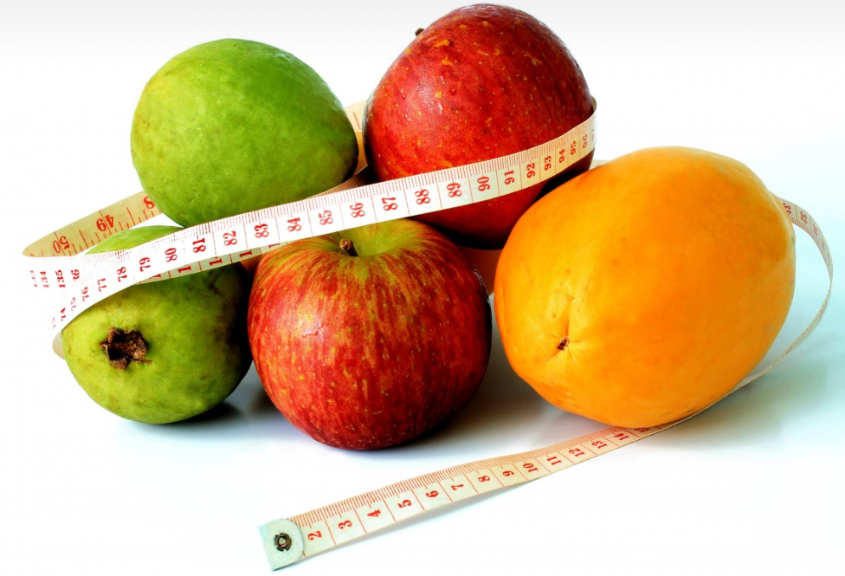
What would your perfect diet be if you could eat whatever you wanted?
What would be the consequences of eating this type of food?
What does this process tell us about the things we desire?
Why is it important to lead a healthy lifestyle?

Slide 3
Watch the clip of the film ‘Super Size Me’
What are the effects of his eating plan on his:
Physical health?
Mental health?
General well-being?
How does McDonalds encourage its customers to consume its food?
Why is this attractive? What are the danger of this for young people?

Slide 4
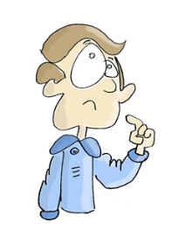
Eating and a ‘happy life’
How does eating play a part in living a ‘happy life’?
How can ensuring you have a healthy and balanced diet contribute to overall wellbeing?
Reflection activity
Write up your response to these questions from your own perspective in a journal entry.

Slide 5
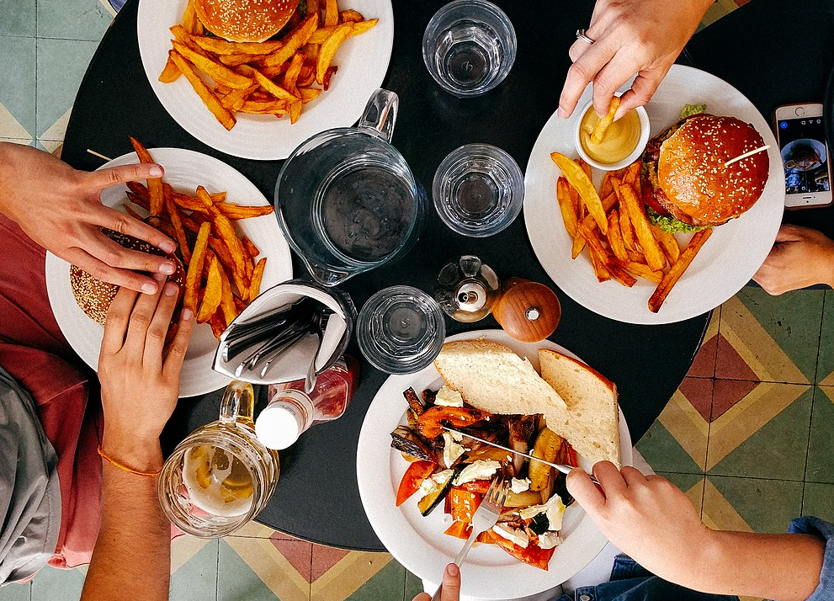
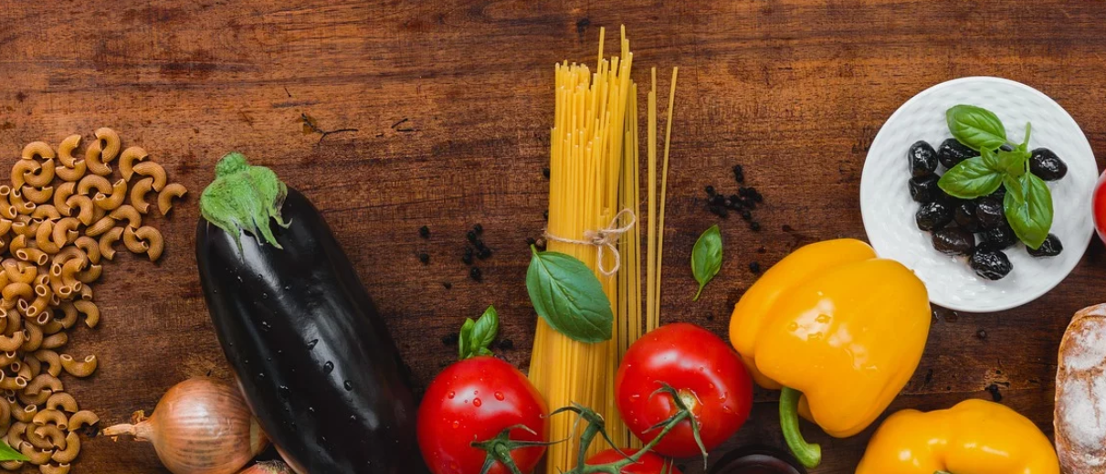
What activities and practices does maintaining a healthy and balanced diet require?
How might you go about practicing these activities in relation to food?
How might you encourage those in your school community to develop healthy diets?
Are there any creative ways you could plan opportunities as a group to help develop this?

Slide 6
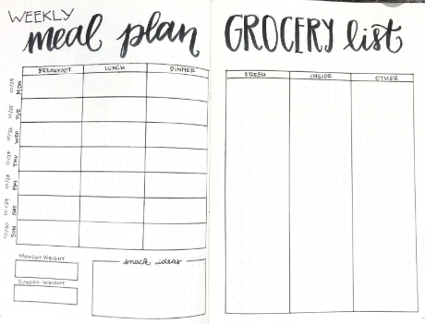
Food diary: watch what you eat!
Over a two-week period keep a food diary, and write about what you eat, when you eat it and how it affects you.
You need to observe what you eat, when you eat and notice how it affects you physically and mentally: you can choose to make changes in the light of what they notice.
Do you notice anything about eating certain foods at certain times e.g. late at night?
How does adding or removing certain change or affect you?

