Slide 1
The Online World
Using technology wisely

Slide 2
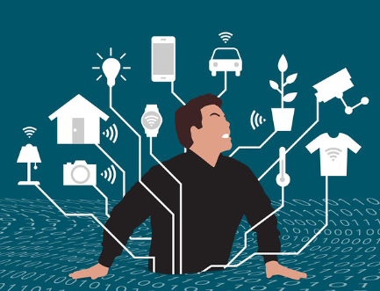
How does using technology affect your everyday life both positively and negatively?
What needs does using technology most meet in you?
What words would you use to describe the feeling of using technology?
Discuss these questions with a partner before feeding back to the class.

Slide 3
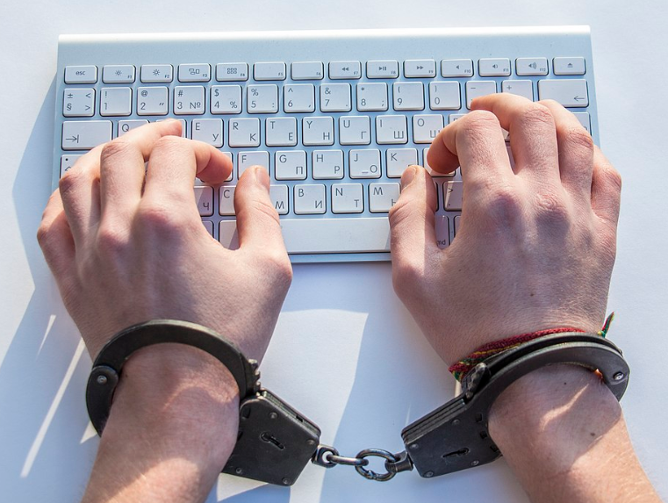
What is technology doing to us?
How might the use of technology be detrimental to us?
How might using technology harm us?
What are the concerns that adults have over young people using technology?
Are they valid or are they blowing things out of proportion?

Slide 4
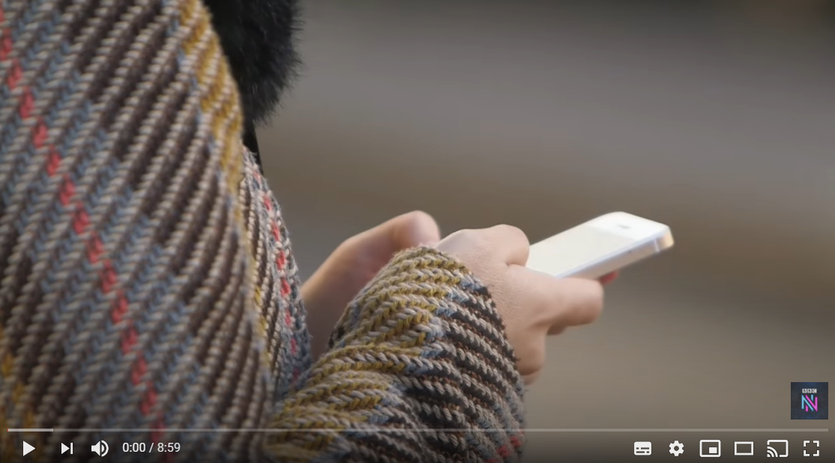
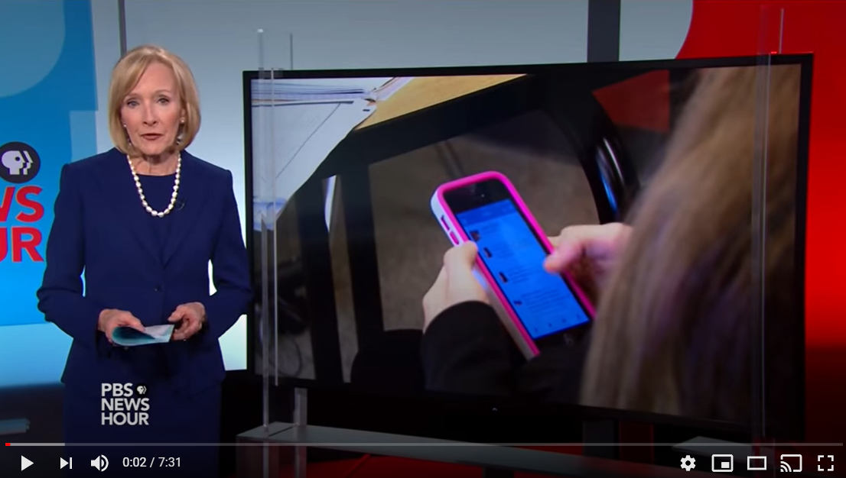
What are the different ways that technology might ‘hook’ people in?
Why is this potentially harmful?
Watch the video from Newsnight describing the ‘brain hacking and the attention economy’
or the ‘drug like effect of scree time on the teenage brain.’
What concerns do these films raise over the use of technology on teenagers?
What concerns you the most?
Which of the issues are most impinging on your life?

Slide 5
Journal entry
Read through the information resource on ‘screen time’ and discuss the issues with a partner.
What are the advantages/benefits of being connected 24/7?
Write a journal entry describing your experience of technology in your own life and whether there are any areas that you need to address in your use of technology?

Slide 6
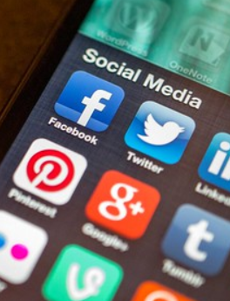
The virtues
A lot of what is discussed around technology is evaluating the negative effects of its use in our lives.
However, technology does give many opportunities to develop virtues in different ways both through the cultivation of character virtues and also in resisting the control and impact technology has on us.
Which virtues does technology allow you to develop and how might you go about identifying and developing these virtues?
Does the use of technology like smart phones and the Internet give you a net gain or a net loss in your life?
Explain your answer.

Slide 7
Is technology addiction real?
Write a two-paragraph opinion piece in response to this question. Be sure to justify your answer, referencing some of the information you have thought about in the lesson (or information you come across in your own research). Consider some of the following questions when developing your response:
What is addiction? How do you define addiction?
Is there a difference between addiction and being "hooked"?
Is there a criteria you would use to determine whether or not someone is addicted to technology?
In your response, identify one thing you plan to do to create more media balance in your life.

Slide 8
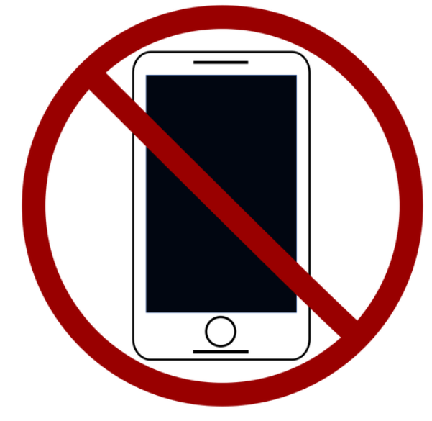
Tech lite!
Think about a 24hour period over the next 2 weeks where you could reduce your technology use to an absolute minimum.
What would you have to do to make this work?
What problems would this cause?
How would you avoid the temptation to use electronic devices for communication/entertainment/work etc?
Predict what your ‘tech light’ day would be like.
How would it feel?
What benefits would there be, what struggles would you need to overcome?

