Slide 1
The Online World
Cultivating a positive online reputation

Slide 2
Think of a range of people who you would describe as having a positive reputation (this might be people that are famous or people from your own life and experience).
Discuss and compare with a partner.
What aspects of their lives are similar?
What did they do to achieve a positive reputation?

Slide 3
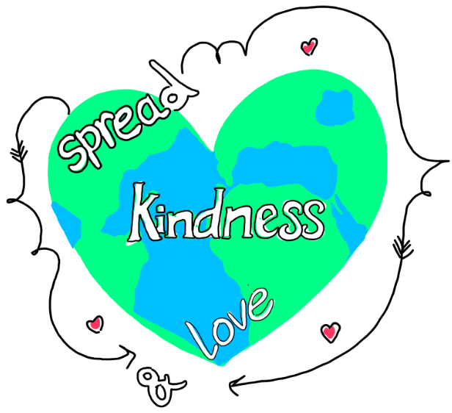
Often people with a good reputation share similar character traits/virtues such as kindness, fairness, being reliable and many more.
Which virtues do your examples display?
Do you think it is important to have a good reputation?
How might a good reputation help you in the different areas of your lives such as friends, future career, volunteering opportunities?

Slide 4
Online reputation
We can enjoy a good reputation online as well as offline. What are the different areas we can cultivate a positive reputation online?
What information do we routinely publish online about ourselves?
What types of information might damage a person’s reputation online?
Have a discussion with a partner and share some examples from your own life.

Slide 5
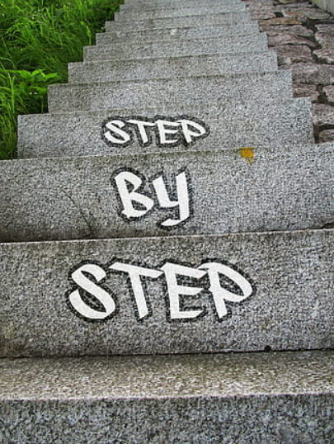
Creating a positive online reputation
How might you proactively use social media and other online technologies to help you achieve your goals?
Write a journal article outlining a 3 goals for this academic year. These could be academic related or a steppingstone for a future career.

Slide 6
How could you use social media to help achieve your goals?
How would you be able to build a positive reputation?
What type of posts or social media channels would help you?
What virtues do you need to utilise to help you in achieving your goals?
How might using technology assist you to achieve them?
Share your ideas as a class.

Slide 7
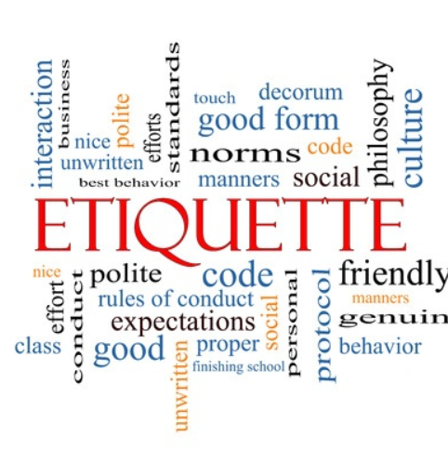
Online etiquette
What does the term etiquette mean?
Create a checklist for good online etiquette
Do you actively think about what you’ve identified on your checklist when you come to use technology and online resources? If not, why not?
What barriers do you face when using online platforms?
What mistakes have you made in the past and what might you do differently in the future?

Slide 8
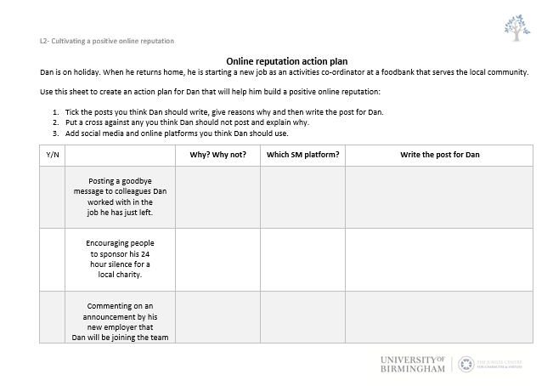
Online reputation action plan
Complete the resource sheet action plan. Decide which posts Dan should make and on what platform he could post them on.
Is there consensus with the whole class?
Have a discussion on the issues this action plan raises.

