Slide 1
Your future, your world
The Good Life

Slide 2
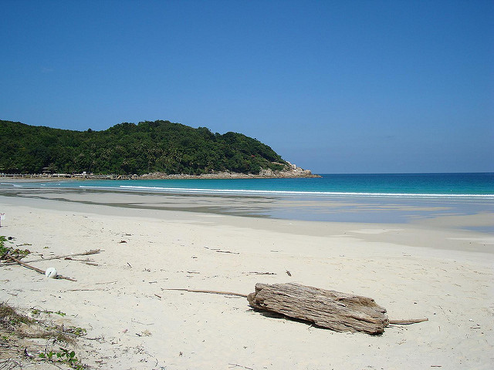
Introduce yourselves to the person next to you.
What one item would you take to a desert island and why?

Slide 3
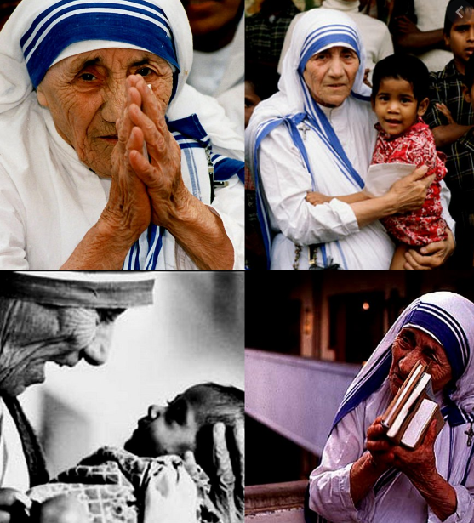
What is a good life?
What would it mean to say someone has led a ‘good life’?
Can you think of anyone who have lived a ‘good life’?
How did this person live their ‘good life’?
Was it by chance or on purpose that this person lived a ‘good life?’

Slide 4
Approaches to the good life
How we live a ‘good life’ is a question that philosophers have been debating for thousands of years!
We’ll watch an introduction to philosophies of ‘the good life,’ there is a helpful video here:

Slide 5
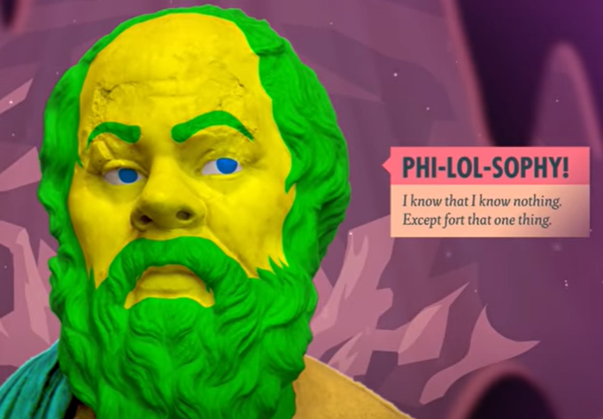
Discuss: Do you agree or disagree with these ideas? Why/Why not?
What strengths do each of these views have?
Extension: Do you think there are any weaknesses to these views?
To recap from the video:
Existentialists think there is no meaning to life apart from the meaning that you give to it
Hedonists think life is about the pursuit of pleasure
For some religious worldviews, their purpose is defined by a higher being.
For Aristotle, the idea of a good life was one of constantly seeking to further develop our virtues.

Slide 6
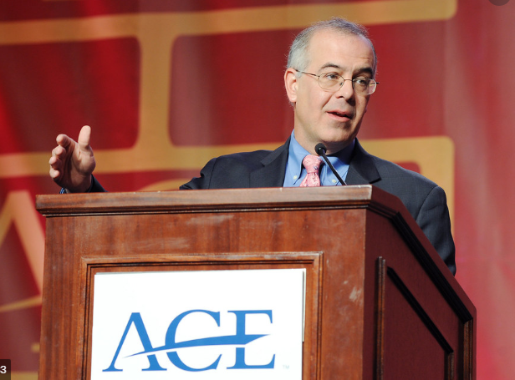
Eulogy or résumé virtues?
David Brooks talks about the difference between eulogy virtues (what we want to be remembered for) and résumé virtues (what we pursue in life to get ahead).
Do you recognise this difference in your life?
Is this problematic?
Should there be a difference?
Since 2003, David Brooks (above) has written opinion pieces for The New York Times.

Slide 7
The VIA
You are going to think about which virtues are most important to you. Individually complete the adapted VIA survey to identify your most valued virtues.
Why have you chosen those virtues?
Have you chosen the same/different virtues?
Are the virtues that they have chosen predominantly moral/civil/intellectual/performance?

Slide 8
Choose 1 virtue, from your top 4 or bottom 4, that you would like to develop further.
You should complete an action plan:
What could you do practically to practice this virtue?
What might be the barriers to developing this virtue?
How could you overcome or limit these barriers?

