Slide 1
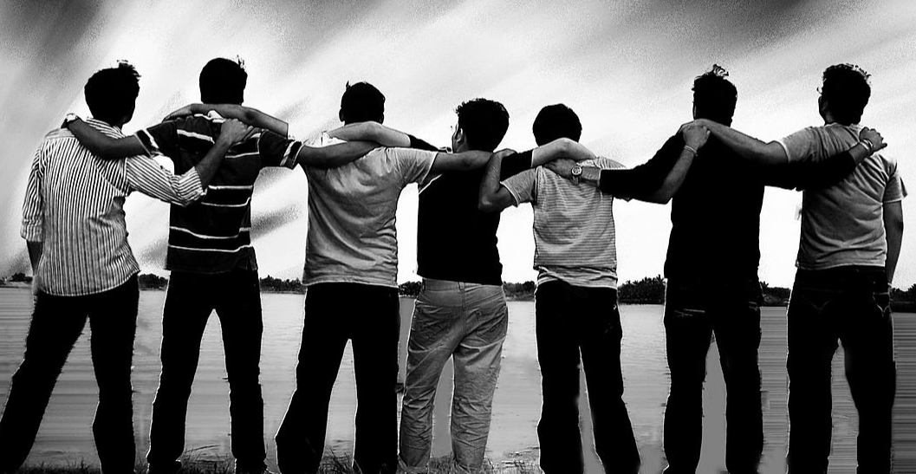
Peer pressure

Slide 2
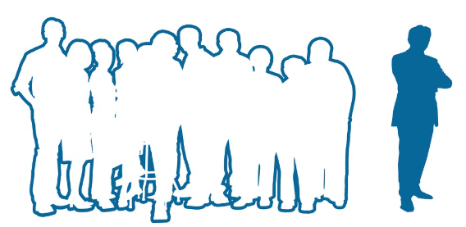
What is ‘peer pressure’?
Can you think of an example of where you have felt under peer pressure?
Why was it so hard for you?

Slide 3
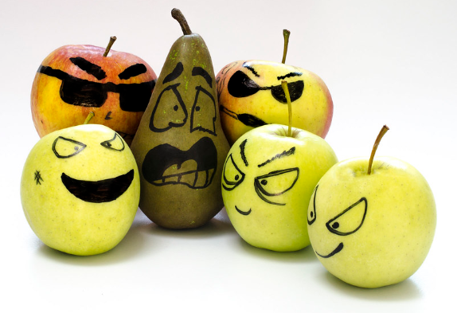
The dictionary definition of peer pressure:
the strong influence of a group, especially of children, on members of that group to behave as everyone else does:
e.g. There is tremendous peer pressure to wear fashionable clothes.

Slide 4
Moral dilemma
The Year 11 prom was beginning to wind down and students were beginning to leave to go into town. The evening had started out well but a group of girls had sneaked in some alcohol and of Sarah’s friends had all been drinking. The girls had made an impromptu plan to head into town to continue the party but Sarah was not keen. She had told her parents the plan for the evening and it didn’t involve drinking or heading to town. Her friends were now calling for her to come and one of them made a comment to the group about her being a ‘fun sponge’.

Slide 5
What are the consequences of Sarah going off with her friends?
What emotions might she be feeling being pressured in this way by her friends?
Which virtues are clashing in this scenario? Are there more than two?
What are the different ways that she might be able to deal with this situation?
What might her actions mean for any of her friends in a similar situation?

Slide 6
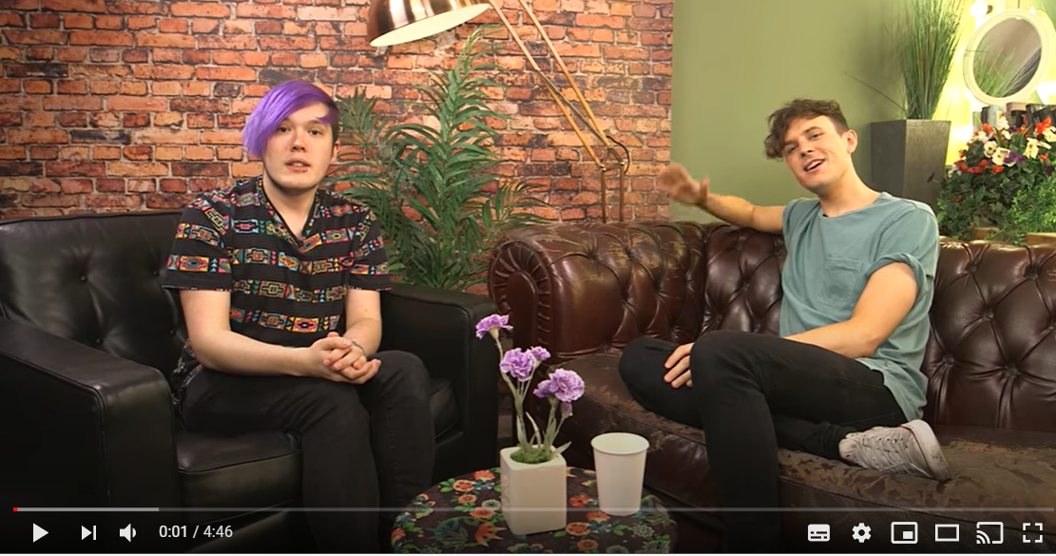
Resisting peer pressure
What can you do when you are feeling peer pressured?
Watch the clip and discuss as a class.
Make a list of strategies from the conversation between the hosts.

Slide 7
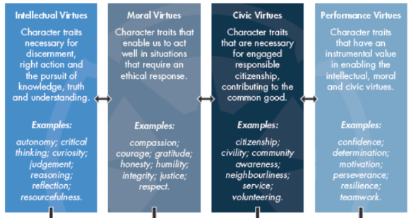
Which virtues do you think you need to use to deal effectively with peer pressure?
You can think of virtues as a bit like muscles; the more you practice using them, the better you will be at using them when needed.

Slide 8
Peer pressure and a herd mentality
Experts tell us that "herd mentality" is often something that can be influenced by things such as peer pressure, conformity, the need for acceptance and the desire to belong to ‘in groups’.
These things often cause people who are in groups to behave in ways that are similar to others around them, in the ‘in group’. For example, a person might choose to drink when with a group of friends that do, even if they aren’t actually keen on alcohol. They might listen to a type of music and say that they like it, when really they don’t.
When ‘herd mentality’ turns into ‘mob mentality’ a person can find themselves in a far more serious situation. A football match, where everyone around you is chanting offensive chants, may see you join in, when you would never usually do this – or even get involved in a fight or vandalize a building. A person may start to feel that there is less of a chance of getting caught than if they was acting alone. They might also feel less guilt because other people also caused the damage. The guilt is ‘spread’ in their minds.

Slide 9
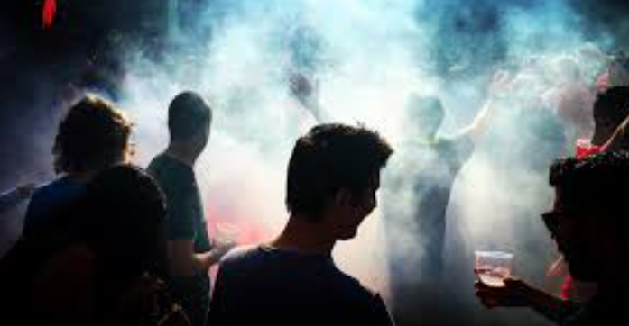
Explain the difference between herd mentality, herd behaviour and peer pressure.
Have you seen the results of a herd mentality?
Discuss some examples with a partner.

Slide 10
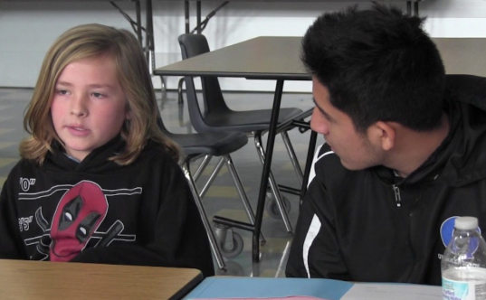
What advice would you give?
Discuss the ways in which you might encourage a younger student joining your school to resist peer pressure.
How might they develop their character and cultivate healthy relationships with their friends?

Slide 11
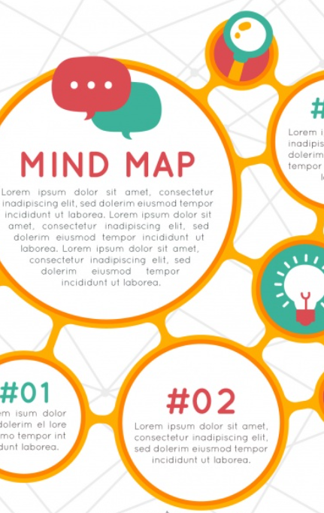
Work in small groups and work through the following tasks:
Create a mind map to plot out the different strategies you could use to resist peer pressure (this can include resisting peer pressure online).
Come up with a slogan for you would encourage younger students to adopt.
Design an infographic or leaflet with information and issues relating to pressure. Consider giving this to a younger student in the school to help them navigate the issues.

Slide 12
Host a podcast conversation with member of your group on the issue of resisting peer pressure. How can you incorporate your own stories of successes and failures in these areas?
You can link the conversation to the character virtues you discussed earlier in the lesson.

