Slide 1
Mental Health
Facing Challenges

Slide 2
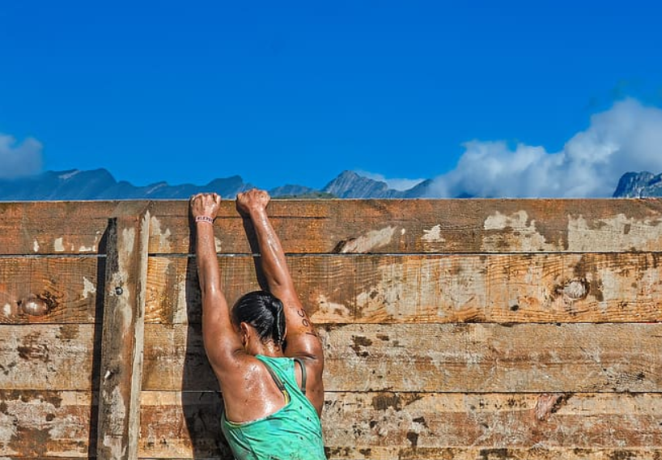
Which emotions do people experience when they are faced with a challenging situation or problem?
Discuss with a partner.
How have you felt when you’ve faced a challenge in your own life and overcome that problem?

Slide 3
Can challenges be good for us?
Discuss with a partner how solving a problem or meeting a challenge can make you feel.
Does it make you feel more confident in what you can do? If so, how?
How does it enable you to grow and develop?

Slide 4
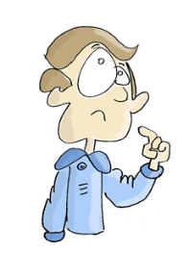
Write a reflective account that outlines a challenge you took on, the fears you had to overcome and the emotions you experienced.
This might have been starting or changing a part-time job/volunteering, leading a team of people, public speaking, visiting a country you hadn’t been to before, moving school, being part of a sports team, etc.
Which feelings can you remember when facing the challenge?
Which character traits/virtues did it require you to use in order to overcome the challenge?
Were you successful or did you need to adapt and make alterations in order to be successful?
How did you feel on completing the project or overcoming the challenge?
How did your success and/or struggle to achieve develop your character and you as a person?

Slide 5
Consider some different examples of challenges you might face in other settings.
How could these be viewed as an opportunity and/or a way to overcome a fear?
Can you think of examples within different settings, e.g. in the workplace, at school, or in the community?
What action plans might you devise to tackle this challenge and turn it into a positive experience that helps your own personal development?

Slide 6
Role Models
Read the brief stories of the well-known figures on the PowerPoint. All three had challenges that they had to overcome in order to find success in their chosen fields.
What can you learn form their stories?
Which virtues have they displayed in their lives in order to be successful?

Slide 7
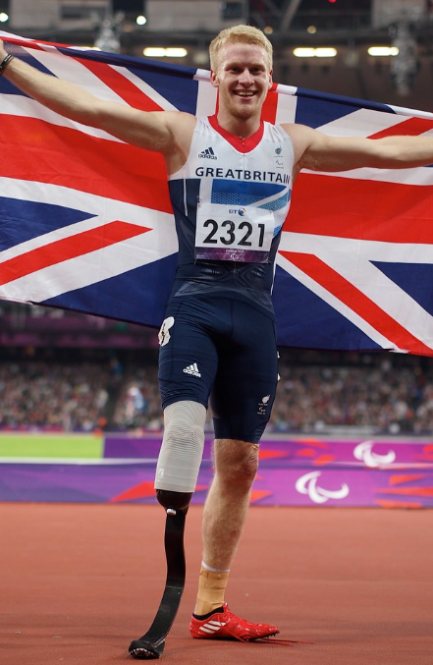
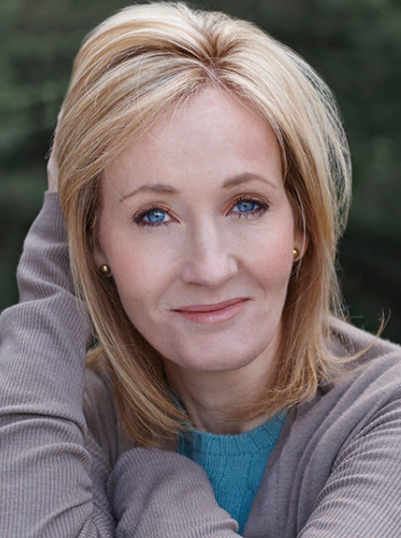
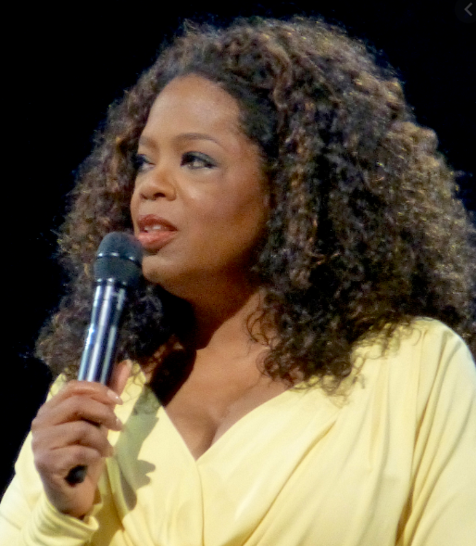
Jonnie Peacock won Gold in the men’s T44 100m at the 2012 and 2016 Paralympics. In 1999, aged just six, he had to have part of one leg amputated after a bout of meningitis in which he nearly died.
Oprah Winfrey was born into poverty in rural Mississippi to a teenage single mother and later raised in an inner-city neighbourhood. She experienced hardship during her childhood, she was raped at age nine and became pregnant at 14; her son died in infancy. She has been ranked the richest African-American of the 20th century, the greatest black philanthropist in American history, and was for a time the world's only black billionaire. She is also, according to some assessments, the most influential woman in the world.
J.K. Rowling is well-known for writing the bestselling Harry Potter stories, but she began writing the books in challenging circumstances. Whilst a single mother and studying full-time for a teaching degree, J.K. Rowling had an idea for a children’s story about a boy wizard. She wrote in the evenings, often sitting in local cafes having walked her baby daughter to sleep in her pushchair.

Slide 8
Hopes and fears
Part of taking on new challenges in our lives is identifying our hopes and fears for all that the challenge will involve.
There are many exciting challenges facing you during KS4 both inside and outside of school. By identifying techniques and strategies to build new skills in dealing with these challenges we grow and develop many aspects of our character.
We each have different way of approaching challenges based on many different factors.
Which of these two options do you typically gravitate towards when you’re facing a challenge? Why is this your default response?
Why do you think this is?
This challenge is an opportunity!
This challenge is a real problem!

Slide 9
Write out three labels ‘Hopes’, ‘Fears’ and ‘Skills required’ on an A3 sheet in a group.
You will be presented with several different scenarios. Identify what the key challenges might be for each scenario.
What difficulties might each person face in each scenario?
What hopes and fears would the individuals have in that scenario?
What skills might they need to develop in order to achieve their goals?
Write your answers under the relevant headings.

Slide 10
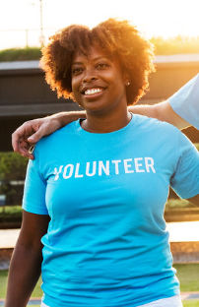
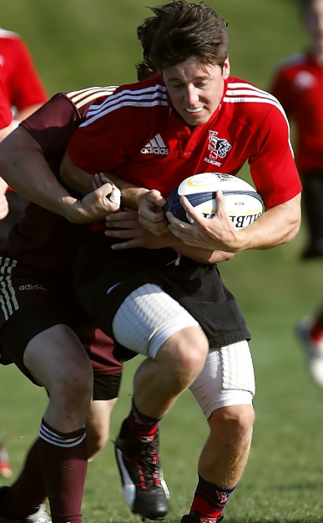
Volunteering in your spare time
Starting A-levels at a new sixth form college
Taking part in a national sports competition

Slide 11
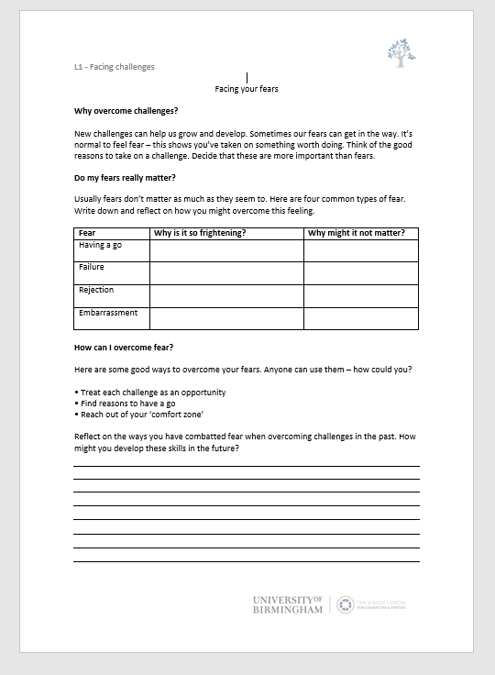
Do my fears really matter?
Use the reflection sheet to explore the role of fears in overcoming challenges. Complete the blank sections under ‘Do my fears really matter?’ and ‘How can I overcome fear?’ with your own examples and tips.
This should be done as an individual activity to encourage self-reflection.

