Slide 1
The Online World
Online gambling, impulsivity and delayed gratification

Slide 2
The last session on gambling centred around the issue of addiction.
This session is going to focus on the issues of impulsivity, delayed gratification and the factors that influence people’s involvement in online gambling.

Slide 3
Whatever a person’s genetic makeup and upbringing, however, we all have the ability to make choices as to which behaviours we engage in.
Often the influences around us determine how we act in different situations. Today’s lesson focusses on those influences and how we can reduce them in order to reduce the likelihood of engaging in unhealthy gambling behaviours.
It is clear that everybody has a different level of requirement for stimulation in their day-to-day activities, with some people getting bored more easily than others. These people can sometimes look to risk-taking behaviours as a way of relieving boredom.

Slide 4
On a scale of 1-10 (with 1 being ‘strongly disagree’ and 10 being ‘strongly agree’) write down your view on the following statement. Write this on a post it note and stick on the board.
“Some people are born more likely to gamble than others; there is nothing you can do about that.”
Discuss as a class the range of opinions and issues raised by the statement.

Slide 5
Impulsivity and delayed gratification
What does the word ‘impulsivity’ mean to you? Can you come up with a definition with a partner?
What does the term ‘delayed gratification’ mean?
In what ways might delaying gratification prove to be a positive force in your life?

Slide 6
Impulsivity – Acting without thinking about the consequences of those actions.
What might be some of the issues with acting impulsively?
Come up with some examples where acting impulsively can prove to be dangerous.
Delayed gratification – Discounting short-term rewards (instant gratification) in favour of longer-term rewards (with the suggestion being that these rewards can be more beneficial for the individual in the long term).
How might delaying gratification prove to be a positive force in your life?
Why might ‘delayed gratification’ be challenging for us? What examples can you come up which demonstrate delaying gratification has been positive in your own life?

Slide 7
The Marshmallow Test
This is Walter Mischel’s famous Marshmallow Test.
The experiment explores the question of what would happen if you told a young child they could have one marshmallow now or two if they wait for 15 minutes on their own with the marshmallow.
If you were able to give the child some pointers about how to resist the urge to eat the marshmallow what would you suggest?
Have you ever used these ideas yourself in different situations?
In which situations would it be useful to utilise these approaches?

Slide 8
Here are some approaches which might help encourage delayed gratification:
Avoidance – when the marshmallow was covered up children were less impulsive.
Emphasis of reward – when children were reminded of the reward they less more impulsive.
Positive distraction – if given a toy or told to ‘think fun thoughts’ the children were less impulsive.
Abstraction – when told to think of the marshmallow in an abstract way the children were less impulsive.
Self-directed speech –children who told themselves ‘I have to wait’ were less impulsive.

Slide 9
How might these approaches help to combat the rise in online gambling?
Can you describe how you could use them in an online gambling scenario?
Resisting the urge to act on impulse is a skill that we can learn. As we practise it, we can develop our character.
How might you develop this skill to shape your character positively?

Slide 10
Advertising
How does gambling advertising draw people into online gambling activity?
Look at the range of online gambling advertisements and discuss the different ways the companies are trying to attract you to play and making demands of your impulse control.
What techniques do gambling advertisers use to attract potential customers?

Slide 12
Did you identify any of these?
Company name
Tag line
Money offer
Availability
Variety
Promises of ‘big wins’ and ‘the best odds around’
Do you think the reality of a gambling lifestyle matches that which is promoted in the advertisements?
Why do you think so many gambling websites offer free bets to people who sign up?
How else do gambling websites try to encourage interest and continued play on their site?

Slide 13
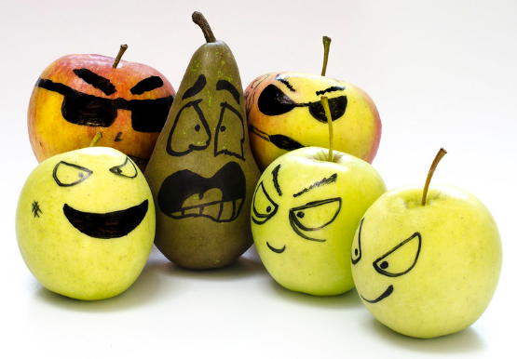
Peer influence
Peer approval, or peer pressure/influence, can be a significant cause of starting to gamble.
‘Peer pressure’ is where a person seeks to do what others want them to do and feel a level of need to comply.
Peer influence is often a strong factor in our decision making and can often compromise our values if we end up making choices that are not our own.

Slide 14
Read the dilemma with Mike and his friends that have started putting money on online slot machines.
“I am fortunate to have a group of close mates who I enjoy spending time with. Recently we’ve started hanging out after school to play on these digital fruit machines on a phone app. Two of my mates are really into it, but I’ve tried it once and lost a fortune. I’m not that interested in continuing and don’t want to lose any more money but I’m getting mocked for not turning up to play by the rest of them.”

Slide 15
What would you challenge Mike to do in this scenario?
What are the main issues for him to consider here?
Have a discussion as a group and feedback the main points to the class.
Some issues that might arise might be the risks in continuing to gamble money, the nature and quality of the friendships within the group, how to discuss difficult issues with friends, avoidance and exit strategies, and suggesting other activities for the group to take part in.

