Slide 1
Reflecting on exercise

Slide 2
True or False?
Exercise can improve your memory.
You should exercise once a week.
Your body temperature decreases when you exercise.
Exercise can help you to feel good about yourself.
Exercise can decrease your risk of serious diseases including heart disease and strokes.

Slide 3
What is the problem?
How would you feel?
What virtues are involved in this scenario?
What do you think a wise thing to do is? Why?
You get home from school exhausted. You were in trouble again for not handing in your homework and the teacher has given you one last chance to get it in tomorrow. You are supposed to have hockey practice this evening and, if you miss it, you might get kicked off the team. However, if you go, you will not get your homework done, will have detention and might miss the match. What should you do?

Slide 4
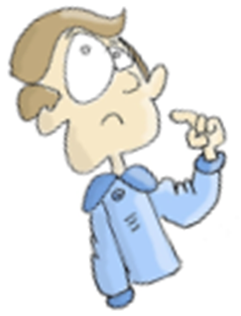
What am I happy with? | What would I like to work on? | My goal | How I will achieve my goal?

