Slide 1
What makes a virtuous journalist?

Slide 2
Sort the statements into those that describe a virtuous journalist and those that describe an unvirtuous journalist.
Someone who gathers information from lots of different sources before writing their article.
Someone who gets the story out before anyone else, no matter what the cost.
Someone who publishes their articles even if they know it will be unpopular with powerful people like the government.
Some who writes articles because lots of people will like them and read them.
Someone who uses undercover techniques like phone hacking to get the information they need.
Someone who writes articles based on an interesting rumour that they heard.

Slide 3
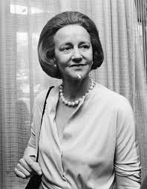
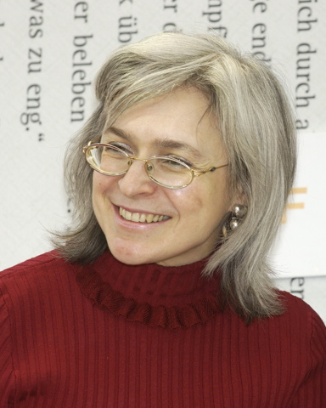
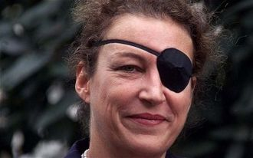
Role model research:
Katherine Graham
Anna Politkovskaya
Marie
Colvin
Find out: Where/when the journalists worked. What they are remembered/famous for. What virtues they showed and how.
Images: commons.wikimedia.org

Slide 4
This interactive game online will allow you to practice making some of the decisions that journalists have to make when preparing an article: https://www.bbc.co.uk/news/resources/idt-8760dd58-84f9-4c98-ade2-590562670096 [accessed 28.05.2020].

Slide 5
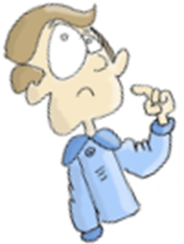
How did you find the pressures of being a journalist? What virtues were needed?

