Slide 1
Recognising peer pressure

Slide 2
Fact or fiction?
a) If you do something because of peer pressure, you are not responsible for your actions.
d) Peer pressure can be experienced online as well as in person.
e) Peer pressure only happens to young people.
b) If you are a good friend, you will always do what your friend wants.
f) If you give in to peer pressure, you lose some of your individuality.
c) Peer pressure comes from a desire to fit in.

Slide 3
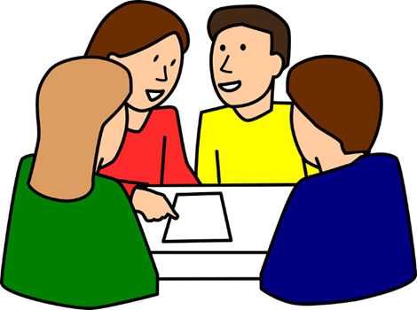
Watch video: https://www.childnet.com/resources/pshetoolkit/peer-pressure/back-me-up [accessed 28.05.2020]. - Who is being pressured? - What are they being pressured to do? - Why does Jack go along with what Charlie is doing? - Are Charlie and Jack equally responsible for bullying? - What do you think Charlie will do next? Is this the right thing to do? - What virtues does Charlie need to do the right thing?
Image: pixabay.com

Slide 4
What is the problem?
How would you feel?
What virtues are involved in this scenario?
What do you think a wise thing to do is? Why?
You walk into the toilets at break and see one of your friends making fun of a new pupil in the class who doesn’t speak much English. They see you and tell you that you have to join in. You don’t want to, but they have said if you don’t they will tell the teachers you were making fun of the new pupil.

Slide 5
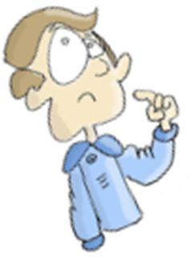
Which virtues do you think are the most important for dealing with peer pressure? Why?

