Slide 1
Standing up to peer pressure

Slide 2
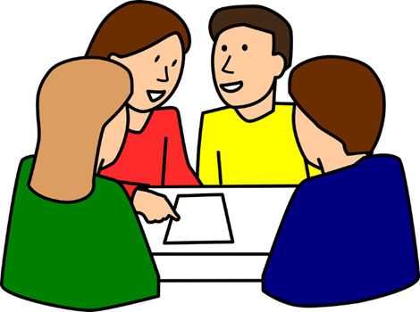
“Peer pressure makes girls drop out of sport.” Discuss: - How might this be the case? - Have you ever experienced this? - How does it make you feel? - What could we do about it?
Image: pixabay.com

Slide 3
Look together at the following article: https://www.telegraph.co.uk/women/womens-life/9626762/Olympic-gold-medallist-Helen-Glover-Young-girls-face-peer-pressure-to-drop-out-of-sport.html [accessed 28.05.2020]. Look at how peer pressure could have stopped Helen from becoming an Olympic gold medallist. How did she overcome this? What virtues did she show?
Image: wikipedia.org

Slide 4
There are some tips here for dealing with peer pressure: https://www.bbc.co.uk/cbbc/findoutmore/help-me-out-peer-pressure Or, you could watch the video here: https://www.childline.org.uk/info-advice/friends-relationships-sex/friends/peer-pressure/ Discuss as a class and make a list of strategies.

Slide 5
Use the scenarios from the first lesson on peer pressure. In each group, you need to role play one of the scenarios with one person being pressured, one person putting pressure on and two by standers. The bystanders must begin by listening but then take a side to join in. Then choose a different scenario and swap roles.
Image: pixabay.com

Slide 6
Discuss: - How did you find standing up to peer pressure? - What techniques did the people putting pressure on you use? - What techniques did you use to resist? - Which techniques were the most effective? - Which techniques were less effective?
Image: pixabay.com

Slide 7
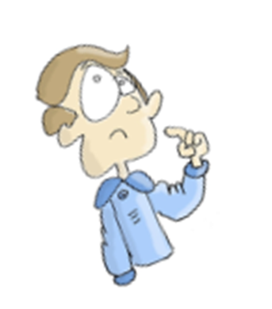
What would happen if: - You are too defensive and apologise for saying no? - You say no aggressively to a friend?

