Slide 1
How can you volunteer?

Slide 2
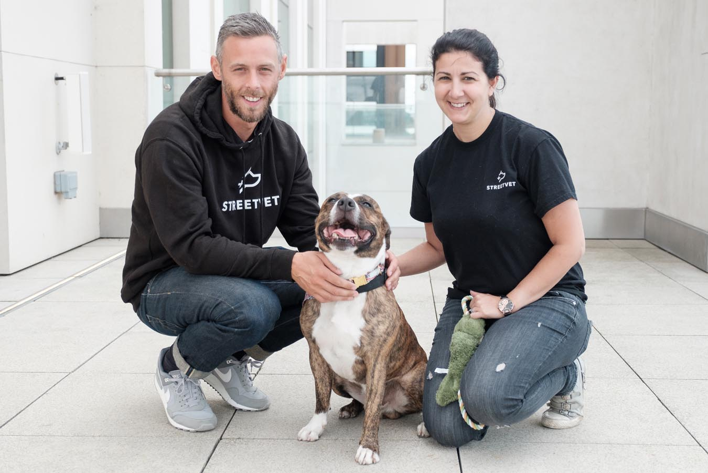
Jade Stott and Sam Joseph founded StreetVet in 2016, inspired by the bond between a homeless man and his dog. Streetvet vets and nurses are volunteers who work in the London community 4 days a week and have helped care for over 450 dogs who live with their homeless owners.
Tom Rebair was diagnosed with obsessive compulsive disorder and anorexia as a teenager. He volunteers with a charity called ‘Young Minds’ to help break down the stigma of eating orders in young men. He regularly speaks to audiences of over 200 people about his story and how to spot the signs of mental health problems. He has also raised over £75,000 for the charity.
Image: scrumbles.co.uk
Image: pointsoflight.gov.uk
Which virtues do these role models show?
What do you think motivated them to volunteer their time and experience to help others?

Slide 3
Watch the video: https://www.youtube.com/watch?v=SZBGeGsFBes [accessed 28.05.2020].
Discuss:
What are the different roles that volunteers can do?
Why do you think it is good to be able to volunteer in a variety of ways?
Why do you think people volunteer with the Royal
National Lifeboat Association?

Slide 4
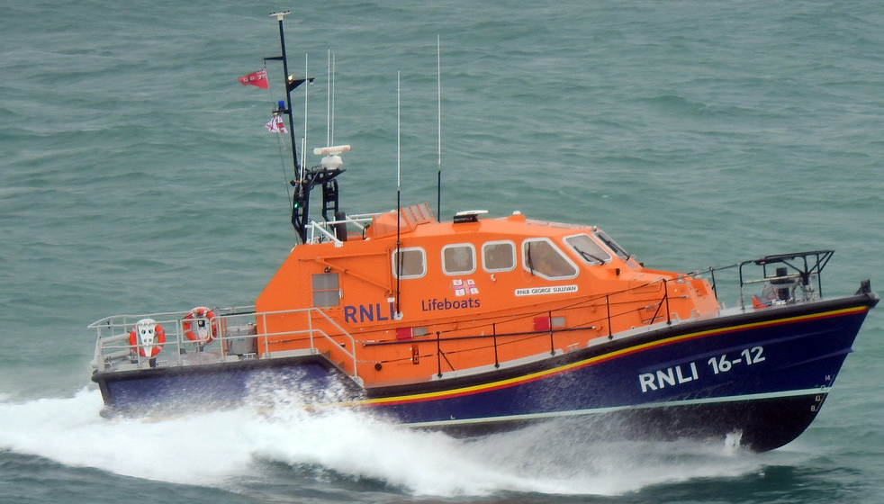
Create a poster encouraging more volunteers to sign up to roles within the RNLI.
Image: flikr.com

Slide 5
What is the problem?
How would you feel?
What virtues are involved in this scenario?
What do you think a ‘wise’ thing to do is? Why?
After art, the sinks in the classroom are a mess and the painting equipment has been left out. The teacher says that, if one person volunteers to clean it during break, the whole class can go out to break-time. If no-one volunteers, the whole class will miss their break time. You know that it was mainly two boys who made the mess, you did not use the painting equipment. What should you do?

Slide 6
Make a class brainstorm of all the opportunities to volunteer at school (this could be joining the student council, being a librarian, being a peer mediator etc.).
Choose one of the volunteering opportunities and create a short advertising presentation which includes the virtues that might be needed and the virtues that volunteers could develop in the role.

