Slide 1
Participating in a democracy

Slide 2
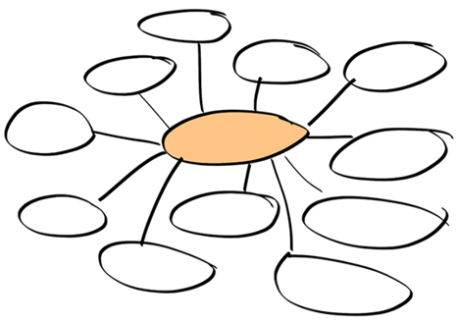
Democracy only works if ordinary people participate. What are the different ways that people can participate in democracy? Create a brainstorm on the board.
Which of these can young people be involved in?
Image: pixabay.com

Slide 3
What is the problem?
How would you feel?
What virtues are involved in this scenario?
What do you think a ‘wise’ thing to do is? Why?
You are having an election for the school council. Your best friend is standing for election and has made you promise to vote for them. However, you think the other candidate would be better at the job. The other candidate isn’t very popular. Your friend will be really upset if they don’t win. What should you do?

Slide 4
What issues in your local community are important to you? Create a brainstorm on the board.
In groups, research one of the issues and plan a letter to send to your local MP.
You can write to them using the website www.writetothem.com [accessed 29.05.2020].
Image: commons.wikimedia.org

