Slide 1
Win-win situations

Slide 2
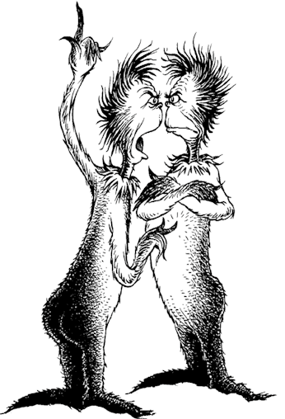
Watch ‘The Zax’ by Dr Seuss: https://www.youtube.com/watch?v=ji4MUtCm8Hw [accessed 29.05.2020]
What is the conflict about? What barriers are there to solving the conflict? What virtues would ‘The Zax’ need to develop to solve the conflict? What other barriers might there be to solving a conflict?
Image: pinterest.com

Slide 3
Which of these actions will escalate a conflict and which will de-escalate a conflict?
Name calling
Explaining how you feel
Mentioning an event that happened in the past
Blaming
Walking away
Lowering your voice
Raising your voice
Listening carefully to the other person
Involving other people

Slide 4
Aleena is a keen footballer and attends football practice every week. Her mum says that, if her room isn’t tidied by 6pm, she can’t go. The coach says that, if she doesn’t go to practice, she won’t be picked for the match on Saturday. It is 6pm and Aleena hasn’t tidied her room. What should happen?
 | Aleena’s Mum loses | Aleena’s Mum wins
Aleena loses
Aleena wins

Slide 5
Which virtues are needed to create win-win situations? Why?

