Slide 1
Mediators

Slide 2
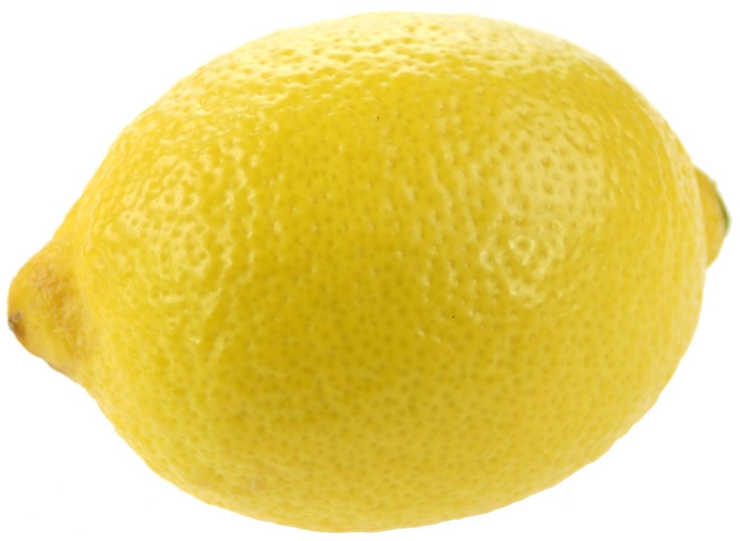
The Last Lemon It was late on a Friday evening and there was one last lemon left on the shelf. Suddenly, two hands reached out to snatch it and there were two frustrated women glaring at each other. They had reached for the lemon at exactly the same time, so the only fair thing to do, they decided, was to have half of it each. The first lady took her half home and squeezed out the juice, just about filling up the bottom of a cup for her pancakes with sugar. She threw the rest away, annoyed that there wasn’t really enough juice. The second woman took her half home and grated the rind to add to her lemon cake. She sighed, it wouldn’t be as zesty as usual. She threw away the rest.

Slide 3
What was the problem?
Was it a win-win solution? Why?
What would a win-win outcome have been?
What prevented this from happening?
Can you think of any situations where this has
happened in your life?
Image: pixabay.com

Slide 4
- What does the word ‘mediator’ or ‘to mediate’ mean?
- What is the role of a mediator in a conflict?
- Which skills and virtues do you think a good mediator needs?
Write a job advertisement for peer mediators or an application letter for why you think you (or someone else) would be good at the job.

Slide 5
What are the key tips or points for dealing with conflict?
Create a poster/leaflet/guide for peer mediators or for pupils to advise on how to deal with conflict.

Slide 6
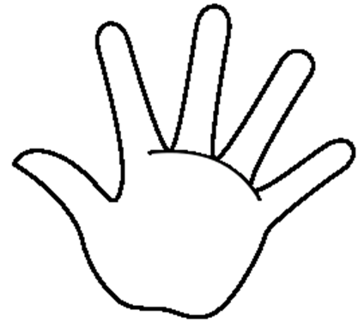
If there is a peer mediators programme in your school, could you publicise it through posters/an assembly?
If not, could you write letters to your headteacher suggesting that you set one up?
Image: commons.wikimedia.org

